Slide 1



Weight loss surgery
Could weight loss surgery be an option for me?

Slide 2
Overview of content
To introduce the bariatric (weight loss surgery) team
Outline the types of weight loss surgery available at Gloucester Royal Hospital
Provide an overview of the benefits and potential complications following weight loss surgery
Explain the lifestyle and dietary changes necessary following weight loss surgery

Slide 3


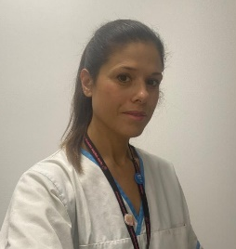


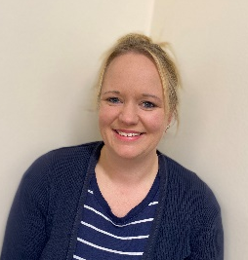
Meet the team
Mr Oliver Old
Consultant Bariatric Surgeon
Mr Andrei Ilczyszyn
Consultant Bariatric Surgeon
June Beharry
Specialist Dietitian
Jen Credicott
Specialist Dietitian
Lisa Stokes
Specialist Nurse
Dr Gail Bohin
Clinical Psychologist
Laura Nines
Bariatric Co-ordinator

Slide 4
Why choose weight loss surgery?
Years of trying to lose weight
Yo-yo weight pattern over a number of years
Highly motivated but feel like dieting isn’t working
Health concerns
Want to be more active, improve quality of life

Slide 5
Types of surgery
Notes:
Laparoscopic (key-hole)

Slide 6
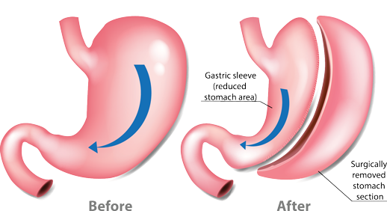
Sleeve Gastrectomy

Slide 7
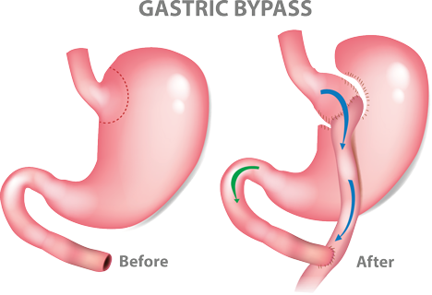
Gastric Bypass

Slide 8
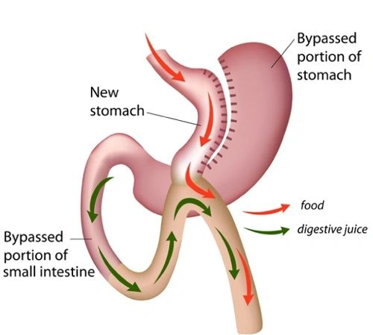
One Anastomosis Gastric Bypass (OAGB)
Notes:
OAGB is also known by other names, including Single Anastomosis Gastric Bypass (SAGB) or mini-bypass (MAGB). This procedure was developed after the RYGB, and has a growing body of evidence to support its use, but less long term data (beyond 5 years) than the RYGB.
The stomach pouch is slightly longer than in a RYGB procedure.
The stomach is joined onto the small bowel as with the RYGB. However, the bowel is not divided, and digestive juice (green arrows in diagram below) flows through a ‘loop’ of bowel that then meets the stomach, and then continues to flow down the gut together with the food from the stomach (red arrows). This procedure involves only one join or ‘anastomosis’.

Slide 9

Benefits of weight loss surgery
Health benefits
  For example; reduction in medication needed for Type 2 diabetes & sleep apnoea
Physical benefits
  For example; improved mobility and exercise tolerance
Life changes
  For example; improved life expectancy and quality of life
Notes:
Health benefits:
Type 2 diabetes (reduction in medication)
Sleep apnoea (61% no longer needed treatment)
Fertility improvements
Reduction in pain
Cardiovascular benefits
Improved mental health
Physical benefits:
Improved mobility
Increased exercise tolerance
Higher energy levels
Ability to return to activities that felt too difficult in a bigger body
Life changes:
Improved life expectancy
Employment opportunities
Travelling
Increased confidence and self esteem

Slide 10
Potential complications following weight loss surgery
Physical symptoms that might:
  Make eating/drinking challenging
  Require a further operation at a later date
  Impact quality of life
Eating behaviours which present a risk
Life changes that can be challenging
Notes:
Physical
Nausea or vomiting
Reflux or worsening reflux
Dumping syndrome
Ulcer
Change in bowel habits
Gallstones
Hernia
Taste and sense of smell
Stenosis (narrowing)
Reactive hypoglycaemia
Nutritional deficiencies
Behavioural
Over-eating
Sub-optimal food choices contributing to nutritional deficiencies and/or symptoms
Inadequate fluid intake
Life changes
Excess skin
Change in identity
Emotional eating or psychological drivers to eat remain unchanged

Slide 11
Recovery
Usually a one night hospital stay
Mobilise soon after operation
Time off work & driving following operation
Fluid and texture progression diet

Slide 12
Is surgery right for me?

Slide 13
Common misconceptions
Surgery is a “quick-fix”
You can’t gain weight after you’ve had surgery
Surgery stops you eating foods that are “bad for you”
You can’t overeat once you’ve had surgery
Surgery will give me a BMI of 25 or below

Slide 14
Is surgery right for me?
Lifestyle change
Consider existing habits
Self-care
Notes:
Lifestyle change – surgery not a ‘quick-fix’. Certain behaviours that will need to work alongside the surgery to help you get the most out of it. Lifelong commitment.
Start by reviewing current habits – what does your diet look like? When do you eat? What’s the nutritional quality of your meals like? Do you eat a wide variety of foods? What’s your fluid intake like?
What’s influencing your eating habits? (sleep, mood, stress etc…or more practical e.g cooking ability)
Consider how you might need to change your diet and lifestyle to help you meet your needs after WLS.
Not the easy option, or a ‘quick-fix’. Important to look after yourself. Pay attention to any side effects or medical problems, seek support of team.

Slide 15
Understanding why we eat
Physical
hunger
Emotional eating
Boredom
Habit
Social eating
Notes:
Physical hunger just one reason we might eat.
Emotions – food can be a coping mechanism for certain emotions. We all do it to some degree, but it can be difficult when food becomes the primary or only coping strategy. Stress, sadness, happiness, loneliness
Habit – automatic, not thinking about it. Asking to draw attention to your own habits, non-judgemental but with the aim of increasing understanding.
Social eating – saying no to food

Slide 16



Understanding why we eat
Awareness → Plan/coping strategies
Recognising head hunger
Satiety & fullness
Notes:
Drawing attention to own habits and what influences them. Not always food-based solutions (e.g sleep, medication, stress management). Looking at bigger picture of what influences the foods and way in which we eat.
Hunger – what does head hunger vs physical hunger feel like? How can you begin to understand the difference?
Satiety – years of dieting interfere with hormones, can take time to recognise again. Satiety – taste and enjoying food.

Slide 17
Lifestyle changes after weight loss surgery

Slide 18
Meal pattern
Meal timing & regularity
Reduced hunger
Plan for all stages of texture reintroduction
Textured foods
Grazing
Notes:
3 meals/day, regular source of energy and nutrition
Reduced hunger – remind self to eat
Planning – forethought for nutritional adequacy and variety
Textured foods that need chewing (slows down, recognizing satiety, harder to eat large volumes)
Grazing – lead to excess calories and interfere with satiety/fullness, dental health
Satiety – physical fullness and taste satisfaction (mindfulness)

Slide 19
Balance of meals
Meals source of:
  Protein
  Fibre
  Nutrients
Nutritional adequacy
Nutritional quality
‘Problematic foods’
Notes:
Balance meal, balanced diet. Bigger picture of diet.
Priority of protein, aim minimum 60g daily
Nutritional quality – avoiding high fat/high sugar foods. Low in nutrients, easy to consume large volumes, can cause dumping.
Problematic foods – high fat/high sugar → dumping, high calories → weight gain/reduced weight loss, food tolerance

Slide 20
Portion size
Reduced volume
Protein priority
Consistency longer term
Avoiding fluids at meal times
Notes:
Reduced – challenge with nutritional adequacy
Protein majority of meal – doubling up
Consistency – cutlery/serving dishes

Slide 21






Eating behaviours
Mindful eating
20:20:20
Environment/distraction
Satiety
Side effects
Notes:
Mindful eating – paying attention when we eat, using all the senses, avoiding distraction. Allows us to better recognise satiety (taste and physical fullness), important to still enjoy food
Reduces risk of side effects, food getting stuck

Slide 22

Fluid
Aim 2 litres daily
Helps prevent constipation & dehydration
Sips
Timing with meals
Calorie containing fluids
Alcohol
Fizzy drinks
Notes:
Aim 2L/day – varies.
Helps prevent dehydration and constipation
Sips, habit to develop before surgery. Drinking too much in one go may cause discomfort.
Calories easy to consume in liquid form, consider ‘good for you’ options too e.g smoothies, FF milk
Alcohol – contains calories, influences judgement and nutritional choices, may lead to less considered choices. Role in minimising weight loss or weight regain. ?evidence with bypass and alcohol misuse.
Fizz – discomfort, fill stomach.

Slide 23

Supplementation
Regular supplementation
  A-Z
  Vitamin-B12
  Vitamin-D
  Iron
  Calcium
Blood tests & follow-up
Deficiency symptoms
Notes:
Portion size – impact on ability to meet nutritional need, require supplementation
Specific brands recommended
Given individual advice, doses may change over time
Being aware of any changes developing which may indicate depleting levels (e.g symptoms – fatigue, breathlessness, brain fog, neurological changes)

Slide 24
Other things to consider
Activity
Medication – symptom management
Support
Notes:
Finding an activity you enjoy, reframing ‘exercise’, consistency over time. Importance in maintaining muscle mass, metabolic rate, boosts mood.
Medication – given meds on discharge, important to follow advice, some medications may need to change after surgery.
Support – family/friends who understand, contact the team with any concerns.

Slide 25
What to expect

Slide 26
What to expect after surgery
Most people will lose weight but remain in the ‘overweight’ or ‘obese’ BMI classification
Weight loss varies from one person to another
At 1 year post-op, most will have lost 50% of their excess body weight
Surgery is a tool, it won’t do all the work for you

Slide 27

Noticing positive change
Not all about weight
Health improvements
Quality of life
Ability to do things
Notes:
Surgery can be lifechanging, but not all about weight. Consider other ways of measuring improvement e.g health changes, blood test results, reduced pain and ability to do things you couldn’t do before surgery.
Consider weight loss in context of ensuring adequate nutrition. Try not to focus on weight loss at cost of all else, ask yourself what difference you were hoping to see

Slide 28
What next?
Respond to your opt in letter and come and meet us!

Slide 29
More information
There can be a lot of misinformation out there on bariatric surgery. Below is a list of trusted resources where you can gain further information. If you have any specific questions, please do not hesitate to ask one of the team.
Bariatric surgery videos. Have a listen to one of our Bariatric surgeons, Mr Oliver Old, talking about what you can expect from bariatric surgery https://www.gloshospitals.nhs.uk/our-services/services-we-offer/specialist-weight-management/
Weight loss surgery information. Provides general information on all types of surgery, complications, dietary recommendations, surgeons, support groups and more. http://www.wlsinfo.org.uk/
Weight loss surgery information. Discusses options, benefits, risks and long term recommendations. https://patient.info/healthy-living/obesity-overweight/weight-loss-surgery
Weight loss surgery information. NHS website contains information on types of surgery, risks and life after surgery. https://www.nhs.uk/conditions/weight-loss-surgery/
Bariatric cookery book. Highly recommended by our patients. www.bariatriccookery.com
Carbs & Cals. Information on portion size, calorie and protein content of foods/meals. (Book also available from online retailers). https://www.carbsandcals.com/
Living with Bariatric Surgery. Denise Radcliffe. Easily accessible book which gives an “eyes wide open” approach to bariatric surgery

