Slide 1
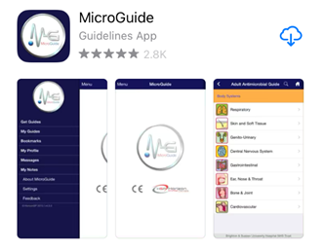
MicroGuide
Users guide
July 2020

Slide 2
What is MicroGuide?
MicroGuide is the new way to access the empirical Antimicrobial guidelines for Gloucestershire Hospitals NHS Foundation Trust
Launch date 27th July 2020
The information can be accessed in 2 ways:
Web based version via the trust intranet
Via a free downloadable app

Slide 3
Web based version
The web based version will be accessed via the quick link as before.
There will be 2 options on the next screen
Adults Antimicrobial guidelines
Paediatrics Antimicrobial guidelines

Slide 4
Web based version – adults
Treatment guidelines can be found under Body Systems
Prophylaxis guidelines can be found under Prophylaxis
Renal Dosing can be found under Drugs (top left hand corner) or by clicking on the drug within a guideline

Slide 5
Web based version – Paediatrics
Treatment guidelines can be found under Body Systems

Slide 6
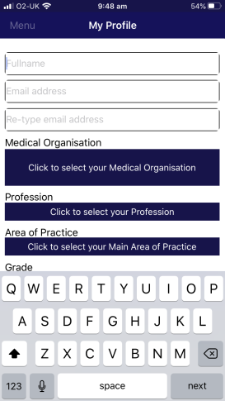
MicroGuide – the app
Download the app free from your app store
Complete the details requested

Slide 7
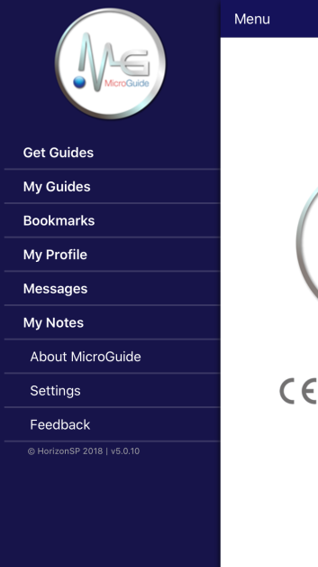
MicroGuide – the app
On the next screen select ‘Get Guides’ and select the guidelines for Gloucestershire Hospitals NHS Foundation Trust
NOTE – there is separate guidance for adults and paediatrics

Slide 8
MicroGuide – the app
Once the guidance from GHNHSFT has been found, click on ‘Get selected guides’

Slide 9
MicroGuide – the app
Once the download is completed, the relevant guidelines will be shown on the screen. The layout is the same as the desktop version.
NOTE – you can also use the search function at the top of the screen to search for drug names or guidelines. Renal dosing may be accessed from clicking on the drug name.

