Slide 1


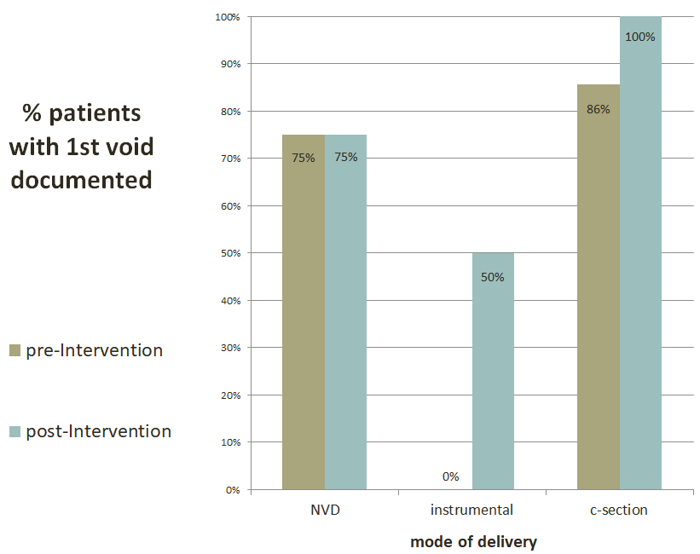
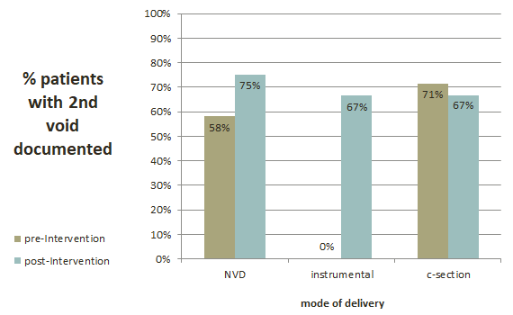
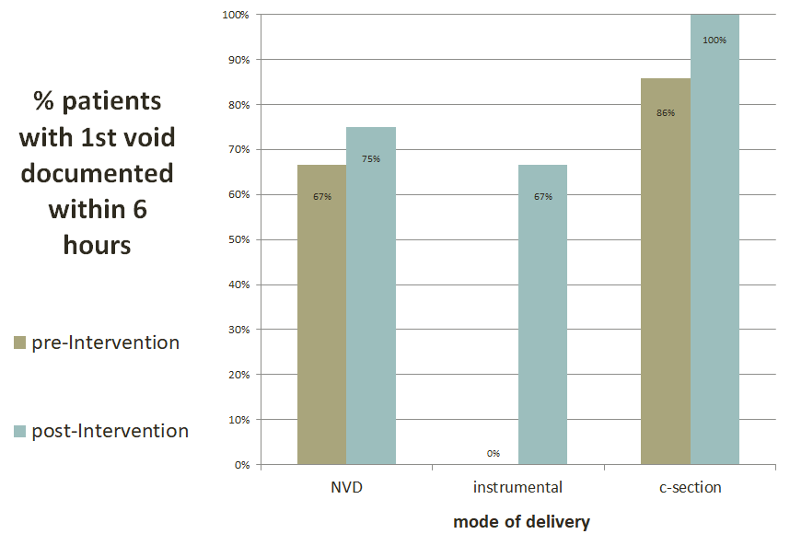
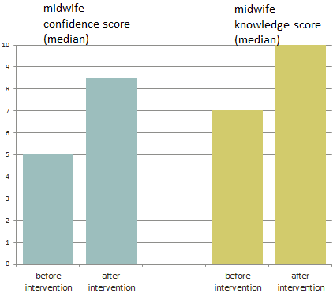
Gloucestershire Safety and Quality Improvement Academy
Improving Postnatal Bladder Care
Kate Mitchell, Advanced Urogynaecology Practitioner (physiotherapist)
Background:
Aim: For midwives to follow postnatal bladder pathway/policy and improve documentation in notes to 90%
For every midwife to attend Bladder care training as part of mandatory training within 1 year.
Bladder care is an important aspect of management in the postpartum period. Postpartum voiding dysfunction occurs in a significant number of women, which can potentially cause permanent damage to the detrusor muscle and long-term complications when left undetected or untreated (O&G&MW news, 2011).
Method: Pre and post intervention notes audit of documentation of voids postnatally.
knowledge and confidence scores of midwives pre and post mandatory training
Results:
Next Steps
Continuation of Postnatal Bladder Care to Midwives on mandatory training
Expand training to medical staff
Re-evaluate midwives confidence and knowledge scores
Midwife “Bladder Care” Champions
1-2 yearly notes audit on documentation of postnatal bladder care
Conclusion: Promising improvements of documentation and midwives confidence and knowledge scores post intervention
#TheGSQIAWay

