Slide 1


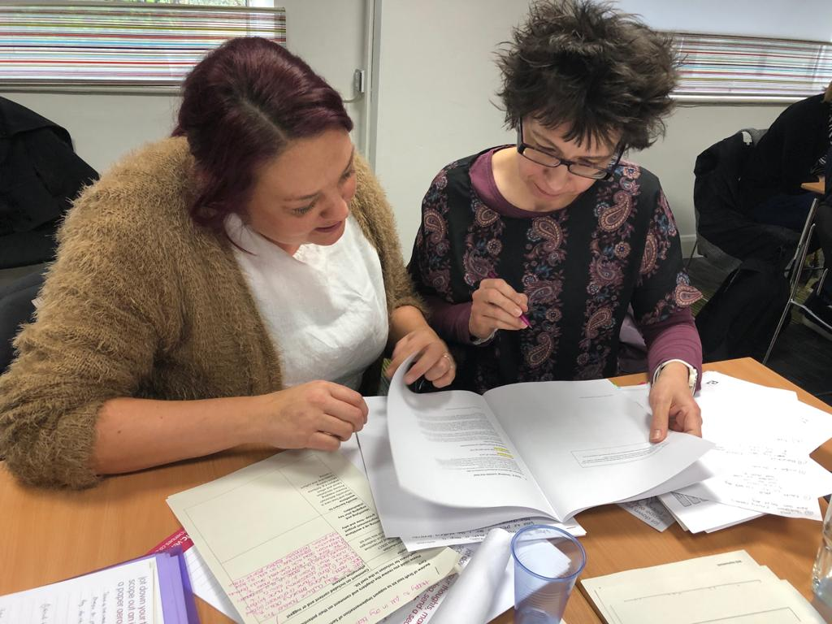

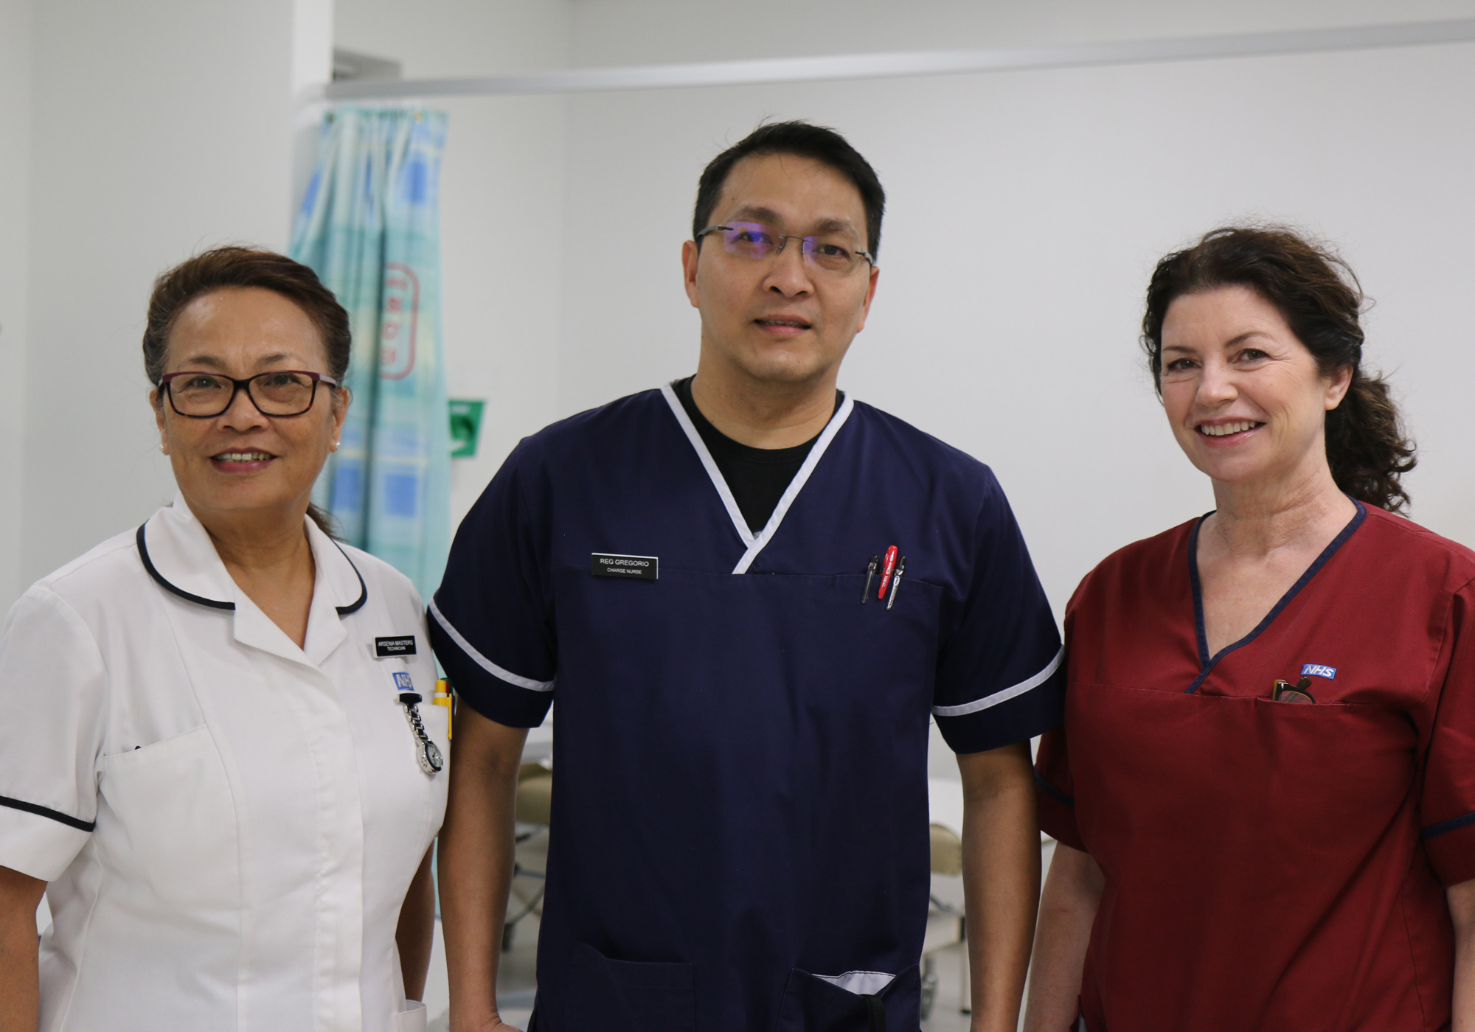
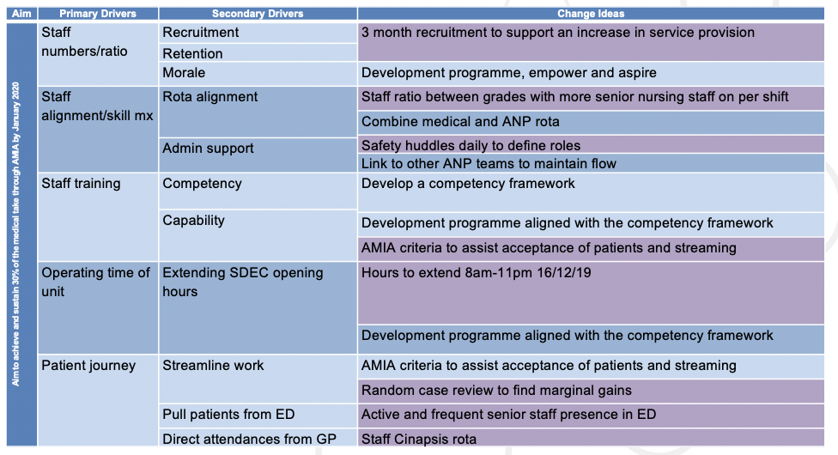
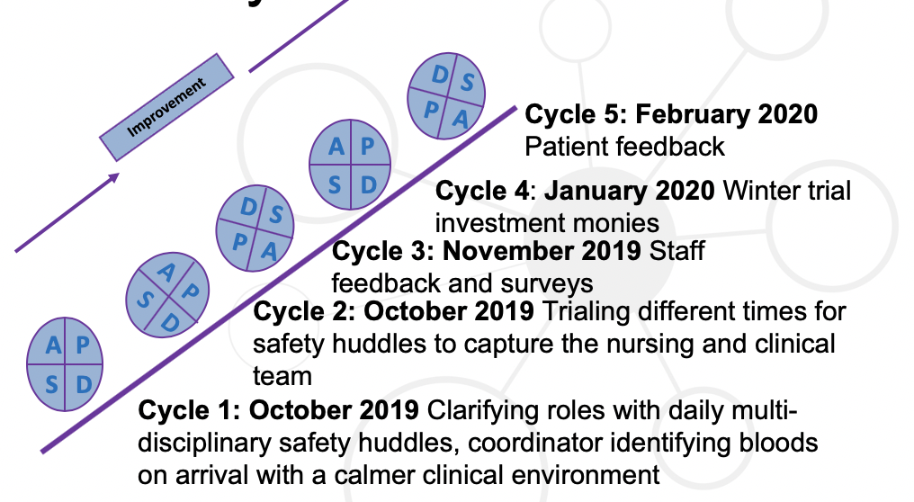
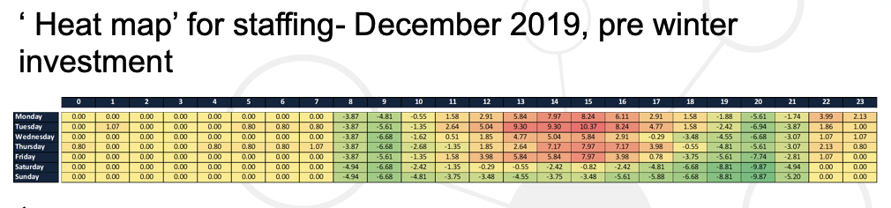
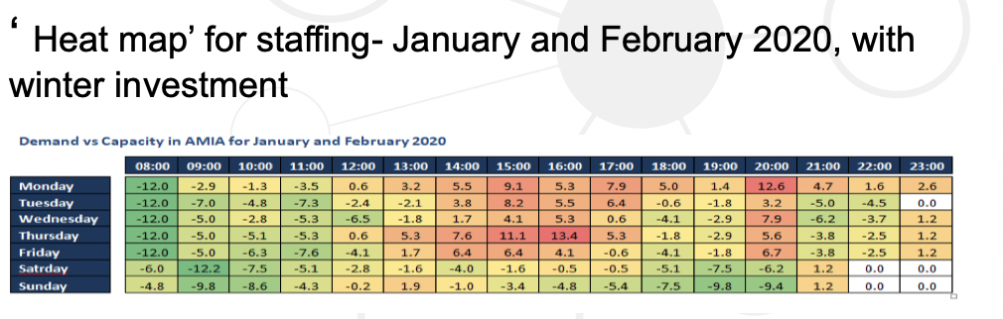
Gloucestershire Safety and Quality Improvement Academy
Identifying our nursing workforce needs in Acute Medical Initial Assessment (AMIA)
Jemma Baker
Background
AMIA provides Ambulatory Emergency Care (AEC) and is a model of care that has redesigned the system in emergency services to be able to provide Same Day Emergency Care for patients who would otherwise be admitted to an in-patient bed within the medical division.
The safety concern is how do we calculate our nursing numbers required to deliver effective patient care in AMIA addressing patient safety, patient experience and staff resilience?
2. Aim
Aim to achieve and sustain 30% of the medical take through AMIA by January 2020.
3. The QI Team
Jemma Baker (Advanced Clinical Practitioner), Jo Barnes (Advanced Nurse Practitioner), Dr Chris Custard (Acute Medical Consultant), Sara Lees (Modern Matron AMIA) and the AMIA nursing team
4. Driver Diagram
(b) Patient Feedback
February 2020. 31 respondents.
Overall AMIA was described as ‘very good’ with positive comments around being a clean department, with access to suitable food and drink refreshments. Patients felt that they were given enough privacy, had suitable answers to their questions and also given the right amount of information they needed about their condition and/or treatment, were involved with their care decisions. Visibility of clinical staff however was perceived to be an issue, with only 51.6% saying they could ‘always’ get attention when they needed it. Given that the nursing staff body had doubled during the winter trial, and even then only just over half of patients felt that staff were there to help, it would not be unreasonable to assume that this would be significantly decreased when AMIA functions on less trained nurses
(c) Managing patient safety
‘heat map’ calculated on a 1:6 nurse:patient ratio with the numbers of patient in the department every hour through the day. Green = less than 6 patients per nurse (too many nurses), red = more than 6 patients per nurse therefore compromising patient safety and subsequent patient flow
5. PDSA cycles
  6. Results
  (a) Percentage of the medical take
  1. October 2019 PDSA 1 and 2 achieving 30%
  2. November 2019 PDSA 3 staff feedback achieving 34%.
  3. January 2020 PDSA 4 Winter investment monies achieving 40.9%
  4. February 2020 PDSA 5 Patient feedback achieving 41.5%
7. Conclusion: Functioning AMIA with 4 trained nurses has a positive impact on patient flow, patient safety, patient experience, staff resilience and team morale
8. Next Steps: Revisit the trial, look at shift times, patient safety net advice, telephone/virtual clinics, sharing findings nationally, live dashboard, weekend working
#TheGSQIAWay

