Slide 1


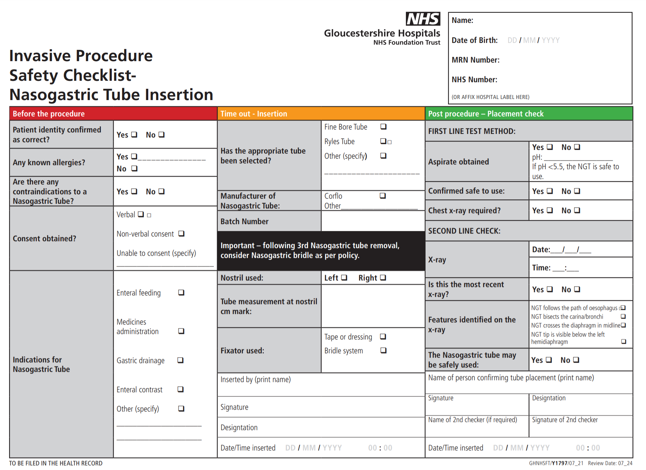
Gloucestershire Safety and Quality Improvement Academy
Standardising Documentation for the Insertion of Nasogastric Tubes
Hayley Mumford
Background
On the 1st June 2018 a letter was received from NHS Improvement requesting a review of Trusts processes for ensuring compliance with Patient Safety Alerts. One of the Patient Safety Alerts highlighted, included nasogastric tube misplacement. A misplaced nasogastric tube may lead to severe harm or even death and is therefore classed as a “Never Event”. Never events are being reported across several trusts indicating that previous Patient Safety Alerts have not been adequately complied with. Never Events are seen as entirely preventable because of national guidelines which provide strong systemic protective barriers.
The Nasogastric Improvement group was established to review current practice in the Trust and to look at potential improvements. The wider team included dietitians, radiographers, and nursing staff. An audit was carried out against the Patient Safety Alert. The notes of patients requiring nasogastric tube insertion during August 2018 showed that compliance with full, clear documentation was variable. It highlighted that there was no standardised way of documenting all the required elements for insertion. Documentation for insertion and confirmation of Nasogastric placement was being recorded in 7 different areas in patient documentation.
NHS England requires organisations to develop Local Safety Standards for Invasive Procedure (LocSSIPs). They set out the necessary steps to deliver safe care to patients undergoing invasive procedures in any location and to standardise practice across the organisation therefore reducing the risk of a Never Event. A nasogastric LocSSIP was already in use within the Department of Critical Care (DCC). The Improvement team decided to use this as a basis for developing a trust wide document.
SMART Aim
Improve compliance with Nasogastric Tube documentation, specifically insertion and confirmation of the correct placement by 50% within 12 months
Measures
Outcome Measure – The number of correctly documented Nasogastric Tube insertions on the new standardised document
Process Measure – The number of datex’s received regarding nasogastric tube insertion or ongoing care
Driver Diagram
PDSA Cycles
AIM
PRIMARY DRIVERS
SECONDARY DRIVERS
CHANGE IDEAS
Staff competent to carry out nasogastric tube insertion
PLAN
DO
STUDY
ACT
Gather baseline data
7 different documents used for NG insertion
Patient notes audit
Find out why staff are not using NG care plan
PLAN
DO
STUDY
ACT
Gain staff opinions on NG care plan
Questionnaire developed – sent to 20 nurses
Review questionnaire results
Create new user friendly document
Nasogastric tube inserted and safely secured
Appropriate equipment available
Training & assessment
CYCLE 1
CYCLE 2
Actions are appropriately & consistently documented
Fixation device/plaster effective at limiting tube movement
Aspirate obtained
Standardise insertion documentation
Improve compliance with Nasogastric Tube documentation, specifically insertion and confirmation of correct placement by 50% with 12 months
Confirmation of correct placement of nasogastric tube
Chest x-ray required
Standardise best practice & policy
Actions are appropriately & consistently documented
PLAN
DO
STUDY
ACT
Gather feedback on new document
Interview DCC staff
Review feedback
Make changes to document
PLAN
DO
STUDY
ACT
Gain feedback from ward nursing staff
Questionnaire sent to 20 ward nurses
Review feedback
Create ongoing care record
Appropriate decision made to feed
Developing staff confidence & competence in checking aspirates
CYCLE 3
CYCLE 4
Feeding carried out safely and effectively
Appropriate feeding regime prescribed
Appropriate documentation complete
Successful x-ray interpretation checks
Tube length checked & documented
X-ray to specify for nasogastric tube placement check
Ongoing care of nasogastric tube
Aspirate obtained
Ongoing care documentation
Documentation of checks
Next Steps
With so many other documents currently in use across the trust there were concerns over the safety of asking staff to complete both a pilot document and official documentation. Agreement and final feedback on the insertion document and ongoing care record was sought from the Nutrition and Hydration Group. Once approval was agreed, the documents were sent to the trust Documentation Group for ratification. This ensures that when testing, it is the only document in use across the trust which will reduce errors. A staff awareness campaign of the new document is planned and regular audits will be completed once the document is in use to check it is being completed correctly.
The Nasogastric Policy and E-learning package is in need of updating to reflect these document changes. This has highlighted the need for an Acute Enteral Nutrition Nurse Specialist, similar to those in the community, who can have responsibility for ongoing management of enteral feeding and nasogastric tubes in the trust. A business case for this role is currently in progress.
#TheGSQIAWay

