Slide 1


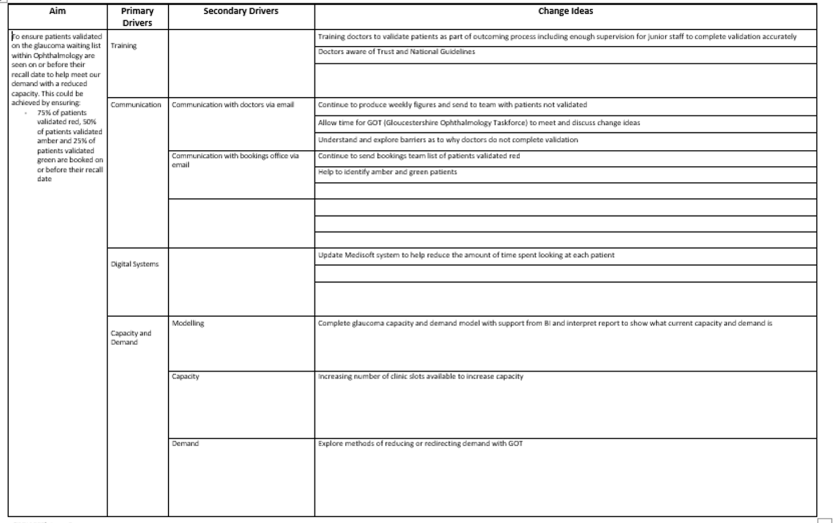
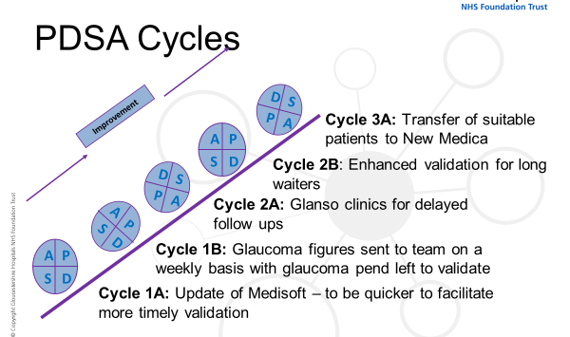
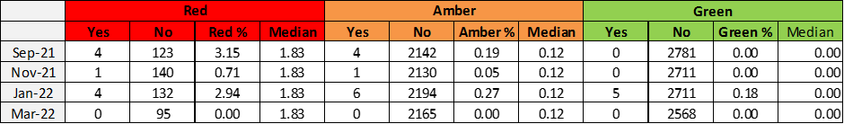
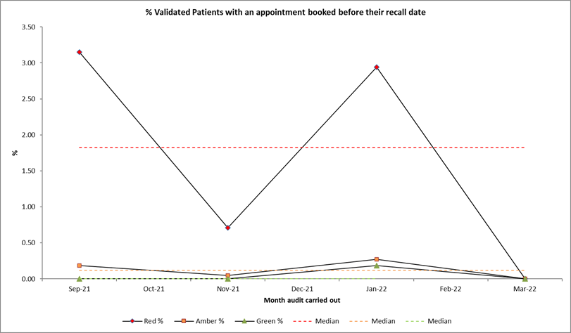
Gloucestershire Safety and Quality Improvement Academy
Glaucoma Service Improvement Project
Katharine Bird, Failsafe Officer, Ophthalmology
Background and Problem
This project focused on the Glaucoma Service provided across Gloucestershire. The team working on the project are members of the Ophthalmology Department who have worked together to improve the Glaucoma Service.
On a daily basis, patients waiting for glaucoma appointments within Ophthalmology are waiting past their recall date for follow up appointments – our demand is exceeding our capacity. This has been exacerbated by Covid where we cancelled clinics and we still have reduced capacity. This has a negative effect on patients as their care is delayed and this could impact on their ocular health.
An initial capacity and demand model was conducted for us to see our baseline data.
Aim - To ensure patients validated on the glaucoma waiting list within Ophthalmology are seen on or before their recall date to help meet our demand with a reduced capacity. This could be achieved by ensuring:
75% of patients validated red, 50% of patients validated amber and 25% of patients validated green are booked on or before their recall date
Methods
The process undertaken included a number of changes. These included:
Medisoft updated 9th November 2021
Weekly glaucoma figures – with glaucoma pend left to validate started sending from September 2021 (continuing from before), highlighting the glaucoma pend left to validate and this was tackled from November 2021
Capacity and Demand – baseline data collected March 2021
Red patients highlighted September 2021, some done before
Glanso clinics 8th and 9th January 2022, 5th, 6th and 27th February 2022, 26th and 27th March 2022, 9th and 10th April 2022, 29th May 2022
Enhanced validation end of February 2022 – long waiters
Transfer of suitable patients to New Medica
Driver Diagram
Results
These are the figures collected from looking at our waiting lists and seeing which patients validated red, amber and green have been booked an appointment on or before their recall date.
There has been a small percentage of patients booked on or before their recall date, but perhaps more PDSA cycles need to be undertaken to make more meaningful change.
Lessons Learnt
Although there has been some positive changes, I think we may have been unrealistic in the percentage targets we set in the aim as we have not met any of the percentage targets for any of the validation categories.
I think we have shown that there is a need to improve our Glaucoma Service to ensure that any ‘at risk’ patients are identified and seen in clinic in a timely manner and this has led to a push to improve our Failsafe Process for all sub-specialities within Ophthalmology.
Next steps
To share the results of the project with the wider Ophthalmology Team and consider similar methods to other sub-specialities.
To continue to highlight our most ‘at risk’ patients validated red to the bookings team to ensure a smooth patient pathway from referral to discharge.
#TheGSQIAWay

