Slide 1


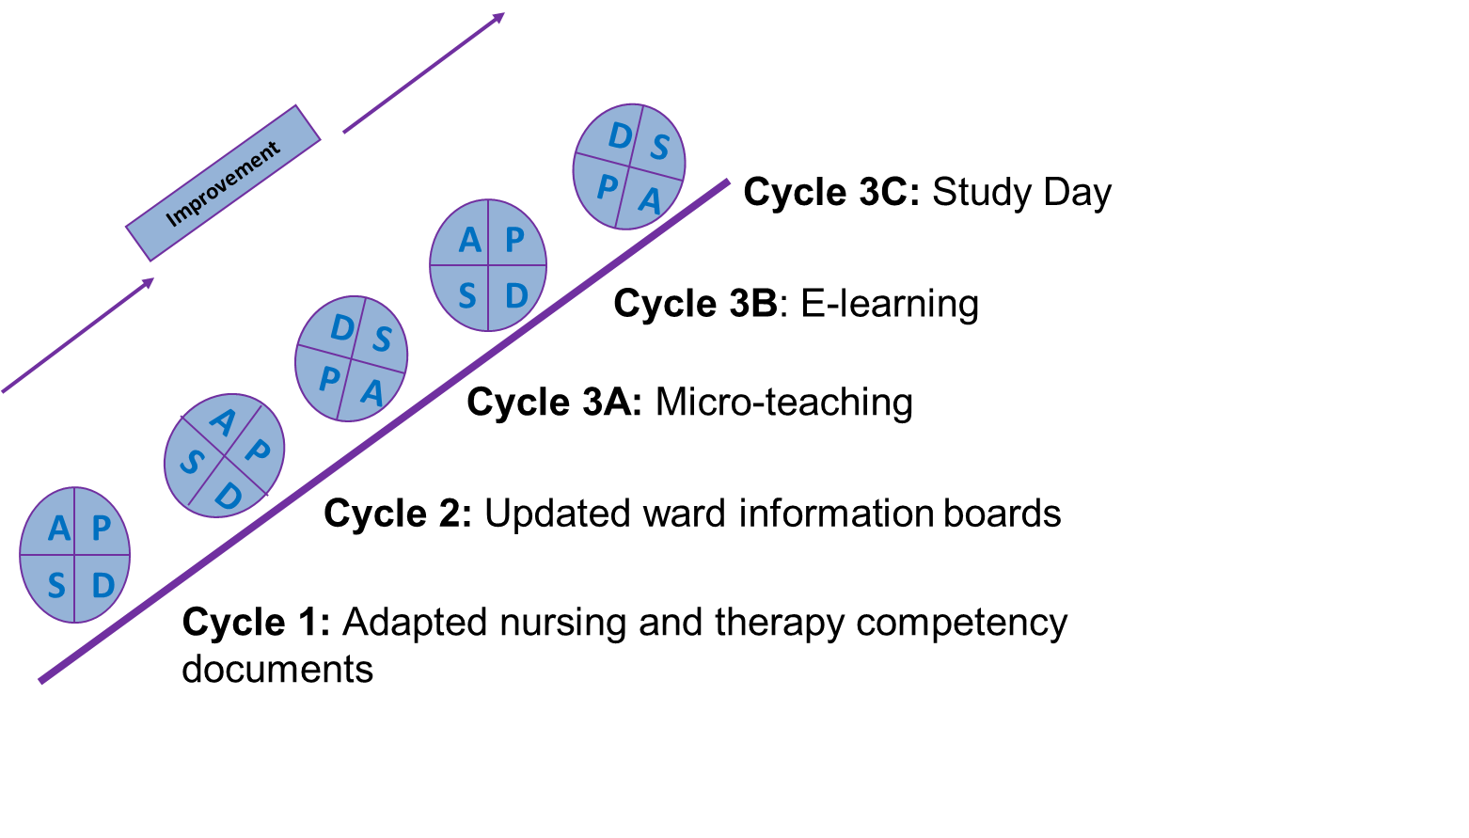

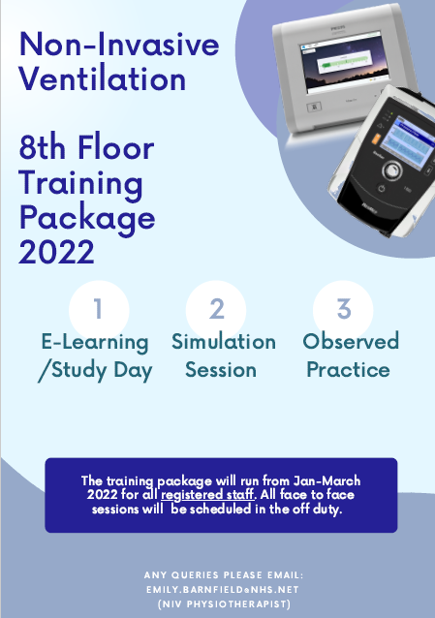
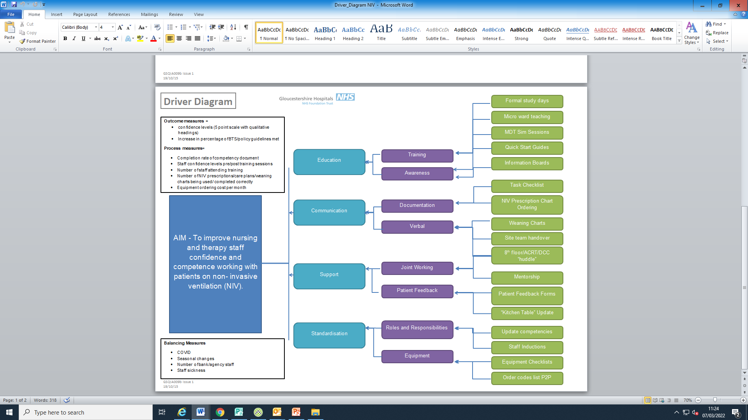
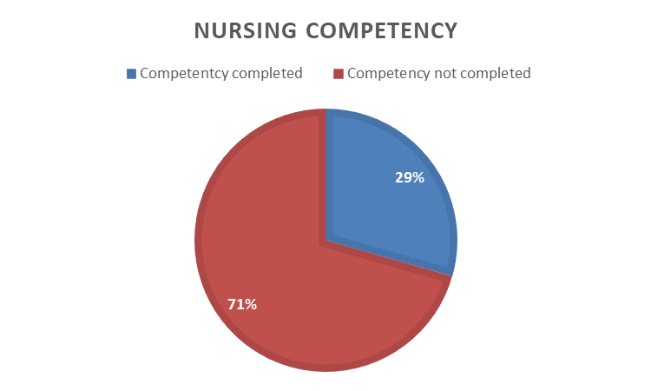
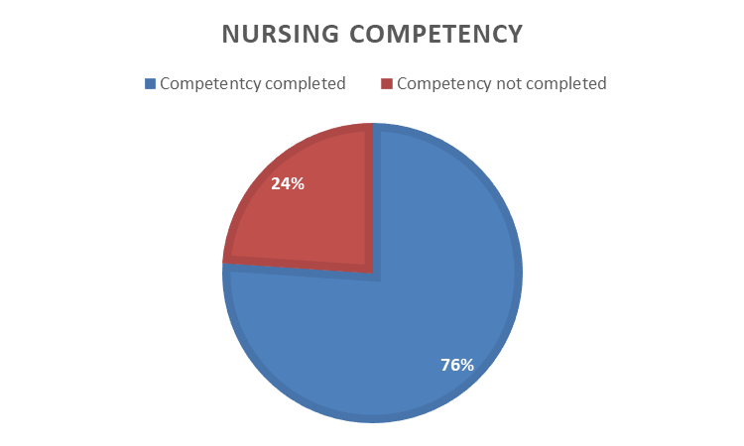
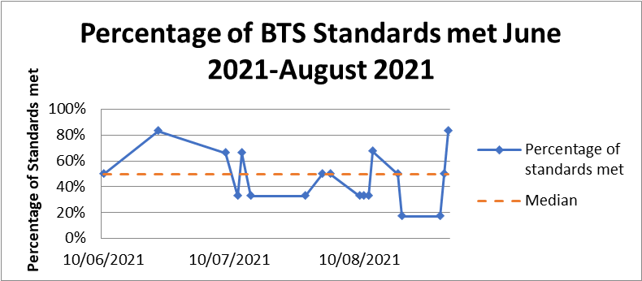
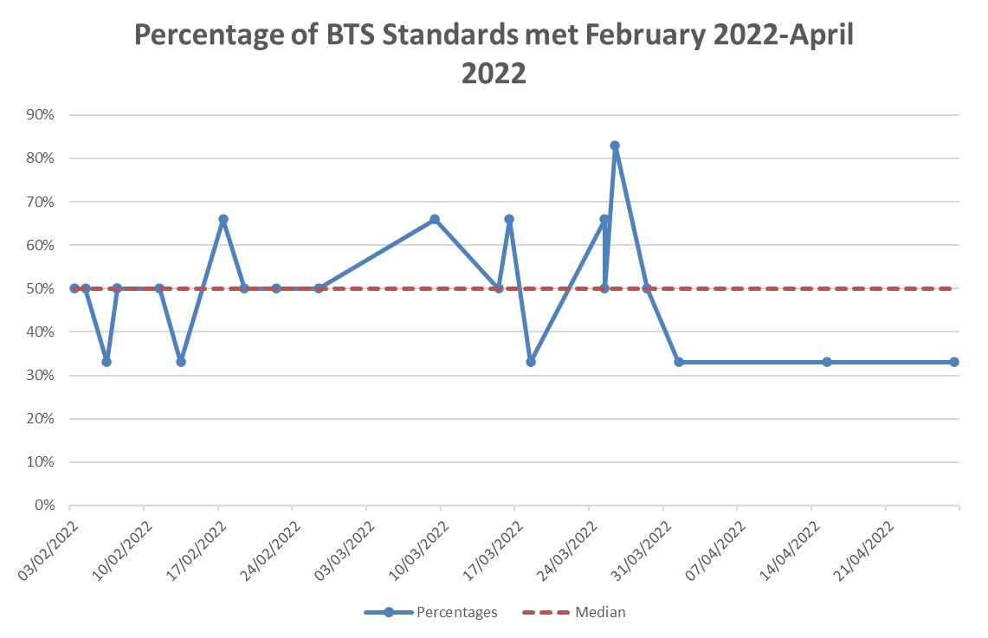
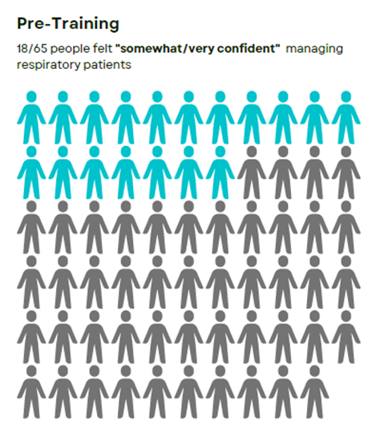
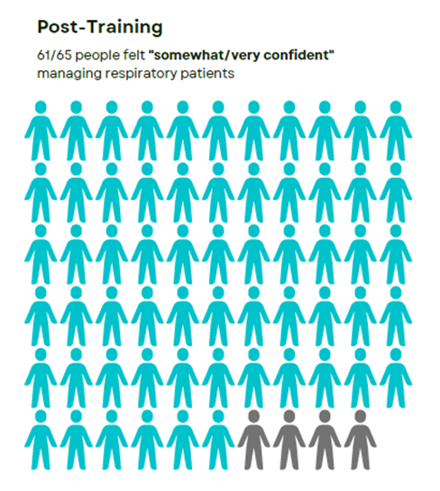
Gloucestershire Safety and Quality Improvement Academy
Improving nursing and therapy staff confidence and competence with patients receiving Non-Invasive Ventilation (NIV)
Emily Barnfield (NIV Physiotherapist), Dani Brooks (8A Ward Manager), Catz Matthews (8B Ward Manager), Pauline Rea (Professional Education Practitioner), Charlie Sharp (NIV Lead Consultant/Gold Coach)
Background
Non-Invasive Ventilation (NIV) uses positive pressure to aid oxygenation and removal of carbon dioxide and is a standard component of the management of COPD patients in several guidelines worldwide (NICE, 2018;Rochwerg et al, 2017). However, despite evidence demonstrating its value, introduction into routine clinical practice in the UK has not delivered the expected patient benefit.
In response to this, a number of national guidelines were published in an attempt to influence clinical practice. The British Thoracic Society (2016) advised NIV should be delivered in a dedicated setting by trained and experienced staff. The Inspiring Change study (NCEPOD 2017) found that 45% of hospitals permitted staff without competency to directly supervise the care of patients receiving NIV, which may be impacting outcomes.
Benchmarking
A recent audit completed at GHNHSFT found:
On average, we met 33% of the national standards, per patient recommended by the BTS. There is also huge variation of the care received on each admission.
71% of staff had not completed the NIV competency document, despite over half, working with more than 3 patients on NIV each week.
72% of staff working on the 8th floor, felt under confident managing patients on NIV despite being the specialist respiratory area.
Aim
To improve nursing/therapy staff confidence, managing patients on NIV in 1 year.
To improve completion rates of the NIV competency document by 50% in 1 year.
Driver Diagram
= Main Focus
PDSA Cycles
Results
· We now meet an average of 50% of the national standards, per patient. However, significant variability is still present with the care delivered (Figure 1)
· 76% of nursing staff have completed the NIV competency document (Figure 2)
· 94% of nursing and therapy staff on the 8th floor now feel somewhat/very confident managing patients on NIV (Figure 3)
Figure 1—Completion rate of nursing competency document
Figure 2—Percentage of BTS Standards met June 21-August 21 and Feb 22-April 22
Figure 3— Staff confidence levels when managing a patient on NIV
Discussion
Work completed has highlighted that a dedicated training package has helped to improve staff confidence and competence managing patients on NIV, however, more work is needed to reduce variability of care. This may be improved by looking at other areas identified in the driver diagram
· Since the beginning of the project, the trust has moved to electronic notes. This has caused issues with documentation of the NIV prescription and ABGs which may also account for some of the variability seen.
· We were only able to comment on the completion rates of the nursing competency as the physiotherapy competency document is still awaiting approval by the documentation team.
Next Steps
The project has shown the need for annual training, including the use of simulation based education.
As NIV is delivered in several areas across the trust, the need for standardisation is paramount to ensure gold standard care
Further development of training utilising simulation based education. Next main area to focus = ED GRH
Integration of NIV documentation on EPR to improve completion of NIV prescription
#TheGSQIAWay

