Slide 1
Annual Members’ Meeting 2022 Redwood Education Centre

Slide 2
Welcome Deborah Evans Chair

Slide 3
Agenda
Welcome | 15:00
House Etiquette: Questions and Answers
Annual Report | 15:05
Annual Accounts | 15.30
Council of Governors: Membership | 15.40
Council of Governors: Report | 15:50
Public Questions | 16:00
Close | 16:45

Slide 4
House etiquette: Questions and Answers
If you wish to submit a question please type Sli.Do into your browser address bar and enter event code #1070042

Slide 5
Annual Report Deborah Lee Chief Executive

Slide 6
Reflections on last year
One of the most challenging years in the NHS’s 75 year history - the challenges have changed but they have not diminished
It continues to be a privilege to lead the Trust and serve the people of Gloucestershire despite the very significant challenges ahead, and not least those recently highlighted by the Care Quality Commission (CQC)
I remain in awe of the skills, compassion and dedication of my colleagues at Gloucestershire Hospitals – they are our most precious resource
Our relationships with system partners continue to develop with increasing evidence of the benefits of these partnerships for patients and communities
Our relationships with our communities have never been more important

Slide 7
Some of the highlights from 2021/22
3,061 Patients waiting more than 52 weeks at the end of March 2021
The first patients benefitting from our £100m-plus capital investment to deliver two centres of excellence
Our surgeons have become the first in Europe to adopt pioneering next generation robotic surgery
The Trust continued to deliver more elective surgery and cancer care than any other Trust in the Region resulting in fewer patients waiting than any other Trust in the Region
The Trust achieved 7/9 cancer standards including 92.8% (24,672) of patients with suspected cancer being seen within 14 days of referral and exceeding the newly introduced Faster Diagnosis Standard
We received our best ever score in the National Cancer Experience Survey with patients rating us 9.1 out of 10: making us one of the best in the country
We launched our first Green Plan and secured £24m of funding from the Government’s Decarbonisation Fund and are making huge strides towards achieving net zero by 2040
1,125 Patients waiting more than 52 weeks at the end of March 2022

Slide 8
Some of the highlights from 2021/22
The Trust took huge strides forward in digitalising our hospitals achieving Level 6: A digital hospital is a safer hospital
Contributed to the vaccination programme in Gloucestershire resulting in more people receiving vaccines more quickly than anywhere else in the country
We recruited more patients into COVID public health studies/trials than any other centre
The Trust has established a Professor of Nursing in conjunction with the University of Worcestershire and overseen the first in-take of medical students at the Three Counties Medical School
We started work on our inaugural mental health strategy for staff, patients and their families
Won or were shortlisted for scores of national or regional awards including both clinical and non-clinical teams and individuals
Delivered our financial plan and achieved a (small) financial surplus

Slide 9
The challenges ahead
Without doubt, one of biggest challenges are those related to our workforce including:
Caring for our colleagues to ensure they are resilient, feel valued and are able to deliver Best Care For Everyone despite the often challenging circumstances in which they work
Retaining staff, many of whom are choosing to leave the NHS – ensuring GHFT is a place that staff want to work and would recommend to others
Recruiting staff to longstanding vacancies and being innovative when it comes to developing our workforce for the future
Working with partners to sustainably address the pressures across the urgent and emergency care system and most notably in ambulance services and social care
Responding to the legacy of the pandemic in respect of patients waiting for care and for treatment
Achieving financial balance in an increasingly difficult context
Developing and maintaining our estate and digital programme with limited capital available to us
Managing public expectation of what the NHS can deliver, and at what pace, in the next year and beyond

Slide 10
The challenges ahead continued…
Addressing the issues reflected in the recent Care Quality Commission’s (CQC) report and our own staff surveys relating to culture – this is central to the challenges above
Remedying the shortcomings identified by the CQC in relation to maternity and surgical services and restoring public trust and confidence where it has been impacted
Re-setting our governance in the context of the post-pandemic context

Slide 11
Priorities for the year ahead
Ensuring we develop and maintain a culture where everyone feels valued, regardless of their characteristics and the majority of staff would recommend our hospitals as a place to work
Supporting staff to recover and build individual and team resilience with a significant focus on retention of staff and recruitment to our vacancies
Redressing the imbalances evident in health and social care to minimise the number of patients awaiting discharge in our acute hospitals and ensure timely ambulance responses
Working with partners and communities to understand how best to address the health inequalities that have been worsened or created by the pandemic
Developing a winter plan, with our system partners, that reflects the unique challenges we will face this winter and the increasing impacts arising from a fragile social care system
Implementing the final phase of our Fit For The Future programme to realise the benefits for patients as soon as possible arising from our Centres of Excellence model
Progressing our digital journey
Maintaining financial stability in an uncertain world

Slide 12
Finance Report Karen Johnson Director of Finance

Slide 13
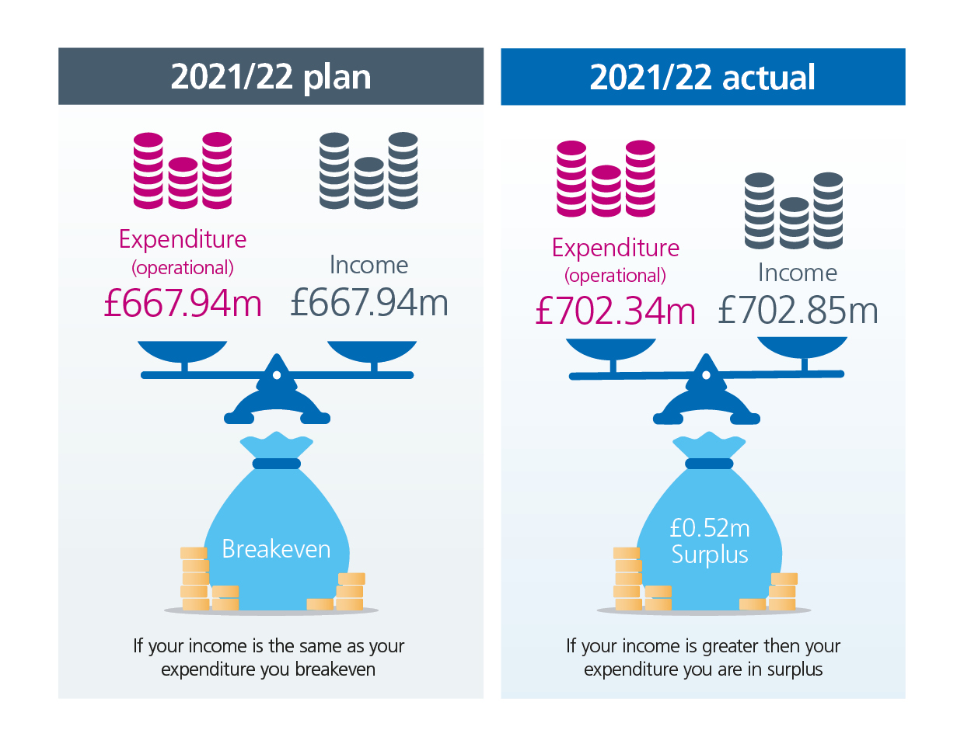
Headline financial results for 2021/22
In 2021/22 the Trust ended the financial year with a surplus of £0.52m against a planned breakeven position
Unlike in 2020/21 where costs were matched with income, the ICS received a fixed level of funding - all system partners worked collaboratively to attribute this funding fairly across organisations.
Although the funding received was sufficient in order to cover costs there was a need to deliver a level of financial sustainability schemes in order to breakeven whilst still managing the pandemic and demand.
The Trust focussed on recovering activity back to pre-pandemic levels. In 2021/22, the Trust delivered 96% of 2019/20 activity levels compared to 69% in 2020/21.

Slide 14
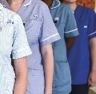
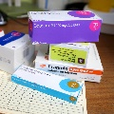
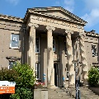
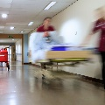
We spent £425m on pay last year | We spent £277m on non pay last year | We generated £703m in (mostly block) income last year, including…
£115m on doctors £97m on clinical support staff £126m on nurses and midwives £87m on admin and clerical | £65m on clinical supplies £83m on drugs £12m on our premises £22m on general supplies £25m on depreciation and impairment of our buildings and equipment £20m on the Clinical Negligence scheme £29m on the other costs of running the Trust £4m on DHSC-funded Covid consumables £17m on non operating costs | £625m from NHS England and Clinical Commissioning Groups £3m from Top-Up funding for validated Covid spend £17m from Education & Training £16m from providing non-patient care services to other bodies £25m from other chargeable income | £2m from DHSC-funded Covid consumables £5m from other patient care activities £7m from other NHS bodies £3m on R&D

Slide 15
Over the last year we have invested over £67.6m on:
Capital Spend
Maintaining the Estate
Critical infrastructure and backlog maintenance of buildings that include; replacement of air handling units, fire safety works, temperature and ventilation works, major roofing works and electrical capacity upgrades.
Donated
Investments including CT Scanner and a contribution towards the enabling works, an Ophthalmic ultrasound system, and other medical equipment, funded from charitable donations.
£5.4m (8%)
Estates Development
Includes investment strategic site development project, creation of a new endoscopy suite, beginning the image-guided interventional radiology project and the completion of the new courtyard build.
IT Infrastructure and Systems
Includes; The continued implementation of patient management system, Maternity Digital System, Office 365 upgrade as well as modernization and replacement of legacy infrastructure including end user devices and other network equipment.
Energy Efficiency
Investment into the infrastructure to improve the carbon footprint including implementation of a battery energy storage system, an air source heat pump and a low loss transformer. Funding from a Salix government grant.
Medical Equipment and Enabling Works
Includes; Provision of a Surgical Robot, Investment in Diagnostic equipment, replacement of linear accelerator, echo machines amongst other smaller valued replacement medical equipment.

Slide 16
Looking ahead and beyond
For 2022/23 the ICS has received a fixed funding allocation to operate within the whole year. This funding is used to provide day to day operational services, support elective recovery, and cover the costs of covid-19 support. As in pre-pandemic times the Trust and ICS need to deliver financial sustainability schemes in order to operate within these resources – the Trust has a c£19m requirement.
2022/23 is likely to be another uncertain year with continued focus and drive on reducing levels of spend to pre-pandemic levels. The current economic climate has seen the Trust affected by the super inflation rates seen in our country for supplies and services most notably in energy costs.
Alongside this our operational teams continue to operate with the challenges of delivery urgent care and reducing waiting lists. We will commit ourselves to continue working as one team to deliver the very best for our patients within the confines of our funding.
Exciting times ahead with the formation of Integrated Care Boards as statutory bodies from July 2022 promoting system work to ensure our patients and residents receive the best care and services we are able to provide.

Slide 17
Council of Governors: Membership Deborah Evans Chair

Slide 18
Our Governors

Slide 19
Our Governors

Slide 20
The Governors Alan Thomas Lead Governor

Slide 21
Governors: 2021–2022
Thanks to retiring governors
Welcome to new governors
What we did – or didn’t - do
Thank you and ‘Farewell’

Slide 22
Questions and Answers
If you wish to submit a question please type Sli.Do into your browser address bar and enter event code #1070042

Slide 23
Thank you

