Slide 1

Cow’s Milk Protein Allergy:
How to Wean Your Baby milk free and reintroduce dairy
Paediatric Dietitians, GRH
0300 422 5506

Slide 2

Outline of Session
What is Cow’s Milk Protein Allergy?
Symptoms and Diagnosis
Lactose Intolerance or CMPA?
Treatment of Cow’s Milk Protein Allergy
Food Labelling
Cow’s Milk Free Weaning (Meal Ideas)
Introduction Of Other Common Allergenic Foods
Cow’s Milk Free Alternative Products
Reintroducing Cow’s Milk Back Into The Diet
Meeting Calcium Requirements & Vitamins and Minerals

Slide 3
What is Cows milk allergy (CMPA)
CMPA is an abnormal response by the bodys immune system in which proteins in a food(in this case cows milk) are recognised as a potential threat . This can then cause the immune system to become ‘sensitised’. When this happens, there is potential that when cow’s milk is consumed the immune system remembers this protein and may react to it by producing allergic symptoms. (Allergy UK)

Slide 4
CMPA
One of the most common food allergies to occur in children – affects 2–5% of children
Two types of CMPA:
  Immediate (IgE mediated), symptoms typically show within minutes of having milk
  Delayed (non-IgE mediated), symptoms typically show within hours, sometimes days, after having milk
Notes:
Mention that all children at the session today are suspected to be suffering from non-IgE mediated cow’s milk allergy
See next slide for a list of symptoms

Slide 5
Symptoms of Cow’s Milk Protein Allergy
Diarrhoea or constipation, stomach ache, nausea, reflux or vomiting, blood or mucus in stools, wind, discomfort with feeding
Itchy skin rashes & eczema
Runny or blocked nose
Swelling of the face, eyes, lips
Swallowing or breathing difficulties (rare)
Notes:
This covers all of the symptoms that people with CMPA have shown. Your child may have experienced only some of these symptoms.
Some of the symptoms listed above can occur with both Ig-E and non-IgE mediated allergies.
Those that cause swallowing/breathing difficulties, runny or blocked nose or swelling to the face, eyes, lips, listed at the bottom of the slide are IgE mediated allergy symptoms. If your child is experiencing any of these, please come and talk to us at the end of the session as you will require slightly different advice in terms of reintroducing milk
Generally, those listed at the top of the slide are from non-IgE mediated allergies, unless they appear within minutes of consuming milk. If they appear immediately, it’s likely to be an IgE mediated allergy.

Slide 6
Diagnosis of Cow’s Milk Protein Allergy
Dependent on type of allergy
Immediate reactions
(IgE mediated)
Delayed reactions
(non-IgE mediated)
Blood tests (RAST test)
Skin prick test
Food exclusion &
reintroduction
Notes:
RAST tests and skin prick tests are evidence based and used by health professionals, along with a detailed clinical history, to diagnose allergies.
RAST test
Stands for Radio Allergo Sorbent Test
A blood test to measure the amount of IgE antibodies to a suspect food in the blood
Skin Prick Test
Involves a small amount of the allergen being placed on the skin and the skin then being pricked. If a small lump, or what we call a ‘weal’ appears, this may result in an IgE mediated food allergy being diagnosed.
Food exclusion and reintroduction
Involves the suspected food/foods being excluded for a period of time from the diet and symptoms observed. If symptoms improve, the suspect food is re-introduced and if symptoms return, this shows a problem with this particular food.
Mention that as all of those at the group are suspected of suffering from non-IgE mediated allergy, that all the tests for IgE mediated reactions are not appropriate.
Alternative Allergy Testing
You may find the below notes on alternative allergy testing useful if anybody asks about them during the session:
MAST (Multi-Allergen Screening Test) – blood test similar to RAST but commercial companies do not have detailed clinical history to help make a diagnosis. Not recommended.
IgG blood test – blood test looking at IgG antibodies present in the blood as claimed that an increase in IgG antibodies indicates an intolerance to that food. No scientific evidence to support this.
Kinesiology – its claimed that certain foods cause an energy imbalance in the body and can be detected by holding a glass vial containing the suspect food. The therapist then tests the muscle response. No scientific evidence to support this.
Hair analysis – a lock of hair is sent to a laboratory and energy fields in the hair are scanned. Used in other areas but its use in allergy testing is unproven.
Leucocytotoxic or cytotoxic tests – blood test where white blood cells are mixed with the allergen. Swelling indicates an allergy to that food. No scientific rationale.
Pulse test – involves taking the pulse prior to eating the allergen and then 15 minutes afterwards. An increase in the pulse by 10 beats per minute indicates food intolerance. No evidence base for this test.
Electrodermal (Vega) testing – tests the electromagnetic conductivity in the body where a reaction to a food is shown as a dip in electromagnetic conductivity
The above information is taken from the BDA Food Fact Sheet on Food Allergy and Intolerance Testing (see appendix 6 on ‘Resources’ in your pack for the hyperlink). It may be worth considering taking some of these fact sheets with you to hand to patients if they ask questions regarding these alternative tests.

Slide 7
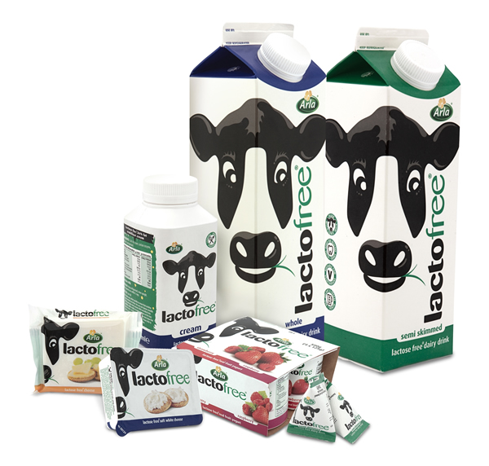
Sure its CMPA? What is Lactose Intolerance?
Body cannot digest the sugar in cow’s milk (lactose)
Often confused with cow’s milk protein allergy
An intolerance, not an allergy
Very rare – affects 1% of UK population
Can be temporary following an upset tummy/ gastro bug/antibiotics
Symptoms are very similar to cow’s milk protein allergy:
  Diarrhoea, nausea & occasional vomiting, wind, tummy ache
Notes:
Lactose free food can still contain milk protein so will not be appropriate for those with cow’s milk protein allergy. A picture of a common lactose free range available in the supermarkets is provided. These are not advised for those with cow’s milk protein allergy.

Slide 8

Breastfeeding
Symptoms from non-IgE CMPA in exclusively breastfed babies is uncommon so its not a reason to stop
If your baby’s symptoms only began when you introduced a top-up infant formula try to revert back to breastfeeding/EBM only if possible
Non-IgE mediated CMPA can only be diagnosed through an elimination diet, followed by the reintroduction of cow’s milk into the breastfeeding mother’s diet (to confirm a return of symptoms).
Notes:
It is also essential to use every possible opportunity to promote breastfeeding amongst the mothers of infants suspected of milk allergy and we have produced a new information leaflet to aid this. WHO guidance is to breastfeed exclusively until 6 months of age and to continue to breastfeed until at least 2 years of age. The benefits of breastfeeding up to and beyond 2 years have been detailed in an excellent Lancet series here . Mothers should be supported to breastfeed as long as they wish to and this support can be particularly important when mothers are following a dairy free diet. The increase in vegan foods available means that there is an ever growing choice of dairy free and tasty foods available for mothers. There are links below that mothers may find useful.

Slide 9
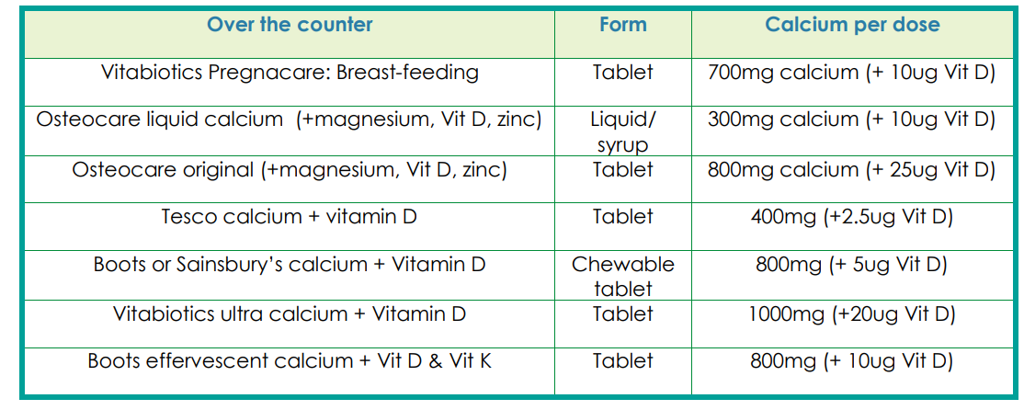
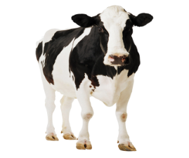
Maternal Cow’s milk exclusion
When CMPA is suspected a strict maternal dairy free exclusion is advised.
Re-introduction recommended after 4 weeks to confirm diagnosis.
10ug vitamin D and 1250mg calcium supplement recommended

Slide 10
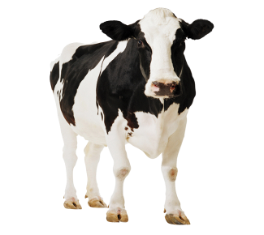
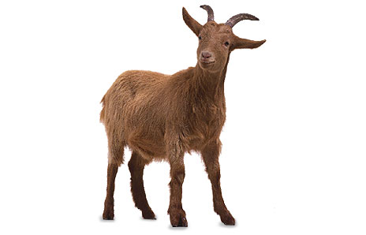

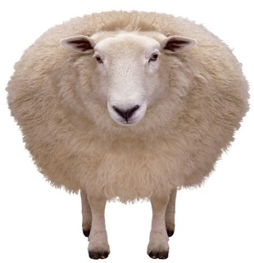
Treatment for suspected CMPA
A diet free from cow’s milk and food made with cow’s milk
avoid milk and food products from other animals, such as sheep, goat & buffalo as the protein is very similar to the protein in cow’s milk
If under 1 year of age, your child should have breast milk or a suitable hypoallergenic formula
Notes:
Mums who are breastfeeding may or may not need to follow a cow’s milk protein free diet.

Slide 11
Soya
Soya products can be introduced from 6 months of age.
There is a 50% chance that if your child has a CMPA they may react to soya. Symptoms will be similar.
If you suspect this then a 2 week period of avoidance with re-introduction is recommended.

Slide 12
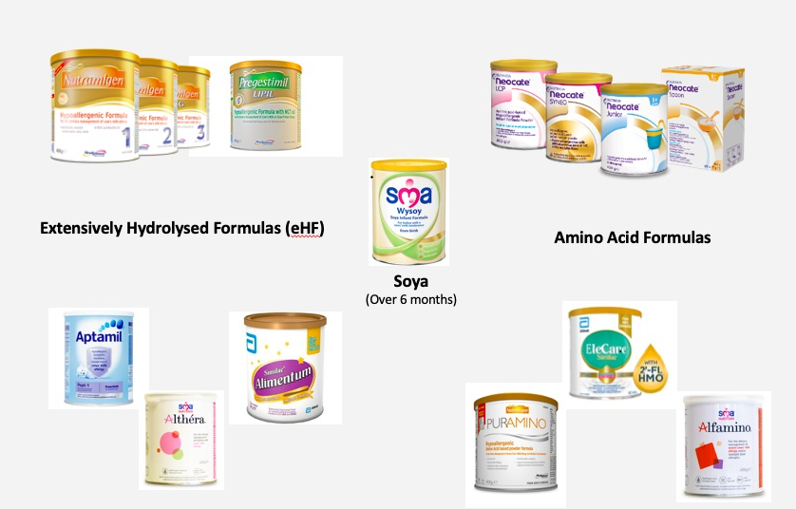
Suitable Formulas for Cow’s Milk Protein Allergy
Notes:
Formulas are available for those babies who aren’t breastfed and or for top ups if not expressing.
Amino acid formulas are suitable for those who have reacted to eHF, have severe non-IgE mediated allergy or severe IgE mediated allergy.
Some formulas contain lactose which are better tolerated if infant older as more palatable.

Slide 13
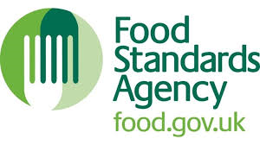
Food Labelling
To follow a CM free diet, it is important to check food labels:
Pre-packed food
  allergens are emphasised on the label, e.g. skimmed milk powder, hydrolysed casein (Milk), cream (from milk)
Foods without packaging/food served whilst you are out
  written or verbal information on allergens needs to be provided by staff
‘May contain’ warnings
  food may be contaminated with an allergen by accident
The law only covers allergens used as ingredients, not allergens that may be present following accidental contact
For medicines, always check with your pharmacist
Notes:
There are many ways that milk can be labelled and not all of them are obvious. For example, hydrolysed casein, whey solids and lactoglobulin.
Changes in the law around food labelling has helped with this. In December 2014, it became law for allergens to be emphasised on the label. Milk is 1 of the 14 allergens that has to be identified in the ingredients list.
Signpost towards Food Standards Agency Leaflet in information pack.
‘May contain’ warnings are not a legal requirement.
Inform audience that there is an activity later on in the session on ‘Reading Food Labels’

Slide 14
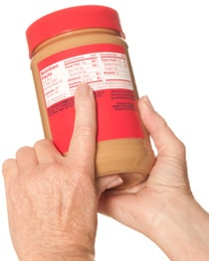
Top Tips
Check ALL food labels – you’ll be surprised by what contains milk!
Ask your local supermarket for a list of their own brand foods which are ‘cow’s milk free’
Don’t assume that a ‘free from’ product will be free from all allergens - always check the label
Online supermarket sites are useful but always check the label of the product
Notes:
Ask your local supermarket for a list of their own brand foods which are ‘cow’s milk free’
Ensure that you keep it up to date however and ensure you still check the label as recipes can change
‘New improved recipe’ is a clue something may have changed
Food Maestro App
Simple, personalised app, which can be downloaded free from the App store. Used to set up personalised food profiles for multiple users (if required), select from specific food allergens, exclude specific ingredients or apply diet filters. You can scan barcodes to check that foods are suitable for the profiles you have set up. Search or browse by food category and search results will show which foods are suitable & safe for selected profiles. Can filter search results by the number of teaspoons of sugar a product contains plus more.

Slide 15
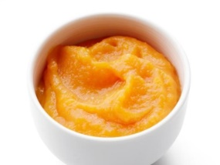

Cow’s Milk Protein Free Weaning
This is the same as weaning a non-allergic baby except you are avoiding foods which contain cow’s milk
Weaning occurs around 6 months
Stage 1
Try mashed or pureed fruit and vegetables like parsnip, potato, yam, sweet potato, carrot, apple or pear
Baby rice or porridge (remember to check food labels)
Use baby’s usual milk (breast milk or hypoallergenic formula) to mix food to desired consistency
Pureed/mashed meat, chicken or lentils
Notes:
Signs that a baby is ready to be weaned include:
Showing an interest in food and able to swallow it (babies who are not ready will often use their tongue to push the food back out of their mouth)
Able to co-ordinate their hands, eyes and mouth so they can look at a food, pick it up and put it their mouth, by themselves
They can stay in a sitting position and keep their head steady
Signs that are commonly mistaken as signs that a baby is ready to be weaned include:
Wanting extra milk feeds
Waking at night
Chewing fists
If using prepared fruits/vegetables/baby rice/porridge from a shop, remember to check the labels for milk.

Slide 16
Stages 2 & 3 – Meal Ideas
Breakfast
  Cow’s milk free breakfast cereal/porridge with milk substitute
  Toast fingers with cow’s milk protein free spread
  Pancakes made with milk substitute
Main meals
  Baked beans or scrambled egg on toast
  Meat/chicken or fish with potato/rice and vegetables
  Pasta with a tomato, roasted vegetable sauce or cow’s milk free white sauce. Can add cow’s milk free cheese.
  Flaked fish poached in a milk substitute, mashed potato & vegetables
  Shepherd’s Pie using cow’s milk free substitutes
  Omelette using soya milk & cheese alternative
Check the food labels
Notes:
Remember to always check labels of products
Signpost towards recipe books for hypoallergenic formulas
Signpost towards websites for alternative milks e.g. Alpro, Oatly, Koko for recipe ideas. Highlight here that suitable milks will be discussed later in the presentation but alternative milks are not suitable as a main milk drink under 1 year of age.

Slide 17
Puddings
  Fruit
  Cow’s milk free yoghurts, desserts, ice cream, custard (serve with fruit)
  Rice pudding, semolina or custard made with milk alternative
  Milk jelly using milk alternatives
Finger food/snacks
  Raw vegetable sticks
  Dried fruit/small pieces of soft, ripe fruit
  Cow’s milk free cheese cubes/slices
  Breadsticks or hummus
  Crumpets/bagels/pittas/cheese scone made with cheese alternative
  Sandwiches with egg/tuna/chicken/ham/cow’s milk free cheese spread
Check the food labels
Notes:
Puddings can be difficult as usually these revolve around dairy products. There are plenty of cow’s milk free alternatives now available.
Remember to always check labels of products.
Hoping to find some pictures which aren’t copyright protected to add to this slide.

Slide 18
Introduction Of Other Common Allergenic Foods
Includes:
  egg, soya, wheat, peanuts and other nuts, sesame seeds, mustard seed, celery, fish and shellfish
Do not delay the introduction of these from 6 months of age
Introduce by giving one new food at a time to help identify any foods your baby may react to
Notes:
Hoping to find some pictures which aren’t copyright protected to add to this slide

Slide 19
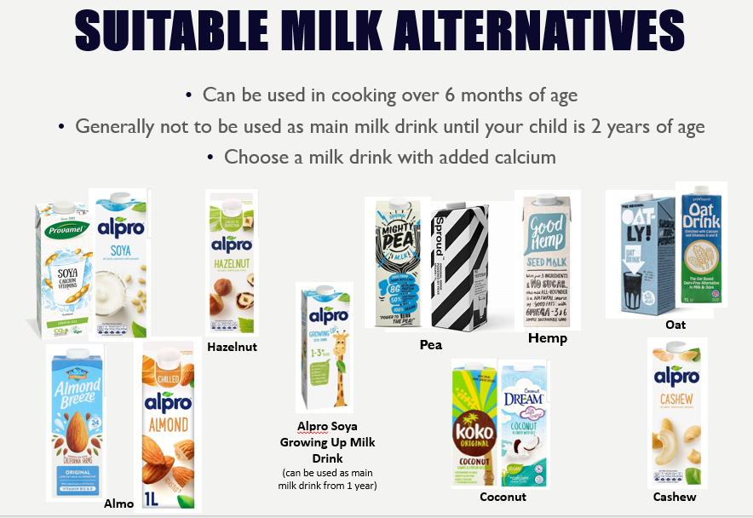


14+ M

Slide 20
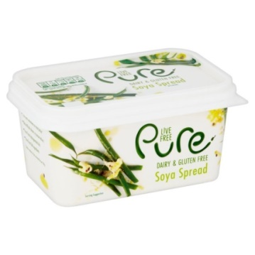
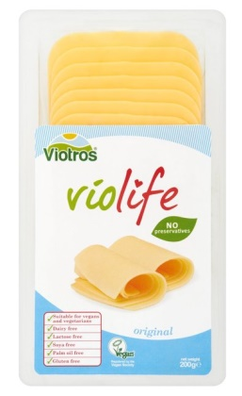
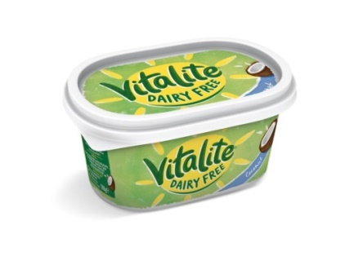
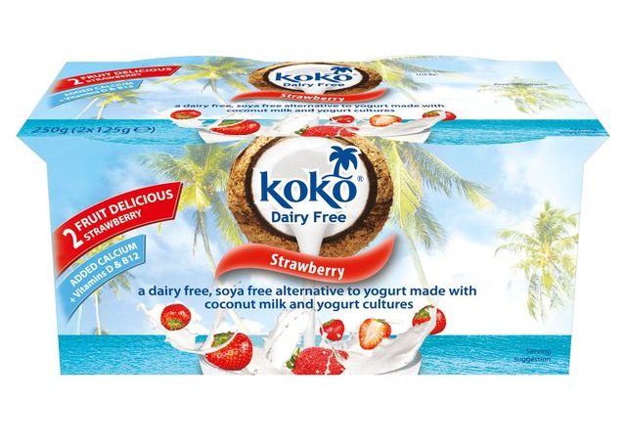
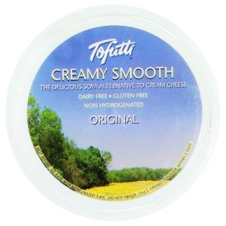
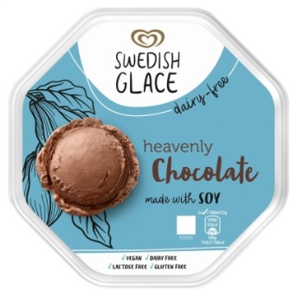

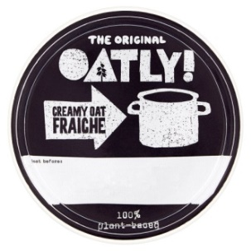
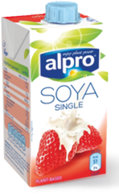
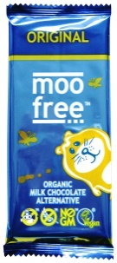
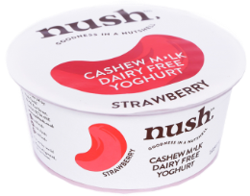
Other Cow’s Milk Free Alternative Products
Spreads
Cheese
Yoghurts & desserts
Ice creams & frozen desserts
Creams/Custards/Crème Fraiche
Chocolate
Notes:
Advise audience that they will have chance to look at some of these products at the end of the session
Spreads – Often made from vegetable oils. Examples of brands include Vitalite (pictured), Pure (pictured) , Flora Freedom, supermarkets own brand
Cheese – Made from a variety of foods but the most common are coconut oil & soya. Examples of brands include Tofutti (pictured), Violife (pictured), Cheezly, Wilmersburger, Sheese, Vegan Gourmet, supermarkets own ‘free from’ ranges. It is worth mentioning that these often don’t cook like cheese, so may be worth trying a few brands.
Yoghurts & desserts – Made from a variety of foods including coconut, cashew nuts, soya, almonds. Examples of brands include Nush (pictured), KoKo (pictured), Alpro, Coyo, Coconut Collaborative, supermarkets own brands
Ice creams & frozen desserts – Made from a variety of foods including soya, almonds and coconut milk/cream. Examples of brands include Swedish Glace (pictured), The Coconut Collaborative (pictured), Almond Dream, Booja Booja, Perfect World, Alpro, Jude’s.
Creams/custards/Crème Fraiche – Made mostly from soya & oat milk. Examples of brands include Oatly (pictured crème fraiche but also do cream & custard), Alpro (pictured single cream but also do custard), supermarkets own brand
Chocolate – Made from soya and rice powder. Examples of brands include Moo Free (pictured), Jo’s Organic, The Raw Chocolate company, Kinnerton, supermarkets own brand

Slide 21
Will My Child Grow Out Of Their Cow’s Milk Protein Allergy?
Some children with mild to moderate non-IgE mediated cow’s milk protein allergy will grow out of it by their first birthday
Most children will grow out of their allergy between 1 and 3 years of age
Some may take longer than this or may not grow out of it

Slide 22
Reintroducing Cow’s Milk Back Into The Diet
Milk (containing cow’s protein) can be reintroduced into the diet at 9-12 months of age OR 6 months after starting a cow’s milk free diet
Use the Milk Ladder
  Ensure your child is well before commencing
  Begin at step 1 and consume the amount of food suggested
  If the food is tolerated, continue giving your child this food and then try the next step and so on…
  If the food is not tolerated, stop and try again with this step in 8-12 weeks. Continue to keep any milk containing food that was tolerated in the diet
Notes:
Reintroducing milk back into a child’s diet is recommended because:
Evidence suggests that introducing baked milk into the diet may speed up tolerance
Improves quality of life for both your child and you as parents (shopping, parties, holidays)
No unnecessary dietary restrictions
If a child has not been on a cow’s milk free diet for 6 months when they reach 9 months of age, they should wait until 6 months on the diet has passed before reintroducing milk to the diet.
Signpost to copy of Milk Ladder and recipes for 1st 3 steps in information pack
Highlight that the back of the milk ladder explains the process
Highlight that symptoms may not be exactly the same as previous symptoms, e.g. infants that vomited previously, may not vomit but more subtle symptoms

Slide 23
Meeting Calcium Requirements
Important to ensure that your child is receiving enough calcium when following a cow’s milk protein free diet
Breastfeeding mums who are following a cow’s milk protein free diet may need a calcium supplement
Calcium requirements change with age
Use foods fortified with calcium to help meet requirements, e.g. cow’s milk protein alternatives
Notes:
Calcium requirements can usually be met by the diet, however, a calcium supplement can be taken if not.
Signpost towards Calcium BDA Food Fact Sheet or alternative diet sheet in information pack
Breastfeeding mums – if drinking more than 1 pint of calcium fortified cow’s milk alternative per day, likely to be meeting requirements
Daily calcium requirements decreases when a child turns 1
Inform audience that there is an activity later on in the session on ‘Calcium content of foods’
When drinking oat milk, shake the container well as the calcium settles at the bottom
Pasta and rice can be boiled in calcium fortified alternative milks to increase the calcium content of the diet, however, sweetened milks shouldn’t be used as they will caramelise

Slide 24
How much calcium?
Age | Calcium (mg per day)
0-12 months | 525mg
1-3 years | 350mg
4-6 years | 450mg
7-10 years | 550mg
11-18 year | 800mg (girls) 1000mg (boys)
Breastfeeding mums | 1250mg

Slide 25



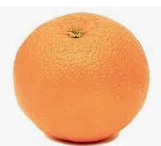


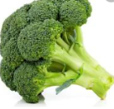
How to meet 350mg calcium
100ml fortified plant milk
50mg tofu
½ slice of bread
4 tsb of soya yogurt
3tbsp (12g) ready oats
100ml fortified plant milk
85g broccoli
1 large orange
200ml fortified plant based milk

Slide 26
Vitamins for Children
The government recommends:
ALL children aged 6 months to 5 years are given vitamin supplements containing vitamins A, C & D
Babies who are breastfed are given a daily vitamin D supplement from birth
Babies who are formula fed, who are getting more than 500ml (about a pint) of formula per day do not need extra vitamins
Notes:
Talk to your pharmacist about suitable supplements for your child. Remember to ask them for a cow’s milk protein free supplement.
Do not give your child more than one supplement at a time as having too much of some vitamins can be harmful. For example, do not give cod liver oil and vitamin drops as cod liver oil contains vitamin A & D.
Once your child has less than 500ml formula per day, introduce a vitamin supplement

Slide 27




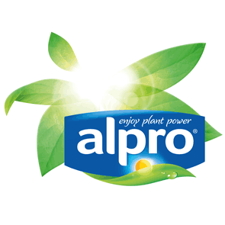
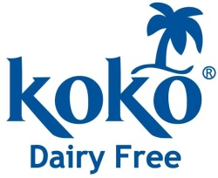



Useful Links
For support
Allergy UK www.allergyuk.org
NHS Choices www.nhs.uk
British Dietetic Association www.bda.org.uk
For recipes (cooking with cow’s milk free alternatives)
www.oatly.com
www.alpro.com
www.kokodairyfree.com
www.provamel.com
www.tofutti.com
www.violifefoods.com
Notes:
May like to include a slide of local shops and what they stock as parents like to know where they can get the products

Slide 28
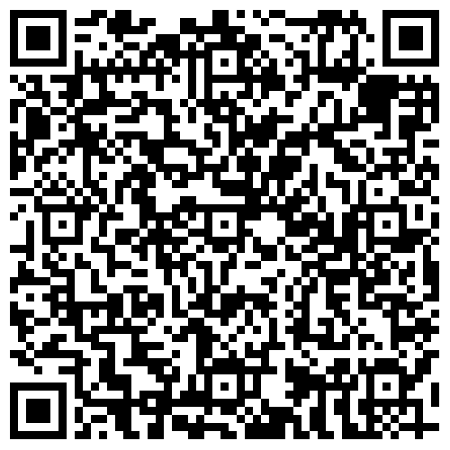
Resources and Support
Scan here to take you to
our self-help library of resources!
https://www.gloshospitals.nhs.uk/our-services/services-we-offer/nutrition-dietetics/self-help-resource-library/
https://patientwebinars.co.uk/condition/food-allergy-in-children/
https://www.gloshospitals.nhs.uk/our-services/services-we-offer/nutrition-dietetics/paediatric-dietitian-resources/
https://www.rosan-paediatricdietitian.com/webinars/

Slide 29
Breastfeeding support
Local NHS Breastfeeding support service (details in your baby’s red book) - a good first stop.
2. Breastfeeding support telephone lines:
National Breastfeeding Helpline – 0300 100 0212.
Association of Breastfeeding Mothers – 0300 330 5453.
National Childbirth Trust (NCT) – 0300 330 0700.
3. La Leche League (0345 120 2918) provides very useful information on breastfeeding on their website, you can find a local group that may be able to also support you. www.laleche.org.uk
4. The Breastfeeding Network provides support for breastfeeding and have drop in centres and provide telephone support.
https://www.breastfeedingnetwork.org.uk/breastfeeding-support/

Slide 30
Breastfeeding support
5. Breastfeeding support group for children with cow’s milk allergy:
https://www.facebook.com/groupsCMPASforBreastFeeding/
6. The NHS also has support websites:
https://www.nhs.uk/conditions/pregnancy-and-baby/benefits-breastfeeding/
https://www.nhs.uk/conditions/pregnancy-and-baby/problems-breastfeeding/
7. GPs can access information on www.gpifn.org.uk to support you through your breastfeeding journey.
8. First Steps Nutrition - https://www.firststepsnutrition.org/eating-well-infants-new-mums
9. Start4Life Breastfeeding Friend – an NHS supported Facebook group that offers advice day or night.

Slide 31

Thank you for listening
That was A LOT of information
Any questions?
If you are concerned that your child has multiple allergies or losing weight you can opt in for a 1:1 appointment by calling the dietitians on 0300 422 5506.

