Slide 1


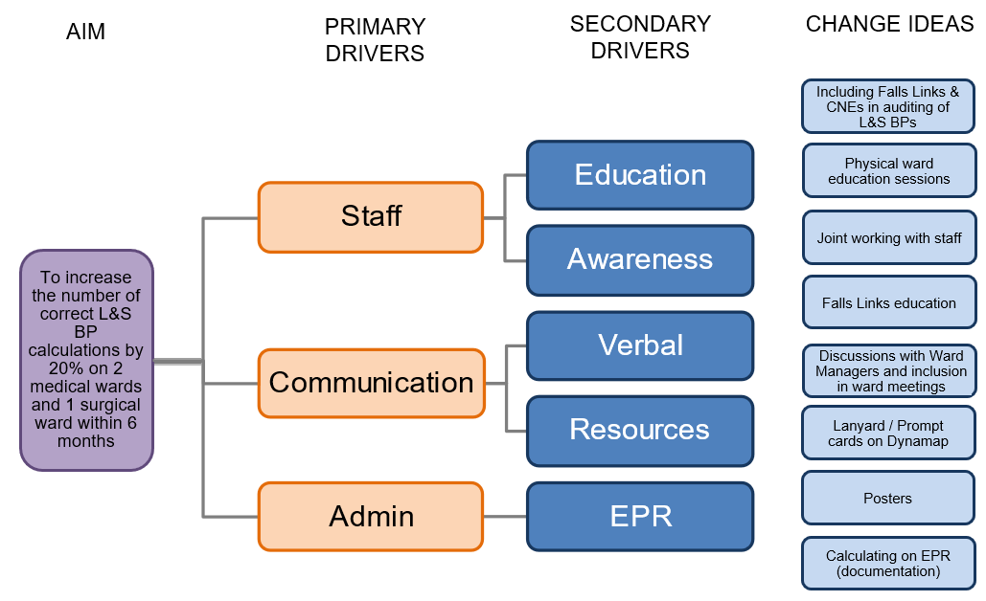
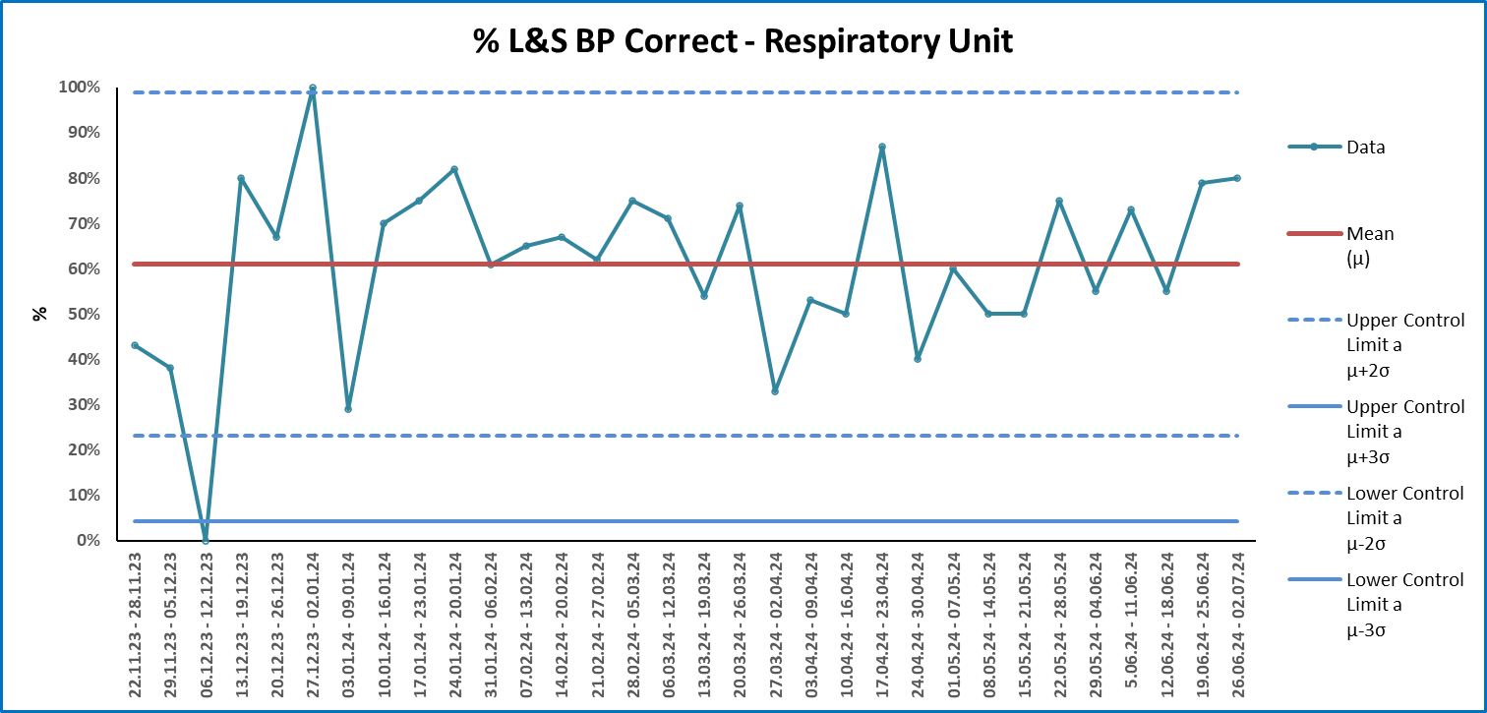
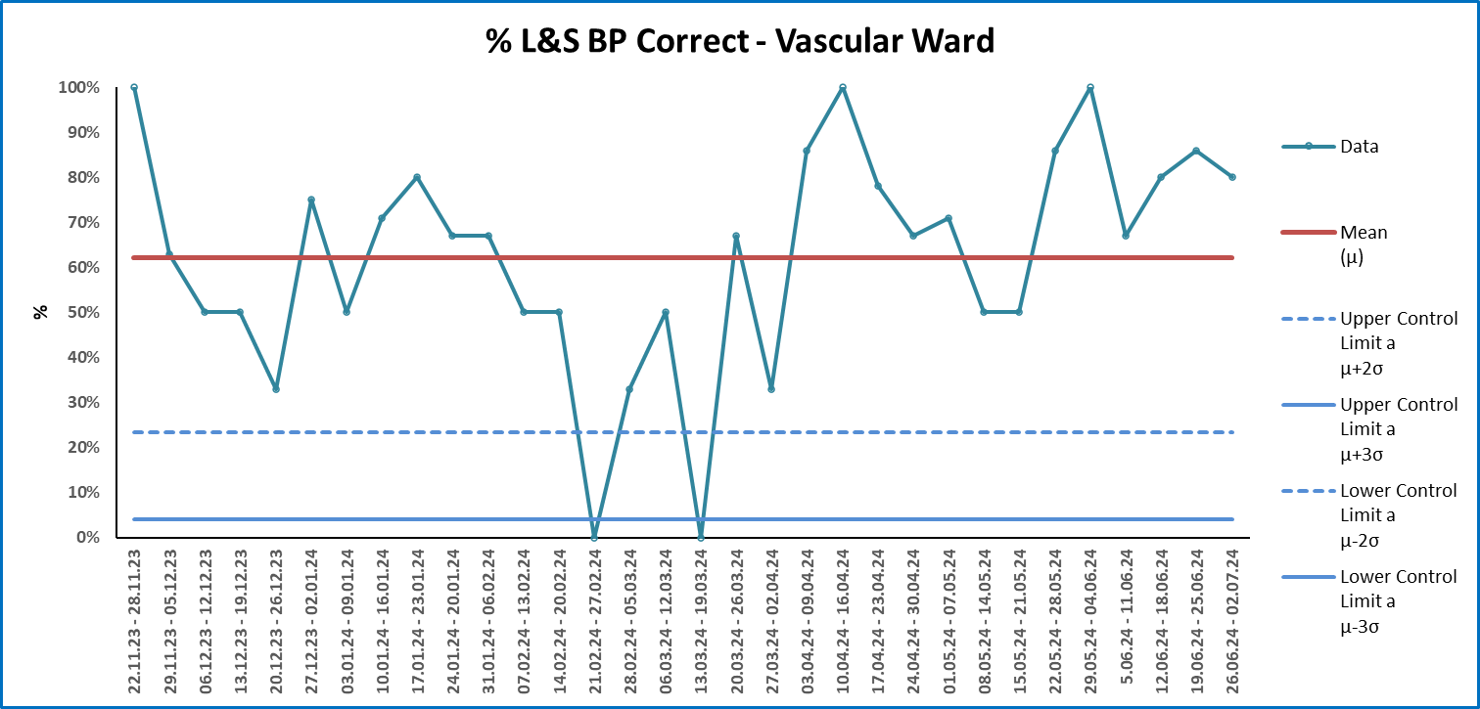
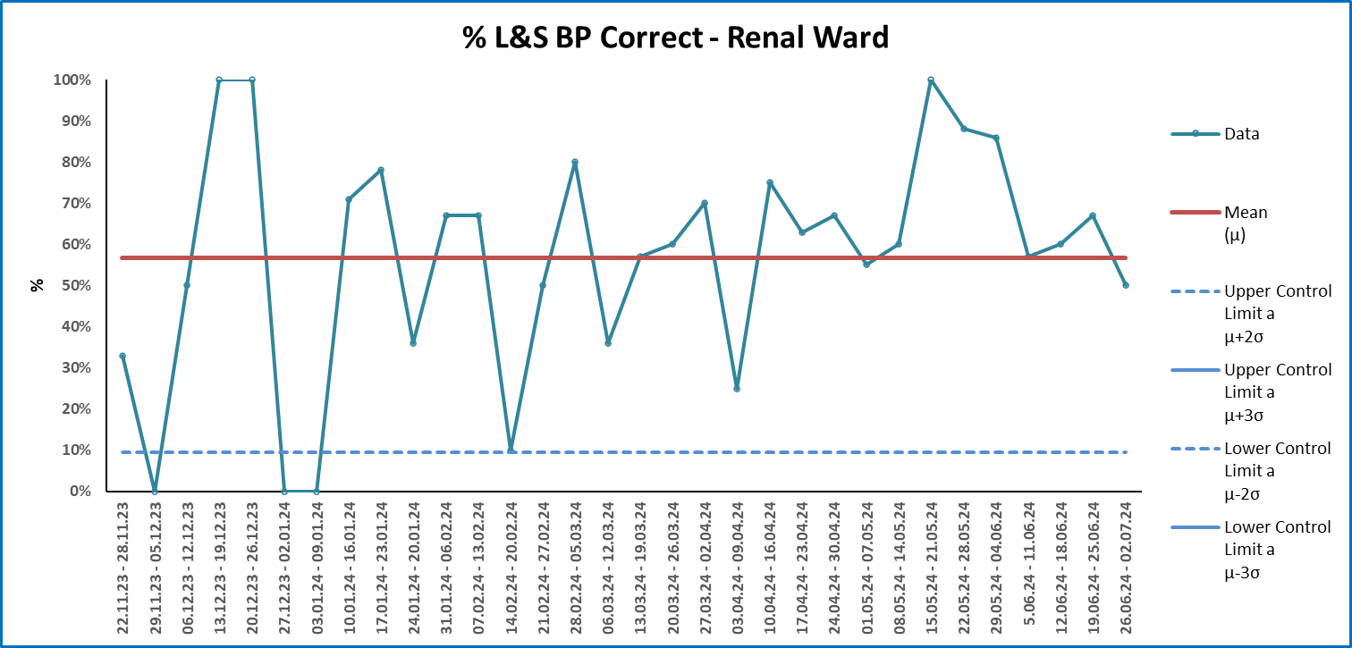
Gloucestershire Safety and Quality Improvement Academy 2024
Improving Lying & Standing Blood Pressure (L&S BP) calculations
Falls Prevention Team – Nadine Jordan (Falls Specialist Nurse)
& Brianna Grimsell (Falls Prevention Practitioner/Physio)
Ward Teams from 4b, Respiratory Unit and 7b
Background
A L&S BP is the assessment used to identify Orthostatic Hypotension (OH); a drop in blood pressure of 20mmHg systolic and/or 10mmHg from a lying to standing position within 3 minutes. Symptoms include light-headedness and blurring of vision, which can lead to syncope and falls.
The National Audit of Inpatient Falls (NAIF, 2023) report found that only 39% of patients who sustained a hip fracture from an inpatient fall had a L&S BP taken prior to the incident (NAIF, 2023). NAIF recommended targeted improvement projects focused on L&S BP measurements to help address this (NAIF, 2023).
Aim
To increase the average number of correct L&S BP calculations by 20% on 2 medical wards and 1 surgical ward within six months.
Challenges & Limitations
L&S BPs were often not being completed – multiple reasons why
The prompt cards were not distributed effectively on the wards – on one ward, they were not put out at all
The ward based session often cancelled due to clinical escalation demands – not all staff received the education
Due to the Falls Team capacity, data was only able to be collected on a weekly basis – some L&S BPs will have been missed
PDSA cycles
Prompt cards on how to calculate a L&S BP and what signifies a drop put in all bays on the ward
Education session provided to staff (By Falls Links & CNEs on Vascular & Respiratory on the ward and by the Falls Team on Renal away days)
Outcomes
The average number of correct L&S BP calculations did not increase by 20% on any of the wards involved
The most improvement was seen in PDSA cycle 2 (education sessions)
There was a shift of 7 points above the mean on the Renal ward following the education being provided by the Falls Team on away days
Though there was no significant improvement in correct calculations, the project did support education being a key intervention. It also indicates that the way in which education is delivered is likely to be important in how successful a change in practice is. This could include a safe learning environment and the background of the facilitators.
For the future
Consider ways of improving the completion of L&S BPs
Explore the impact of education delivery and how this could help facilitate further learning, both in relation to L&S BP calculations and other education across the Trust
Continue covering Orthostatic Hypotension as part of the monthly Falls Prevention training sessions
#TheGSQIAWay

