Slide 1


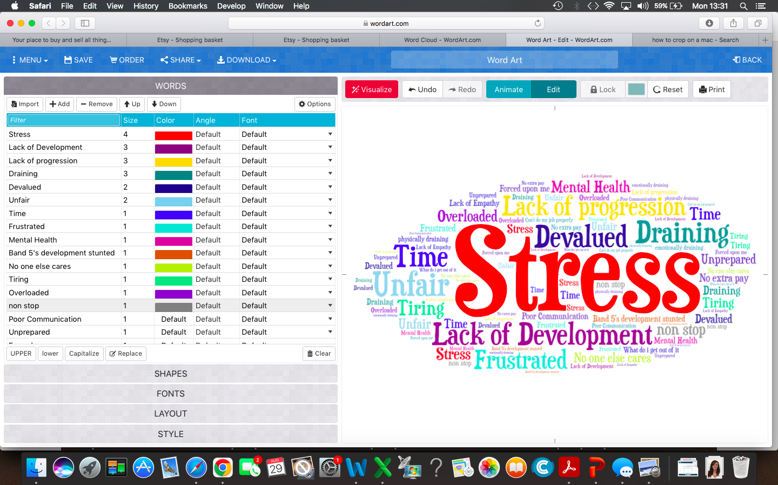
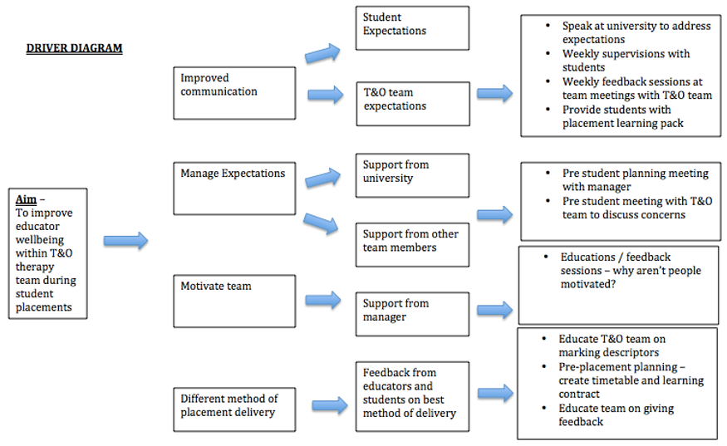
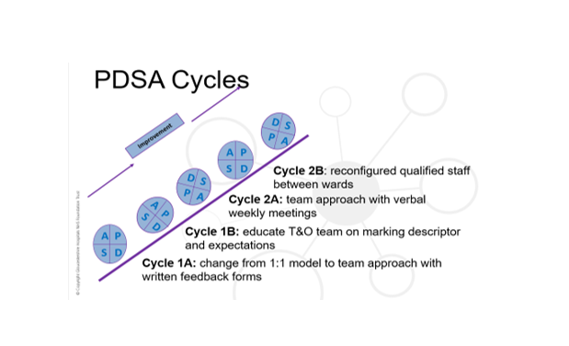
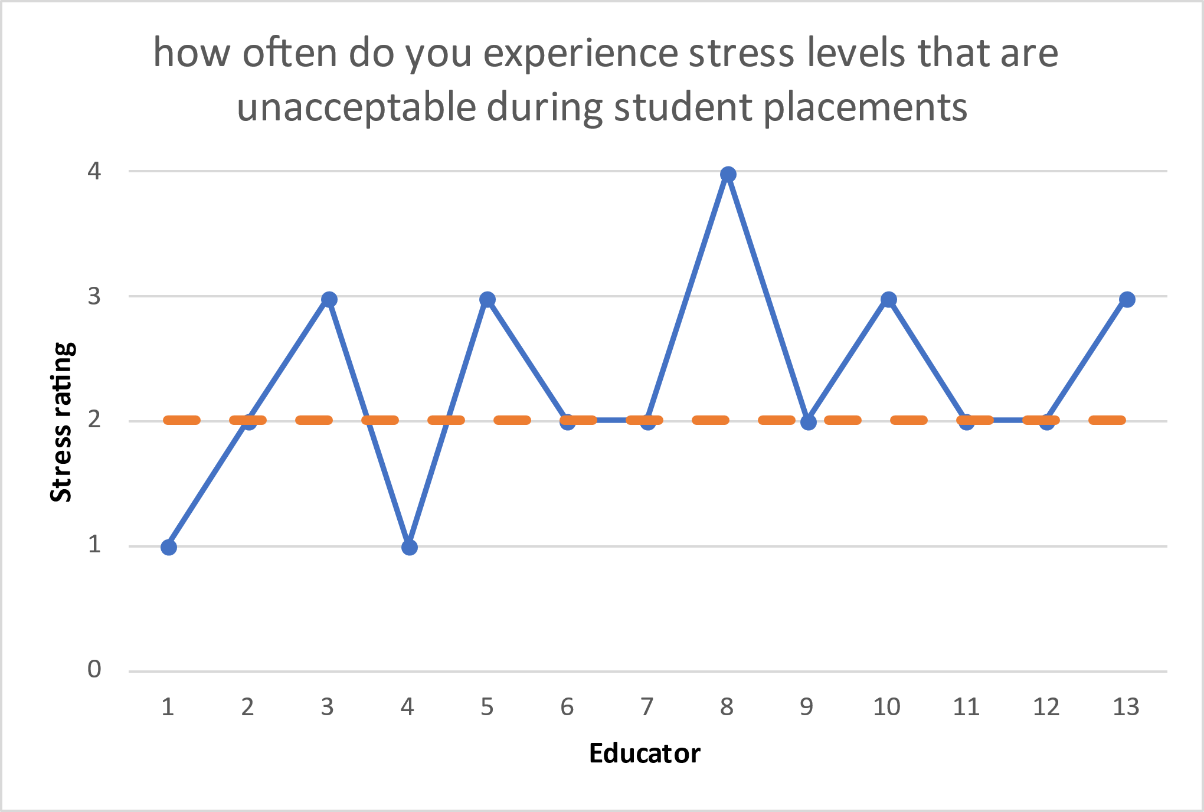
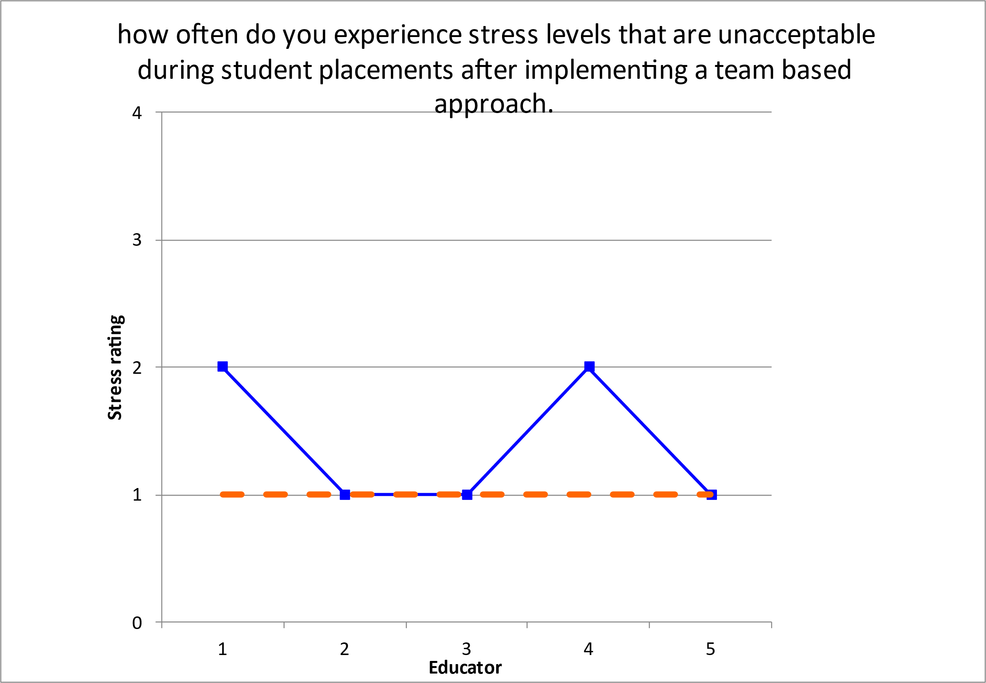
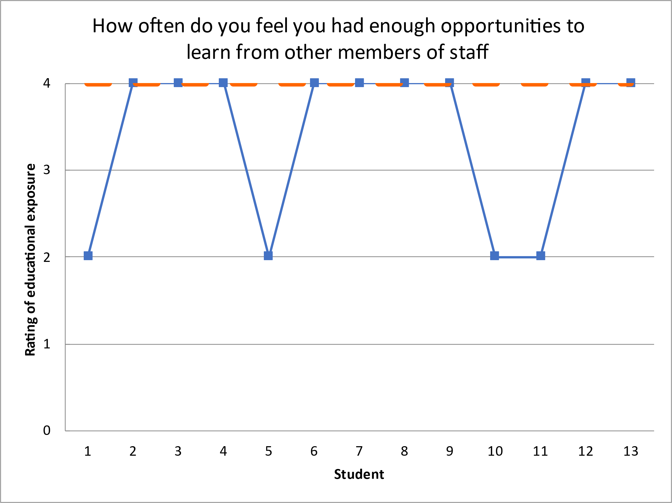
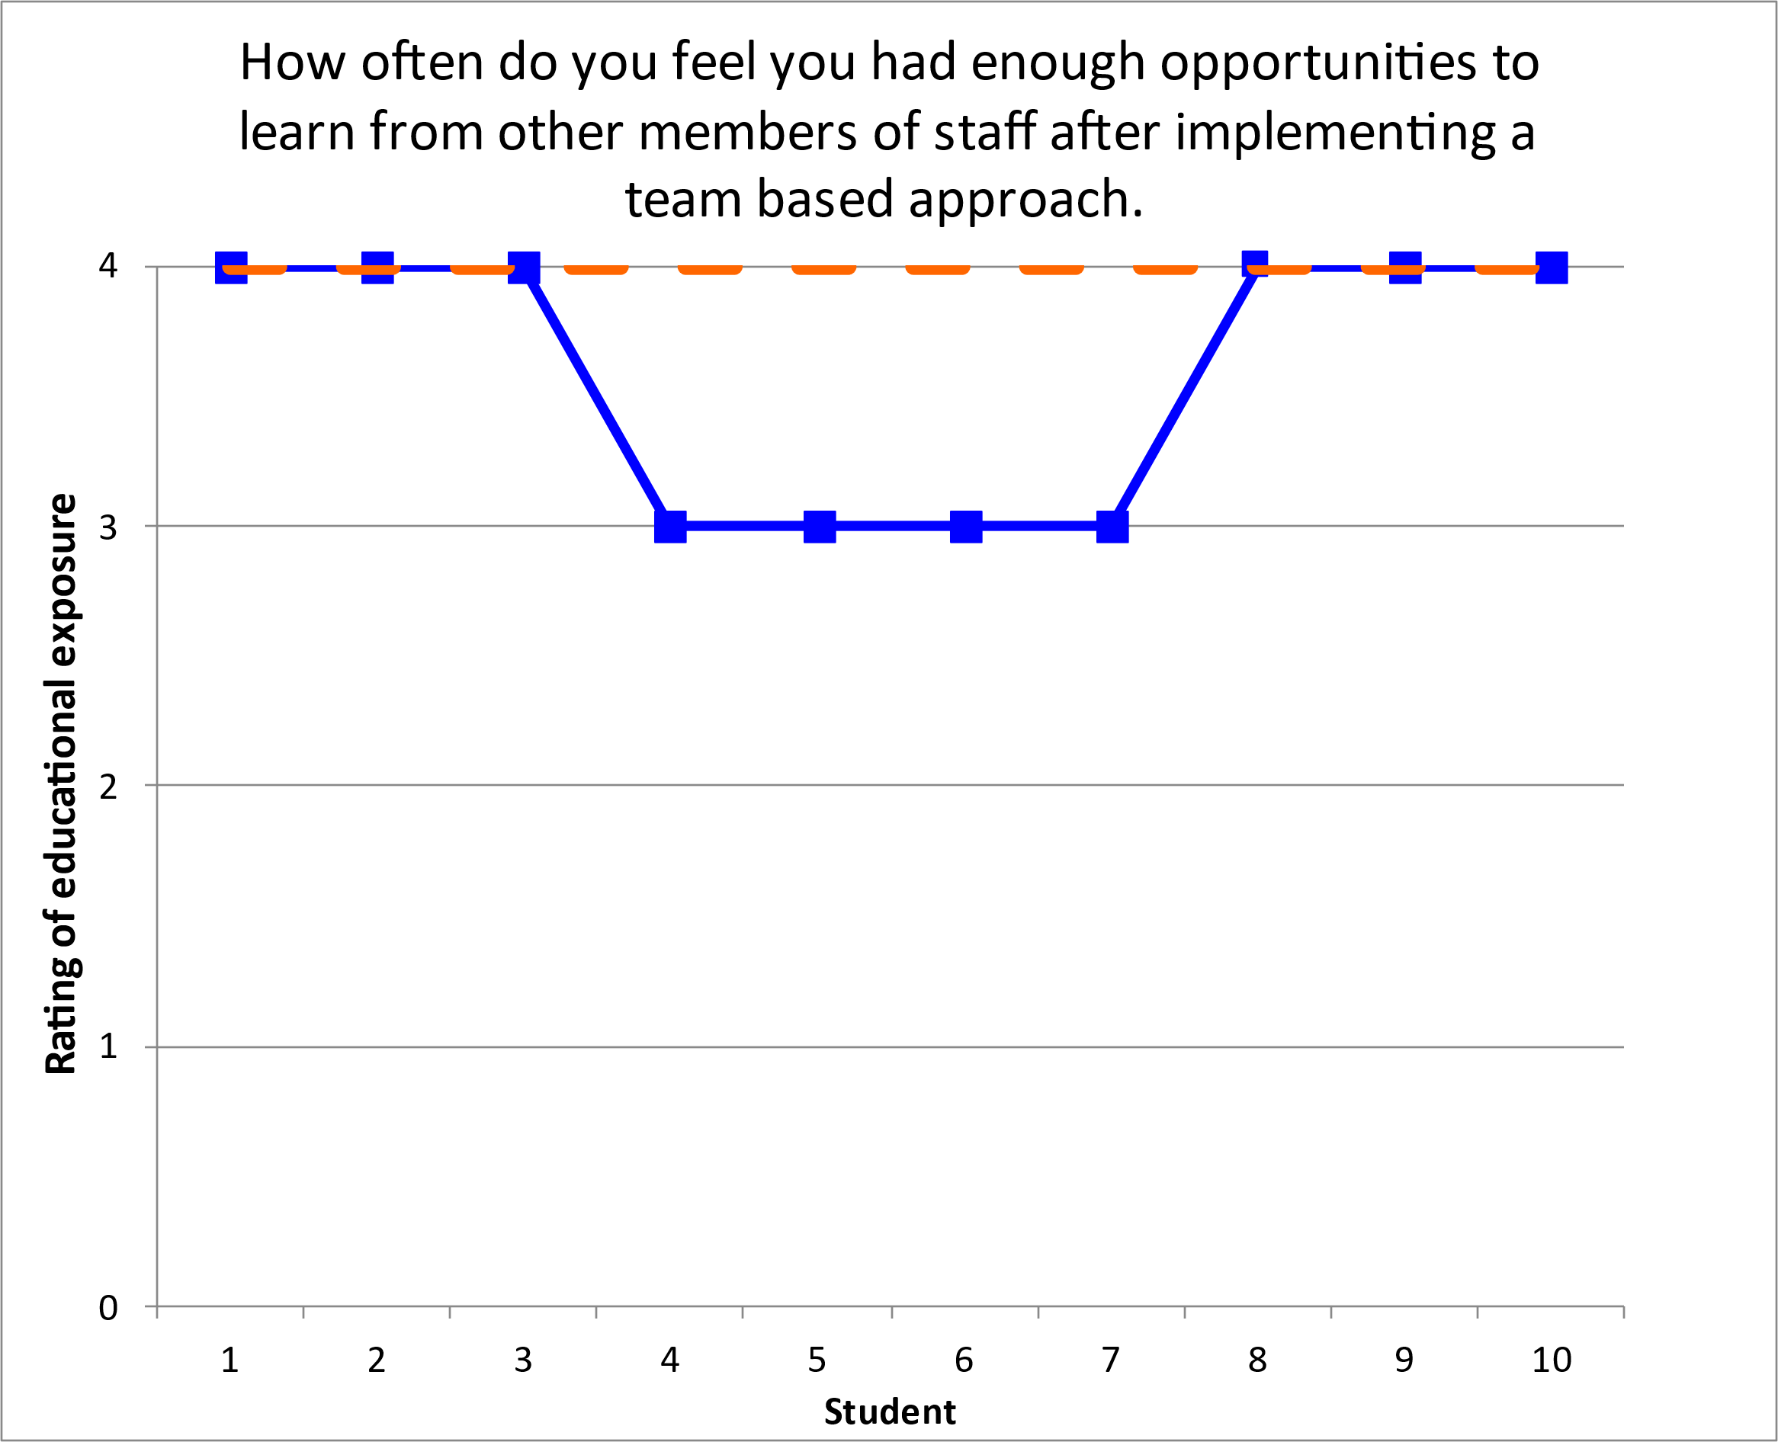
Gloucestershire Safety and Quality Improvement Academy 2023 - 2024
Improving educator wellbeing within T&O therapy during Student Placements
Team Lead: Ani Pillai
Team Participants: Terry Flemons, T&O therapy team, Carol McIndoe, Therapy R&D team
Introduction
As part of HCPC’s standards of proficiency, all registered physiotherapists and occupational therapists have a responsibility to contribute towards student education.
Traditionally, students follow a 1:1 approach, with the educator taking responsibility for all clinical time, conducting supervision, training and paperwork.
Due to an increase in student numbers, there has been a 91% increase in student placements at GHNHSFT since 2019, resulting in an increase in stress within educators who also attempt to maintain their personal CPD and fulfil existing job responsibilities. If continued, this intensifies the risk of staff burnout, reduced job satisfaction and potential increased staff turnover.
Aim:
The Trauma & Orthopaedic (T&O) therapy team has seen a rapid increase in student numbers since 2019, from having 4 students per year to 10 students.
Within the T&O leadership team, we identified that these numbers are set to further increase and therefore the traditional 1:1 approach was not sustainable, having a significant impact on both staff and students.
The aim was to improve T&O educator wellbeing within therapy by 50% within 1 year, by trialling other student education models.
Method
Questionnaires were sent out to appropriate cohorts to gain baseline data, including; all therapy educators within GHNHSFT, T&O therapy team and current students on placement within GHNHSFT.
The T&O therapy team then trialled changing to the team approach, where the main educator conducts their supervision, midway and final appraisals but training and clinical time is spent with all different members of the team, providing the student with a true representation of a qualified practitioner and providing students with a more varied learning environment.
Multiple PDSA cycles were completed, and method slightly adapted over the course of 18 months.
Post change questionnaires were sent out to students who took part in the new model, T&O therapy team and T&O educators.
Results
During Baseline data collection, 85% of educators said they were stressed, 40% of which said they are often or always stressed.
Post-change data showed a reduction in educator stress levels, with 40% stating they felt stressed during student placements.
This concludes a 50% reduction in educator stress levels during student placements.
Other figures to note were, there was no increase in stress seen in the T&O therapy team as a result of the change, alongside an increase in rating of learning opportunities for students which is our secondary driver for this study.
Discussion
Overall, the team based approach was beneficial to the T&O therapy team and proved to be a more sustainable approach.
There are many variables which need to be considered, including the timing the questionnaires were sent out to students, whether they were given before or after placement evaluations, and which individual requested the feedback.
The methods used will continually be reviewed and adapted accordingly. However, it is clear from this quality improvement project that adopting this new placement model could increase our student capacity but not at the detriment of educator wellbeing, as well as improving the quality of education.
There is the potential to roll out this new approach to the wider therapy team.
#TheGSQIAWay

