Slide 1


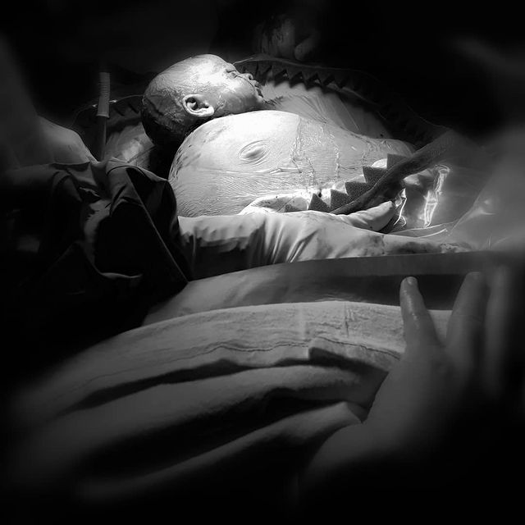
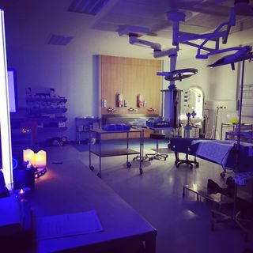
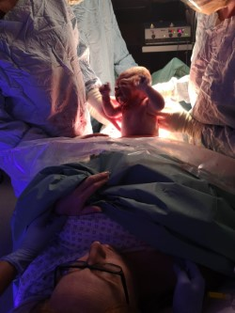

Gloucestershire Safety and Quality Improvement Academy 2023 - 2024
#mycaesarean
Charlotte Harford, Georgia Smith, Maggie Arlidge
Problem Statement:
It was identified that 80% patients who underwent elective caesarean sections were not given any choice regarding the experience of their birth
Method:
We carried out a preliminary survey of patients’ wishes to provide further credibility to the vision. We then performed an evaluation of the current practice in place and found that no women were made aware of an available choice regarding their birth.
We implemented #mycaesarean in December 2020 which is a bespoke service designed to provide women who are already booked for an elective caesarean section the option to shape their experience. Patients are given a leaflet and checklist to allow women to choose certain aspects to be included in their birth, these include: low lighting, LED candles, their own playlists, aromatherapy, lowering of the surgical drapes, time allowed for baby to be born, optimal clamping of the cord and immediate skin-to-skin.
Aim:
The aim is to ensure that 100% of patients having an elective caesarean section are given the choice of what they want for their birth.
Aim | Primary Drivers | Secondary Drivers | Change Ideas
The aim is that 100% of patients having an elective caesarean section are given a choice of what they want for their birth within 3 months of the start of the project | Environment | Lighting | Mood Lighting
 |  |  | Ambient lighting
 |  | Music | Creating Music playlist
 |  |  | Bluetooth docking station
 |  | Safe space | Quiet and calmness in theatre
 | Communication | Staff | Understanding why the change is needed
 |  |  | Limit ‘conversations’ in theatre
 |  | Patients | Communicate the patient’s choice during the morning WHO.
 | Patient Experience | Choice | Understanding of choices available
 |  | Documentation | Create pre-op birth plan checklist
 |  | Risk | Discussion with patient’s consultant re: risks/benefits
 | Knowledge and Understanding | Training | Creating action card for elective caesarean sections
 |  |  | Staff training sessions for ‘natural’ caesarean sections
 |  | Patients | Ensure patients are given accurate information
PDSA Cycle
Baseline audit of patient experience completed
Identified need for patients to be given more choice
Implemented #mycaesarean
100% of patients felt they were offered choice in their birth
#mycaesarean is implemented within the unit as standard practice for all elective caesarean sections.
Results
100% of patients surveyed felt that they were given birth choice for their elective caesarean section and 100% felt they were offered excellent choice in their birth.
Now in 2023 patients continue to feedback that they have choice, feel listened to and have positive experiences when having an elective caesarean section.
Lessons Learnt
Continual training for staff about the project is vital as there is a high change over of teams, and as this is not standard practice in other units, it’s pivotal to the project that we continue to train the staff.
We would love to do a national survey and implement the project nationally.
What’s happened since….
#mycaeasarean article has been published in the AIMS journal: Smith,G et al 2021 AIMS Journal, 2021, Vol 33, No 3
#mycaesarean was implemented in December 2020 and has become the ‘new normal’ at GRH
#TheGSQIAWay

