Slide 1


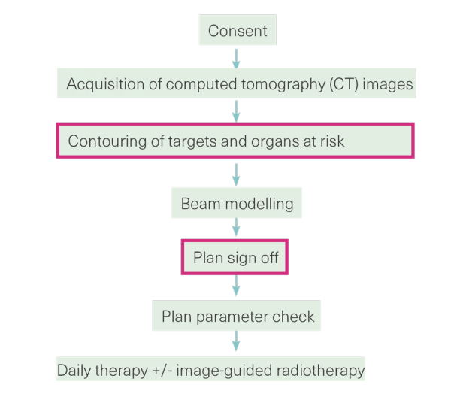
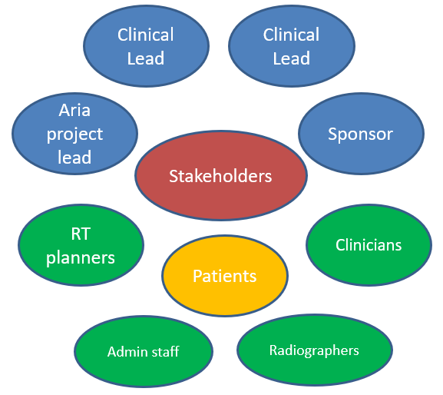
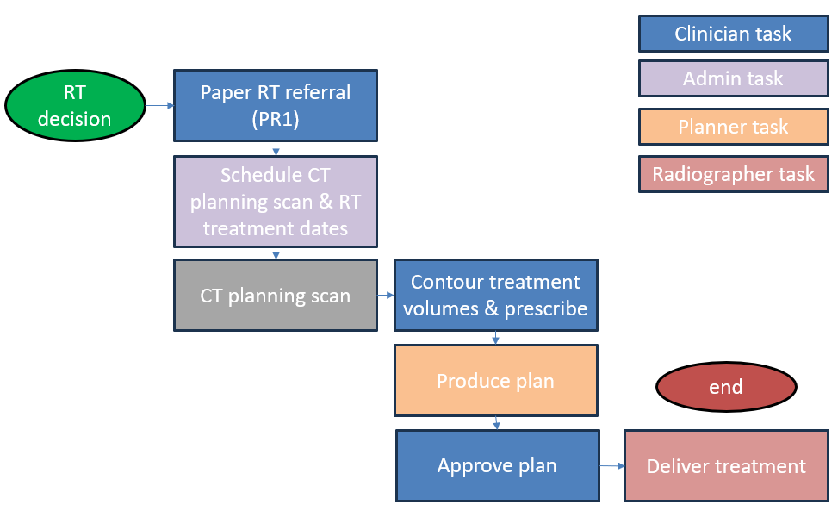



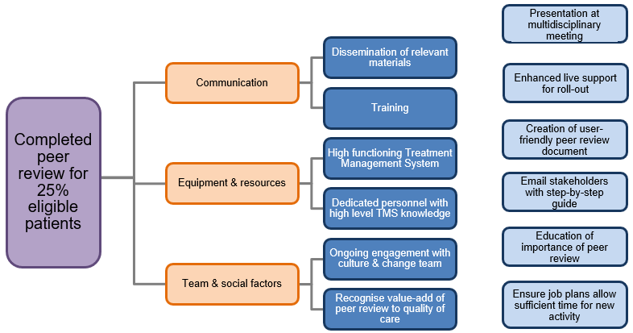


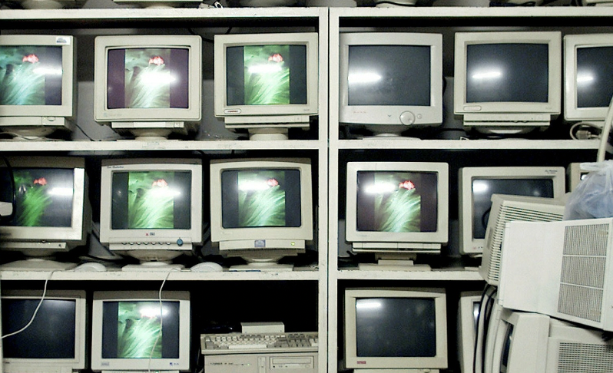

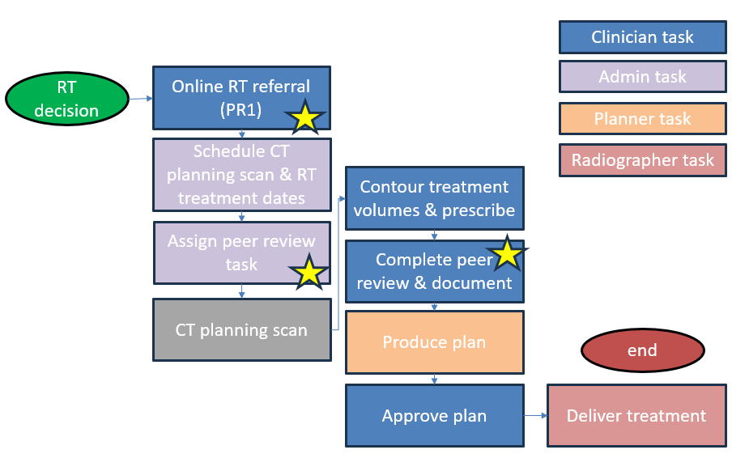
Gloucestershire Safety and Quality Improvement Academy
Peer review project
Dr Yasmin Odding
Improvement Aim
A completed peer review record for 25% of eligible patients in 6 months
Background to project
Approximately 50% of patients with cancer will receive radiotherapy through their cancer journey
Peer review: Royal College of Radiologists recommendations
- All ‘individualised’ radiotherapy contours to be reviewed by more than one Clinical Oncologist
- Departments should have clearly defined and systematic process
- IT infrastructure should allow prospective documentation with standardised and auditable peer review document
Status in Cheltenham Oncology Centre April 2023
- Peer review ‘conversations’ varied significantly between tumour sites
- No standard documentation existed on Treatment Planning System
Improvement Team & Stakeholders
Radiotherapy Workflow
boxes highlighted: Human processes traditionally completed by a single Clinical Oncologist involving complex decision making with potential for bias and judgement error
Outcome Measure: (stratified by tumour site)
the proportion of eligible patients who have completed peer review records vs proportion of eligible patients who don’t have completed peer review record
Process measure: One process with real-time documentation so challenging to break down
Balancing measure: Time implications with regards to patient pathway of implementation of peer review
Process Mapping
PDSA 1: June 2023
Discussion with colleagues, designed peer review form.
Uploaded form, lunchtime education session
Reviewed results
This plan of action abandoned
PDSA 2: September 2023
Met with ODN RT, attended RCR Attended RCR training ‘Barriers to implementing peer review’, broader sit down meetings with stakeholders
Creation of new peer review form and process, pilot with small group
‘Go live’ planned for Jan 2024
Potential stumbling blocks
Driver Diagram
Process Mapping - updated
Future Plans
- ‘Go live’ planned January 2024 to coincide with radiotherapy referral form
- Data collection – quantitative using 3 monthly time points
- Standardise reporting and peer review data collection across south-west network
- Audit compliant with Royal College of Radiologists guidelines
References:
- Radiotherapy dose fractionation (third edition), 2019. Royal College Radiologists website
- Radiotherapy target volume definition and peer review (second edition), 2022. Royal College Radiologists website
#TheGSQIAWay

