Slide 1
Gloucestershire Safety &
Quality Improvement Academy
Quality Improvement Initiative Title Presenter Name (s)

Slide 2
Notes (delete this slide)
- the headings are just prompts for the key information to be included in your presentation, whether you have more or less slides, is up to you
- you will be presenting to a mixed audience so ensure your information is clear and technical terms are explained
- make sure you can keep your presentation to 6 minutes max, as you will be prompted to finish on time
- ensure there is no patient identifiable information included in any data that you present

Slide 3
The Safety Concern
What is the problem your QI is trying to solve, and why is it important?

Slide 4
The Aim
What is your aim statement - make sure it is SMART

Slide 5
The QI team
Include key team members or areas represented. If you have lots you can group them – you don’t need to do a full roll call

Slide 6
Driver Diagram
Briefly talk about your drivers and selected change ideas

Slide 7
Measures
Outcome
Process
Balancing

Slide 8
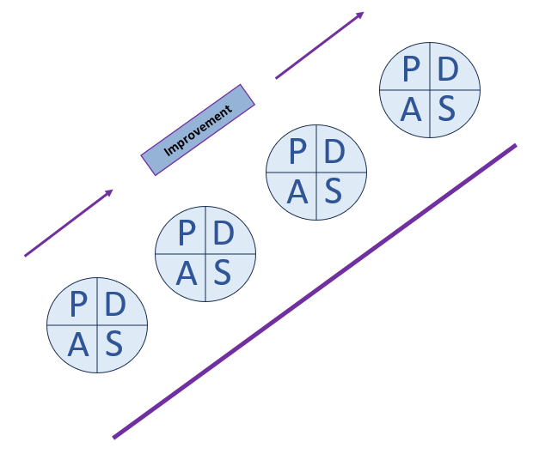
PDSA cycles
Cycle 1A – add description
Cycle 1B – add description
Cycle 2A – add description
Cycle 2B – add description
Cycle 3A – add description

Slide 9
Measurements & Key Results
Present your data to demonstrate what you have learnt and whether your changes have resulted in improvement
Don’t forget run/control charts and marking where test cycles have taken place
Summarise your findings – what conclusion have you been able to draw?

Slide 10
Next Steps
Briefly mention any planned stages of work that are still to be completed
Think about opportunities to spread your improvement to other areas of the Trust.

