Slide 1
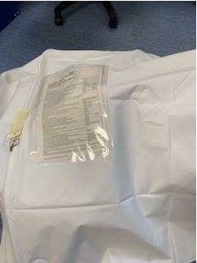
Care After Death A Guide

Slide 2
Care After Death (formerly last offices)
What’s new …
Nose and mouth no longer packed.
Ankles no longer held together by bandage.
Arms no longer secured against body with bandage.
Do not shave patients –shaving patients while still warm can cause bruising and marking that will only appear days later.
Check nose and toes are pointing upwards when sealing the bag- To ensure correct position when taken to the mortuary.

Slide 3
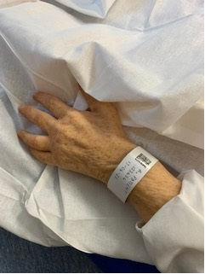
Checklist
Has the death been verified?
Notify bereavement office as soon as patient has died.
Tissue donation pathway completed.
Hospital name/ID bracelet checked for accuracy,
is readable and left on the patient.

Slide 4
Implantable cardiac devices.
Implantable cardiac device in situ?
If patient has a defibrillator (ICD or CRT-D) how has it been deactivated?
Deactivated by cardiac investigation lab.
Deactivation document to accompany patient to the mortuary.
OR
Temporary deactivation by application of magnet over device.

Slide 5
Faith requirements
Does the patient have a practicing faith or religion that requires adherence to?
This is of particular importance within Jewish and Muslim faith, but not exclusively.
If so, please also follow the process for preparing patients of different faiths, found on intranet page “Different Faiths” Different Faiths

Slide 6
Jewellery and property
Jewellery removed (must be recorded in the property book).
Jewellery left on patient (at relatives request) and has been recorded in the property book.
Patient’s property listed in property book.

Slide 7
Washing
Wash patient with soap and water.
Do not shave patients as this causes skin marking.
Patients own teeth or dentures cleaned and placed in mouth.
(If dentures cannot be placed in the mouth they should be cleaned and placed in a denture pot and placed in the cadaver bag with the patient).
Hair brushed.
If stoma in place apply clean bag.

Slide 8
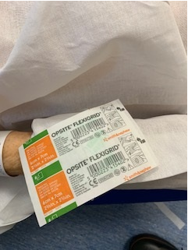
Wounds
Cover any wounds with an occlusive dressing.

Slide 9
PVC’s and SC lines
Are there any lines or catheters left in?
If yes, cover lines with an occlusive dressing
Please ensure you are clear on the checklist as to the location & description of the nature of line(s)

Slide 10
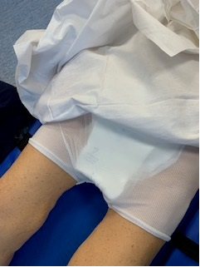
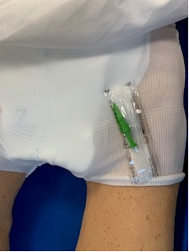
Bladder
Bladder drained – apply gentle pressure to abdomen.
Apply Pad and pants- contains any leakages and maintains patients privacy and dignity.
If patient has a urinary catheter, remove drainage bag and spigot end of catheter.

Slide 11
Suction
Use yanker sucker to clear oral cavity of any secretions.
No longer packing nose and mouth.

Slide 12
Dress
Patient dressed in shroud.
In exceptional circumstances, wearing of own clothes is permissible, but family to be made aware that spoiling of clothes may occur.

Slide 13
Position
Patient placed in appropriately sized cadaver bag.
Bariatric bags should not be used unless required for
the size of the patient.
Patient placed flat on their back, arms by side and feet together.
(Bandages to ankles and elbows no longer required).
If this is not possible please inform porters and mortuary staff.

Slide 14
Suction
After placing patient in cadaver bag check for further secretions.
Use yanker to clear oral cavity again if required.
If cannot be placed on back, place an inco sheet under head, to absorb possible, further leakage.

Slide 15
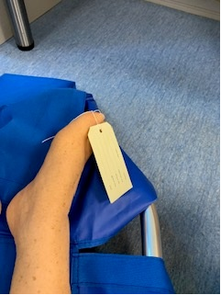
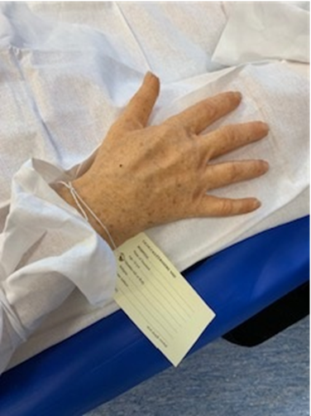
Care After Death
Two identification labels (completed both sides) attached to the patient:
1. Big toe.
2. Wrist.

Slide 16
Prosthesis
Prosthesis to accompany patient e.g. false leg etc.
If yes, prosthesis placed inside the cadaver bag with the patient.

Slide 17
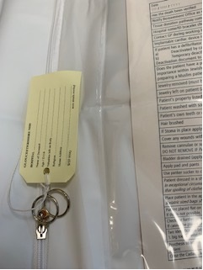
Close cadaver bag
Close the cadaver bag.
Secure the zip with the third identification label (both sides completed).

Slide 18
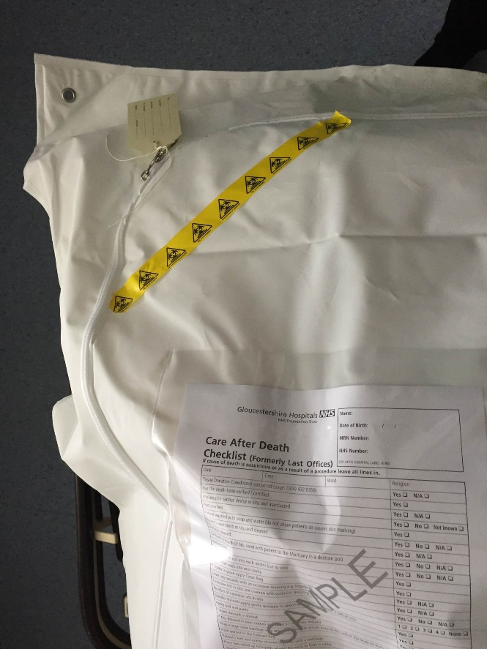
Infection
Does the patient have an infection?
If yes what is the infection………
Place 5cm of biohazard tape across the top corner of the cadaver bag where visible.

Slide 19
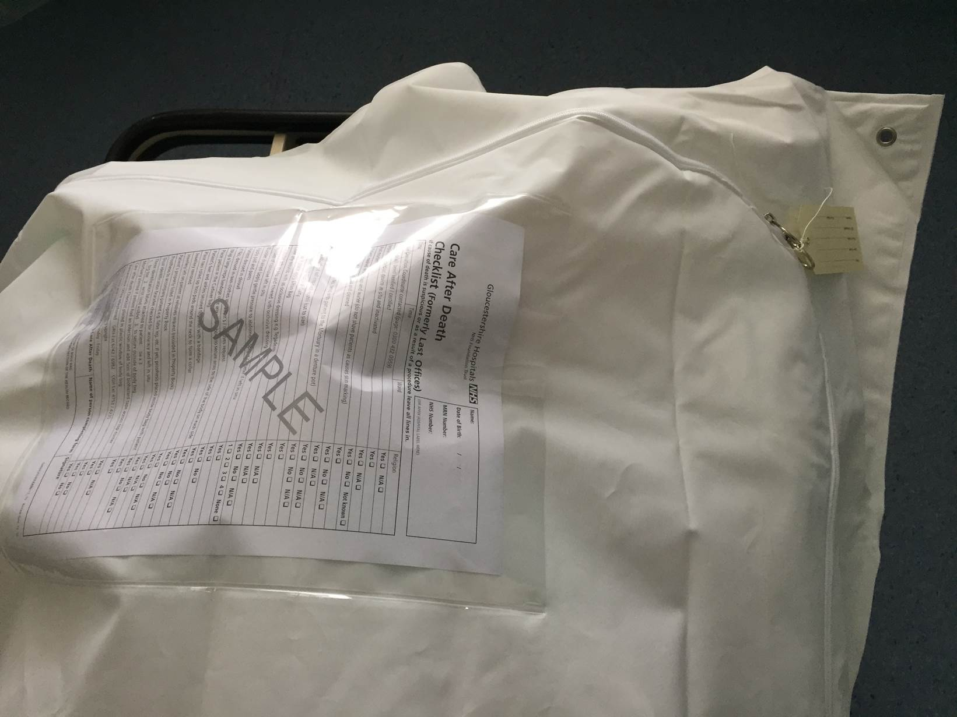
Care After Death
White copy of the Care after death Checklist to be added to the plastic window of cadaver bag.
Duplicate copy of checklist to be filed in notes.

Slide 20
Ready for transport to the mortuary
Carefully fold excess of the cadaver bag under the patient.
The bag will have straps placed at the ankles and elbows by the porters once in the mortuary.
Porters will apply a neck rest in the mortuary.

Slide 21
Tissue Donation
Check the organ Donor Register (ORD) by contacting 0117 9758080
Discuss with family - it could be life enhancing for others.
If family would like to proceed refer the patient to National Referral Centre on 0800 4320559.
Explain to the relatives that they will receive a phone call within 24hrs to gain their consent and ask further questions.
Give the family a tissue donation leaflet.

