Slide 1
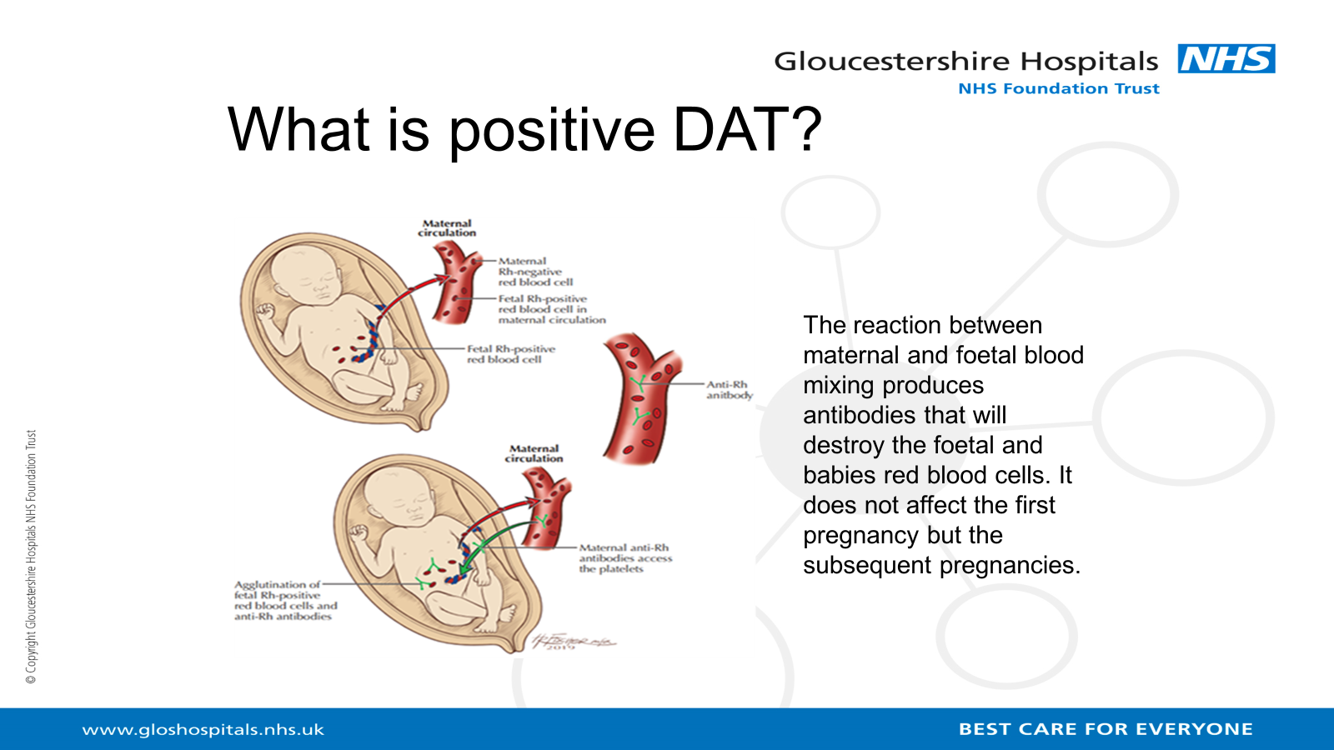
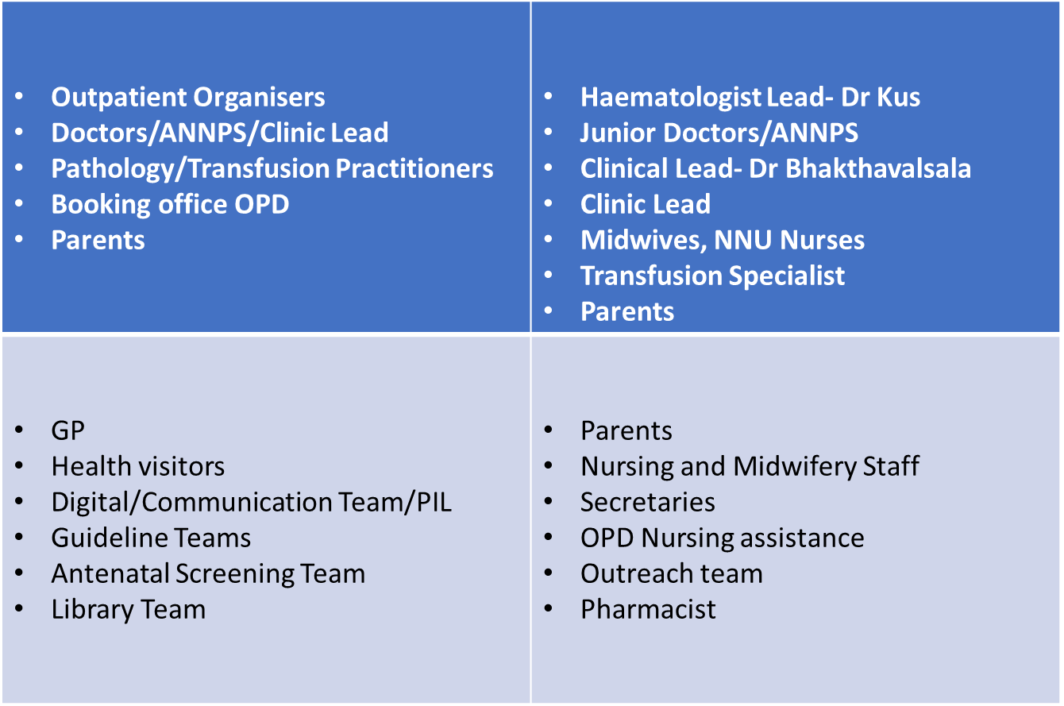
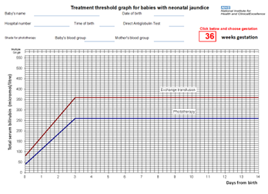
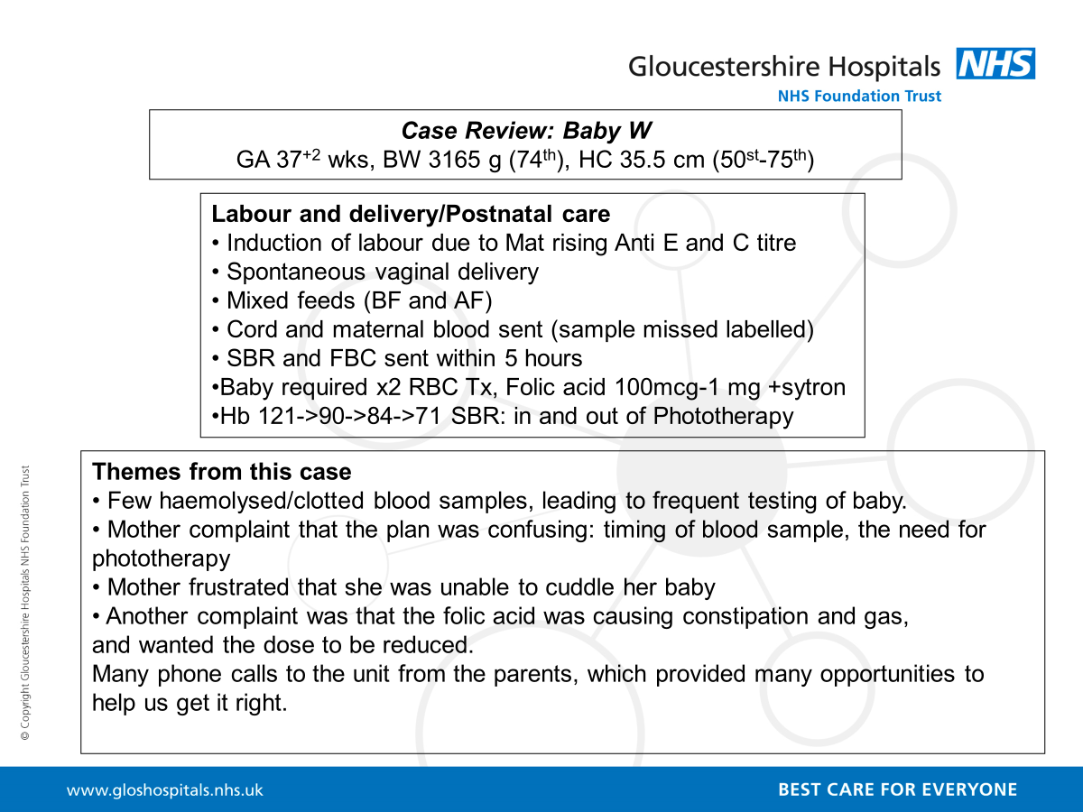

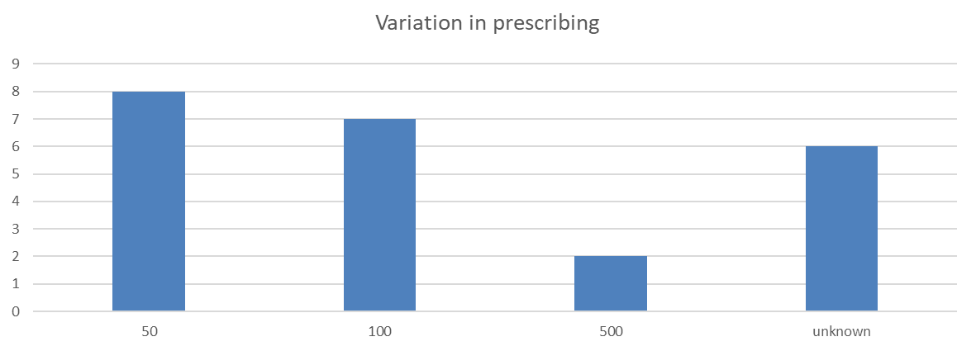
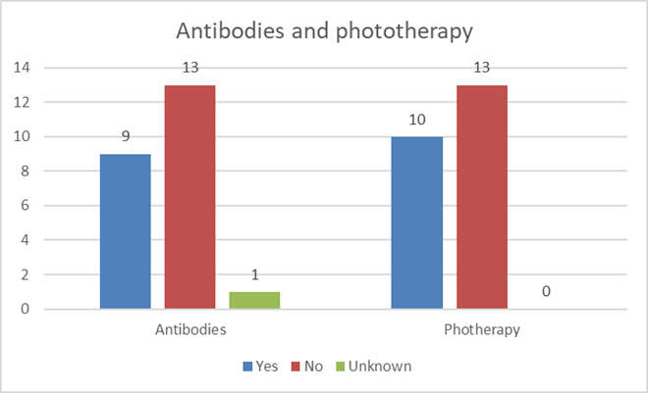

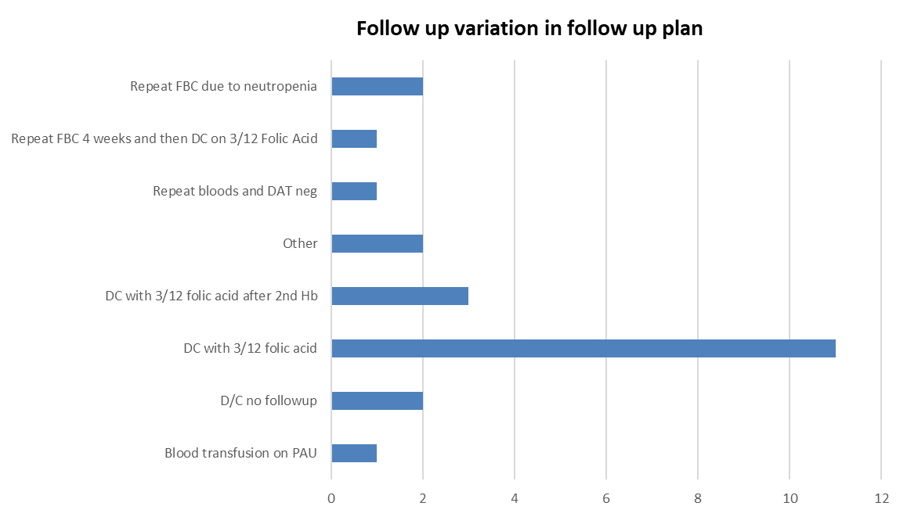
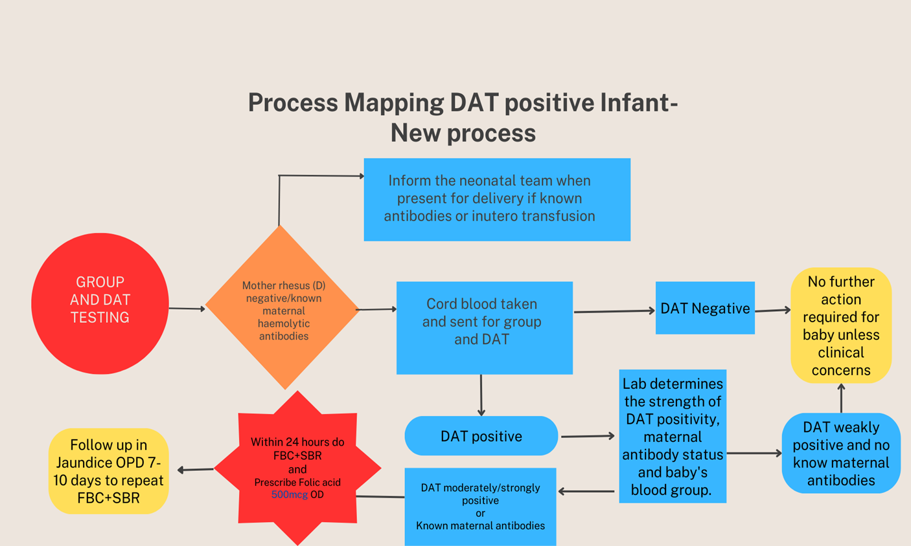
Gloucestershire Safety and Quality Improvement Academy 2025
Babies with positive Direct antiglobulin test (DAT): Care pathway
Michellee Grant, Dr Harriet Croft, Dr Shyam Bhakthavalsala
Neonatal Team
WHAT IS IT?
STAKEHOLDERS AND TEAM
Direct Antiglobulin Test (DAT) is done routinely on cord blood following birth to test for immune-mediated haemolysis. Common indications for this test in newborns are (a)Haemolytic disease of the foetus and newborn (HDFN) (b) Autoimmune haemolytic anaemia and (c) investigation of anaemia or jaundice of unknown causes. Interpretation must consider clinical context and follow up testing.
Neonatal & paediatric Team
Michellee Grant: Consultant Neonatal Nurse/ANNP
Dr Harriet Croft: Neonatal Doctor- Registrar
Dr Shyam Bhakthalvalsala: Consultant Paediatrician
PROBLEM
DATIX reports : Baby was prescribed folic acid 500mcg/kg (considered to be high dose for a weak positive)
Adverse Events: x1 severe anaemia presented in PAU requiring blood transfusion – was discharged on 50mcg dose OD at birth (Low dose for a strong positive and high risk HDFD). Some delays in follow up.
Incidental findings of infants going home with positive DAT and not prescribed folic acid; varying doses of folic acid prescribed.
Staff and patient experience: parents reported confusing information; variation in clinic appointment time scale/ number of appointments required. Several blood letting episodes due to unsatisfactory samples.
Patient safety/satisfaction: Delay in checking cord bloods → delay in checking SBR → Exchange transfusion threshold →Multiple blood transfusions . No patient information leaflet for parent adding to confusion with folic acid dose and frequency of test.
Parents at the centre. Real time feedback
Specialist Consults
Dr Thomas Kus: Consultant Paediatric Haemotologist)
Stuart Lord: Lead Transfusion Practitioner
Tracey Clarke: Blood Transfusion Laboratory Manager
Mira Vujasin: Lead Pharmacist
Special Thanks
Parents of baby W: Mother thanked the team for responding to her concerns and listening to her.
We thank her for: her patience and providing us with valuable feedback.
AIM
By September 2024, 100% of babies delivered at Gloucester Hospital/community with the risk of developing Haemolytic Disease of Foetus and Newborn (HDFN) will follow a new clear and simplistic pathway in monitoring and managing their care.
MEASURES
OUTCOME
Improve communication between healthcare professionals and parents to ensure reduction in patient complaints.
Ensure zero adverse events (preventable causes)
Reduction in the number of patients’ visits to the neonatal clinic (Evidence based testing)
Ensure patients’ outcomes are met, completed and documented on the appropriate system
Ensure consistency of medication prescribing.
PROCESS
A retrospective study of all babies attending the Neonatal clinic with positive DAT, over a one year period (January 2022-January 2023)
A pathology sample audit: January 2023-March 2023 with the percentage of rejected samples
Review of the clinic data base, DATIX system, case reports and Trakcare.
Proportion of babies who got adequate dose of medication
BALANCING
Experience of the staff leading the clinic
Follow up instructions
DATA
Evidence-based testing information obtained from a retrospective review.
Over 1 year period January 2022-January 2023, there were a total of 27 babies seen in the Jaundice clinic with positive DAT. A smaller, 3 month data of samples rejected by pathology were also audited which has cost implications.
To provide a clear investigative and treatment guidance for 100% of infant with positive DAT by September 2024
Effective Communication
Written and verbal instruction to parents
Computerised system, create guideline/SOP
Monitoring and reporting process
Frequency of testing and audit tools
New trainees frequently staff rotation. Staff awareness
Roles and responsibilities, 6 months rotation
Variation in investigation
Organisation and strategies
Follow up process
Staff awareness and Education
Blood booking system and phlebotomy
Patient information leaflets
Discharge letter, Trakcare and GP
SOP/Action card/educational package
Excel worksheet JC add alert to maternity badger
Pathology sample audit
Collected between January 2023 and March 2023 (3 months)
162 requested cord bloods (mother Rh-ve)
152 requested baby DAT (jaundice clinic)
26 investigations r.e +ve DAT
27 rejected cord blood samples during this time
Add to Jaundice guideline
PAU access during acute phase?
Journal club and NICU teaching days, induction
OOLD SYSTEM
All DAT positive patients received Folic acid 50 micrograms (very small dose) for varying durations
All were followed up, leading to over-use of resources
No differentiation between significant and non significant ‘incidental’ DAT positive results
No clear follow up pathways.
OUTCOMES
Cost saving: fewer unnecessary tests and treatments
Enhanced communication with/within the clinical team and parents
Better patient care: avoids overtreatment. No adverse events or patient complaints were reported after change implementation
BARRIERS AND CHALLENGES
Multidisciplinary approach in coordination and collaboration
Cultural changes: historic way of prescribing or doing things
Limited evidence for neonatal management. Most focus is on antenatal screening
Limited clinic spaces and booking facilities for follow up
No designated clinic lead
NEXT STEPS
A new guideline to reflect these changes is being peer reviewed and go through the approval process.
Link to patient information leaflet: GHPI1858_08_24
NEW SYSTEM
Positive DAT reports include strength of the reaction helping to identify clinical significance
Guide for clinicians with treatment and follow up algorithms. Folic acid dose from 100mcg-1mg.
Patient information leaflets available
REFERENCES
deWinter, D.P; Kaminski, A.;Tjoa ML.; Oepkes, D and Lopriore, E (2023) Hemolytic disease of the fetus and newborn:rapid review of postnatal care and outcomes. BMC Pregnancy and Childbirth 23(738).
NICE guidelines for management of neonatal jaundice 31 October 2023: Jaundice in newborn babies under 28 days. Available at: https://www.nice.org.uk/guidance/cg98/evidence/full-guideline-245411821 (Access on 23/11/2023)
Shahulhameed SP; Kumar S and Dharmadas (2018): Neonatal Outcome of Rh-D Alloimmunisation in Antenatal Women Attending a Tertiar Care Hospital. Indian Journal of Neonatal Medicine and Research: 6 (2) pg 024-028.
Suresh, K; Deepthi, A; Yashovardhan, R; Arun, K; Sreedhar Badu, KV; Jothibai, DS and Bhavani, V. (2014): Case Report: Haemolytic disease of the newborn due to multiple maternal antibodies. Journal of Clinical and scientific research: 3 pg198-201.
White, J; Qureshi, H; Needs, E; et al : (2016) Blood Grouping and Antibody Testing in Pregnancy . BSH. https://onlinelibrary.wiley.com/doi/epdf/10.1111/tme.12299 26, pg 246-263
Picture credit (What is positive DAT): Foetal diagnosis & treatment centre: Michigan university
#TheGSQIAWay

