Slide 1
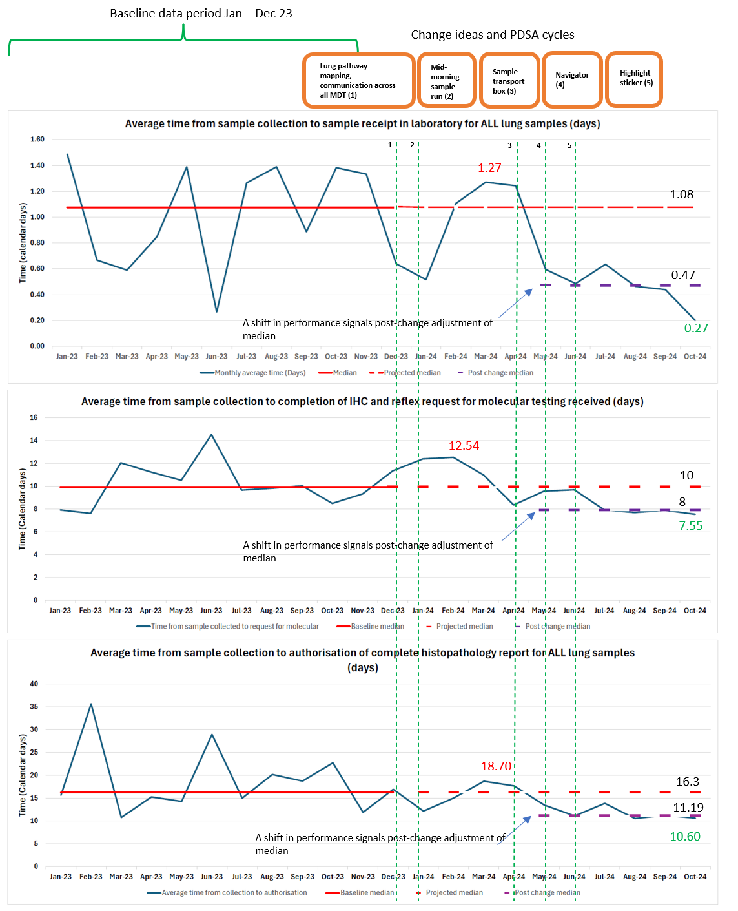
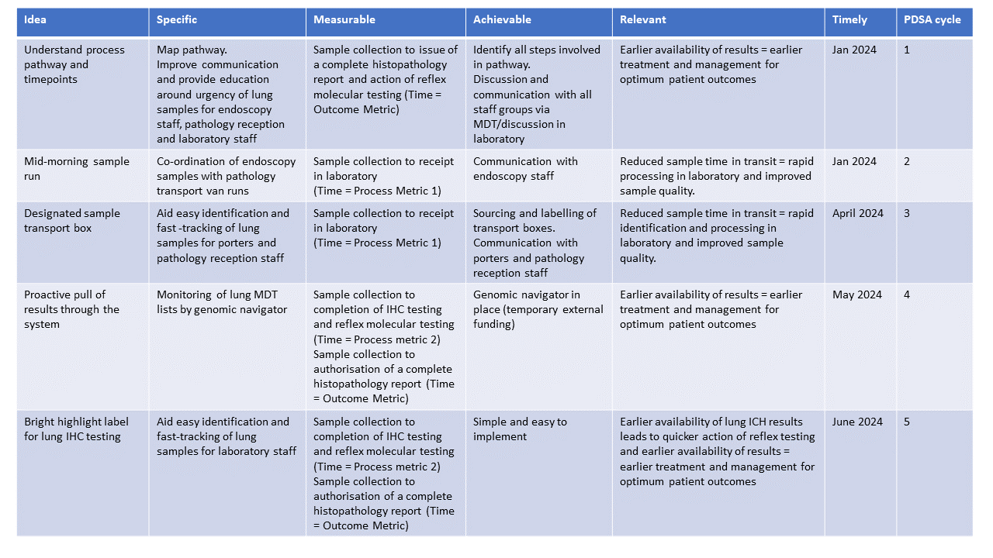
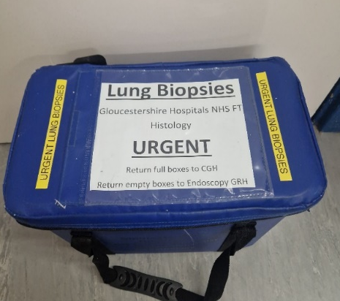
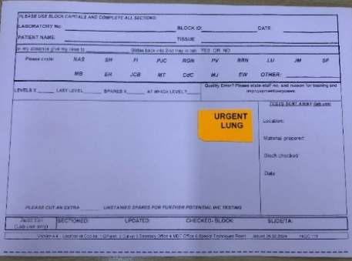
Gloucestershire Safety and Quality Improvement Academy 2025
Improvements in the lung cancer pathology pathway
Siobhan Taylor
Team: Dr Henry Steer, Lung MDT, Lung Pathology team, Histopathologist team, Histopathology lab team.
Introduction
The reliable availability of a cellular pathology report at lung cancer MDTs is critical for smooth and rapid diagnostic pathways. This project arose from a need to address longstanding delays to lung pathology reporting in our trust. Delays and variability in processing times may arise from multiple interdependent parts of the pathway, including biopsy timing and location, human factors, intra/inter-hospital transport, laboratory administration, laboratory sample processing and availability of reporting pathologist.
Methods
In December 2023, we mapped and audited the pathway of lung biopsy samples from tissue acquisition to the issue of a cellular pathology report in our Trust. A number of areas where minor changes could be made were identified and actioned simultaneously. From January 2024 to October 2024, we continuously mapped and audited the pathway. Historical data for baseline data collection and key pathway milestones were taken from the Laboratory Information Management System (LIMS).
Results
Mapping of all of the stages involved from collection of a sample from the patient, to the issue of a histopathology report, alongside data collection from the LIMS enabled us to identify areas where potential delays might occur.
Endoscopy lists operate on a Friday on site 1 which is 9 miles away from the histopathology laboratory on site 2. Samples are transported in large specimen containers via regular inter-site van runs. MDT meetings occur on a Wednesday afternoon.
Figure 2: Run chart - Process metric 1: Sample collection to sample receipt in laboratory for ALL lung samples
Mapping of the pathway and corresponding baseline data highlighted a delay in the time from sample collection to receipt in the laboratory in the previous year for all lung samples. We instigated engagement and education of endoscopy and pathology staff (PDSA 1) and introduced an extra mid-list transport run coordinated with pathology transport van (PDSA 2). After monitoring with insignificant change, we implemented dedicated urgent lung sample transport boxes (PDSA 3).
We stabilised transport times, reducing the variability in length of time samples took to reach the laboratory. There was a reduction of the baseline median time from lung biopsy collection to receipt in the laboratory by 0.6 days from 1.08 days (peak at 1.27) to 0.47 days (low at 0.27).
Furthermore, lung samples were able to be identified on receipt in pathology reception and fast-tracked for same day processing.
Figure 3: Run chart: Process metric 2: Sample collected to completion of IHC and reflex request for molecular testing
An externally funded genomic navigator allowed for proactive monitoring of lung MDT lists enabling samples to be ‘pulled through’ the laboratory in time for the following MDT meeting (PDSA 4). This also improved communication with the reporting pathologist. We noted that reports were held up due to IHC testing and as reflex testing for molecular testing is not performed until all IHC testing is complete and reported, this was impacting time to request for molecular testing. Implementation of a simple highlight sticker (PDSA 5) enabled rapid identification and subsequent prioritisation of these samples following requests for IHC testing in the laboratory.
There was a corresponding improvement in the onward referral to genomic testing (PDL1, Lung DNA and RNA NGS panels). We reduced the variation and stabilised the baseline median time from sample collection to completion of IHC and reflex request for molecular testing from a median of 10 days (peak 12.54 days) down to a consistent median of 8 days (low 7.55).
Figure 4: Run chart – Outcome metric: Sample collection to histopathology report authorisation for ALL lung samples
We identified that there can be an administrative delay from completion of IHC testing and discussion at MDT, to the availability of a complete histopathology report in our LIMS.
Through the combination of PDSA cycles, we observed a stabilisation of the pathway and a corresponding reduction in the baseline median time from sample collection to authorisation of the cellular pathology report by 5 days, from 16.3 days (peak at 18.7 days) down to 11.19 days (low at 10.60 days) over the period of January to October 2024.
Table 1: Proposed change ideas and activities A number of change ideas and SMART (specific, measurable, achievable, relevant, timely) goals were identified and actioned via a series of PDSA (Plan-Do-Study-Act) cycles.
Image A: Designated sample transport box
Image B: Highlight sticker
Conclusions: Understanding every step that the tissue sample takes during the pathway and coordinating each of these elements was critical. Collaboration between the MDT and multiple other staff and services was essential. Minor changes across the pathway with minimal cost can result in substantial improvements. Further change ideas are being considered to reduce this pathway further in-line with the National Optimal Lung Cancer Pathway (NOLCP) and the Cancer Genomics Improvement Programme (CGIP).
Next steps: The laboratory team continue to maintain close communication with the lung MDT. Further ideas for new PDSA cycles include splitting of lung core biopsies to increase sample availability and reduce time to reflex testing, upfront IHC on cases clinically identified as likely lung cancer, improved histopathological reporting of sample quality to streamline onward assessment and referral for genomic testing, and automated electronic requesting of molecular testing via the LIMS.
References:
United Kingdom Lung Cancer Coalition (UKLCC). Driving Quality Improvement in UK Lung Cancer: Utilising good practise and innovation to deliver optimal care and outcomes. Available at: Driving Improvements in UK Lung Cancer | UKLCC (accessed 03/12/24) National Optimal Lung Cancer Pathway. For suspected and confirmed lung cancer: Referral to treatment. Update 2020, Version 3.0. Available at: PowerPoint Presentation
TheGSQIAWay
The author would like to acknowledge all members of the lung MDT and staff within the Histopathology department at Gloucestershire Hospitals NHS Foundation Trust. The Gloucestershire Safety and Quality Improvement Academy (GSQIA). Amgen for support with pathway mapping. Dr Nathan Proudlove, Director, PgDip Leadership and management in Healthcare Sciences, The University of Manchester.

