Slide 1
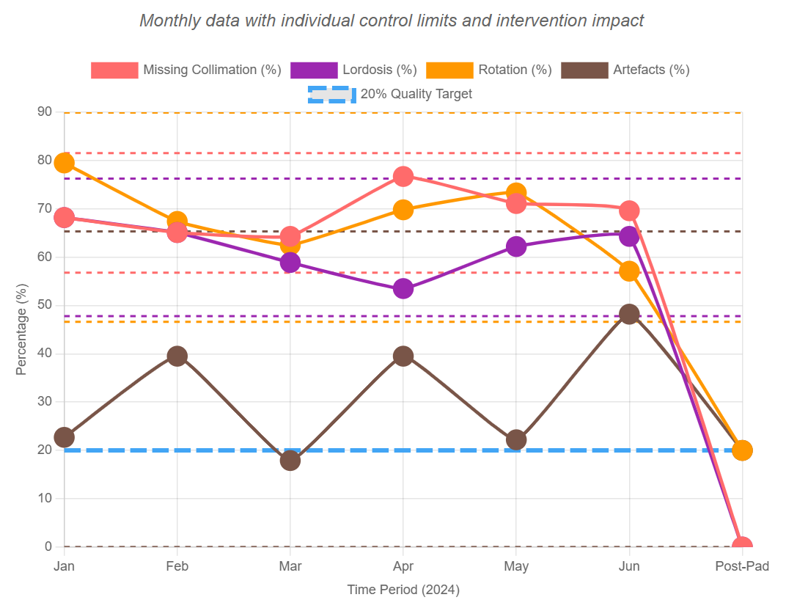
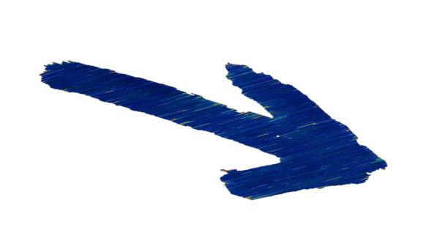
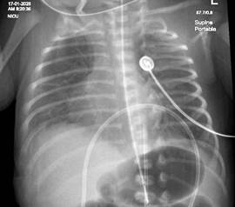
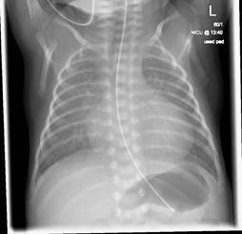

Gloucestershire Safety and Quality Improvement Academy 2025
Improving Neonatal Chest X-ray Quality Through Positioning
Pad Implementation
Dolly Cox (Superintendent Radiographer) and Emma Charles (Senior Radiographer)
BACKGROUND
RESULTS
DISCUSSION
Poor image quality can result in misinterpretation of radiographs and subsequent misdiagnosis (Morris, 2003). High-quality imaging is particularly important in neonates, who are more susceptible to radiation due to their small size and radiosensitive organs (Morris, 2003; Snaith & Hardy, 2014).
Patient rotation may mimic mediastinal shift and alter lung translucency, increasing the risk of error.
In collaboration with Manchester Children’s Hospital, we explored
MORRIS, S. J. 2003. Radiology of the chest in neonates. Current Paediatrics, 13.
SNAITH, B. & HARDY, M. 2014. Improving neonatal chest radiography: an evaluation of image acquisition techniques, dose and technical quality. UK Radiological Congress. Manchester
Image Quality Measure | Without pad (6 month retrospective audit) | With pad (Pilot)
Missing collimation lines | 187 (65%) | 0 (0%)
Lordosis | 178 (62%) | 0 (0%)
Rotation | 194 (68%) | 2 (20%)
Artefacts | 91 (32%) | 2 (20%)
Dramatic improvement in positioning accuracy: Missing collimation lines reduced from 65% to 0%, and lordosis eliminated completely (from 62% to 0%), demonstrating the pad's effectiveness in achieving proper patient positioning
Significant reduction in repeat imaging: Rotation decreased from 68% to 20% and artefacts from 32% to 20%, indicating fewer technical errors and improved image quality consistency
Enhanced diagnostic quality: The positioning pad effectively addresses the most common image quality issues in neonatal chest radiography, leading to better diagnostic images and reduced radiation exposure
Clinical impact: These improvements translate to reduced need for repeat examinations, lower radiation dose to vulnerable neonatal patients, and enhanced diagnostic confidence for clinicians
whether a custom-made foam pad could reduce rotation and enhance image quality.
Before: Processes were "stable" but consistently poor (high defect rates were predictable)
After: Positioning pad created special cause = fundamental process change, not just temporary improvement
Statistical Significance: All results fall outside baseline control limits = intervention definitively worked
SMART GOAL
LIMITATIONS
Within six months of introducing the new NICU imaging pad, reduce collimation errors, lordosis, artefacts, and rotation to ≤20% each in neonatal portable chest X-rays
Time: Project delays due to competing priorities - training content ready but not yet delivered; pilot took longer than expected
Inter-professional working: Limited engagement from radiologists and NICU team - expect improvement with joint radiographer/nurse training sessions
Sample size: Small pilot (n=10) may not be representative - larger audit needed post-implementation
METHODS
EXAMPLES
Our project followed a structured, iterative approach utilising Plan-Do-Study-Act (PDSA) cycles to drive continuous improvement in neonatal chest X-ray quality:
Baseline Assessment (PDSA Cycle 1):
Conducted an initial audit of image quality (pre-pad).
Assessed baseline staff knowledge using a questionnaire.
Intervention Development (PDSA Cycle 2 & 3):
Developed comprehensive training materials and engaged key stakeholders.
Collaborated to source and create the custom foam positioning pad.
Implemented a pilot study (10 patients) and refined infection control protocols.
These images are of the same neonate, who was imaged with and without the pad during two separate examinations 24 hrs apart.
The position of the chest is much improved, with no rotation or lordosis of the chest.
NEXT STEPS
Deploy cascade training model with tracking of new competency
Measure education impact via pre/post questionnaires using Likert scales
Develop paediatric positioning aids for wider age groups
Establish inter-trust partnerships for knowledge sharing
Without pad
With pad
Poor quality image:
No collimation marks
Lordotic (Flat ribs)
Suitable quality image:
4 collimation marks
Not lordotic
3. Rotated
4. Avoidable artefact
3. No rotation
4. No artefact
#TheGSQIAWay

