Slide 1

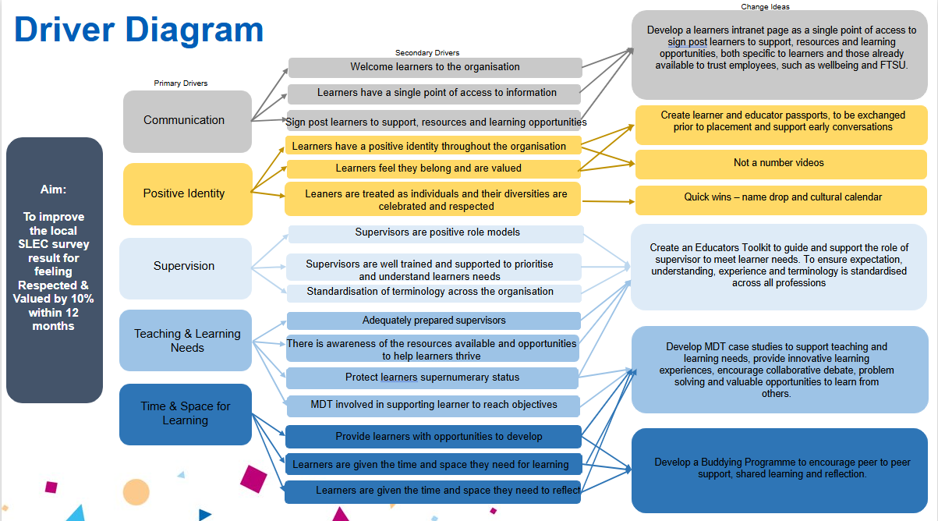
Gloucestershire Safety and Quality Improvement Academy 2025
Improving Learner Experience at GHFT
Becky Symonds & Emma Kellow
Background
Aim
Created in response to healthcare learners feedback on their clinical experiences in maternity services, set out in Kirkup (2015 and 2022) and Ockenden (2020 and 2022) reports.
Designed for learners and those responsible for supporting placement learning across all learning environments and all professions within them
Aligned to the NHS People Promise in recognition that learners are vital to the workforce and are included in the promises we all make to each other, to improve everyone's experience of working in the NHS
Sets out the supportive learning environment required to allow learners to become well-rounded professionals with the right skills and knowledge to provide safe and compassionate care of the highest quality.
On a daily basis learners across the trust are having a poor experience, as they do not feel respected or valued. This results in poor retention rates, low morale and ultimately staff shortages, as learners leave their course/programme or profession shortly after qualifying.
Staff shortages and skills gaps results in a poor experience/outcomes and potential safety risks for both patients and staff.
To increase the local Safe Learning Environment Charter results, for Respect and Feeling Valued by 10% in 12 months.
Measures
Outcome measures – to improve learners feeling Respected and Valued score.
Process measures – improvements in scores for Positive Identity, Teaching and Learning Needs, Time and Space for Learning.
Balancing measures – increase scores in NETS and staff survey results.
Understanding the Problem
Literature search
Educator forum
Networking/shadowing
NHSE maturity matrix completed by professional leads.
Developed a local learner survey to align with SLEC matrix to gain an understanding of learners current experience at GHT. To identify gaps and inconsistency in provision of SLEC, common themes, issues and best practise. ​234 out of a possible 571 responses in total covering all professions and a diverse population of learners.
Raw data identified these top 3 areas of concern:​
Positive Identity​
Teaching and learning needs (algins with NETS – rank 10th out of 12 Acute Trusts in SW)​
Time and space for learning​
Thematic analysis of the same data identified:
Positive Identity/Respect and Feeling Valued​
Teaching and Learning/Supervision (Aligns with NETS Supervision rank (8th out of 12)​
Time and Space for Learning​
In addition to this we identified:
Inconsistency and a lack of standardisation across departments and professions.
Lack of readily available information for learners.
Conclusions
Recent developments have significantly impacted the progress of the SLEC project. Following the government’s announcement regarding NHSE and ICB working arrangements, staffing levels within education teams have declined due to the conclusion of secondments and project-based roles. This reduction in capacity has made it increasingly difficult for education teams to commit to SLEC priorities or develop personalised professional SLEC plans, as their focus has shifted back to core business functions. Nationally, NHSE has recognised the interdependence of SLEC and the Educator Workforce Strategy (EWS), with discussions at the March Roundtable event highlighting the need to prioritise EWS to enable educators to fully engage with SLEC. This national perspective aligns with internal observations, where enthusiasm for SLEC remains high, but practical engagement is currently limited. In response, discussions with the Senior Responsible Officer (SRO) have led to the decision to initiate a project change request, allowing the SLEC Partner to explore the EWS for GHFT and identify opportunities to align it with SLEC. Despite the pause, several initiatives were successfully completed, including the launch of a dedicated intranet page, a trial multidisciplinary team (MDT) session which received positive feedback, and collaboration with the EDI team to support the name drop launch and EDI calendar during National Inclusion Week in September 2025
Next Steps
Educator Toolkit – links to Educator Workforce Programme
Write up SLEC programme with recommendations and lessons learnt to be picked up in future
Identify Educators at GHFT, standardised job descriptions and training expectations
Supporting VSMs in their work to become a Learning Organisation & Centre of Excellence
Creating a Community of Practice for the Educator workforce
#TheGSQIAWay

