Slide 1



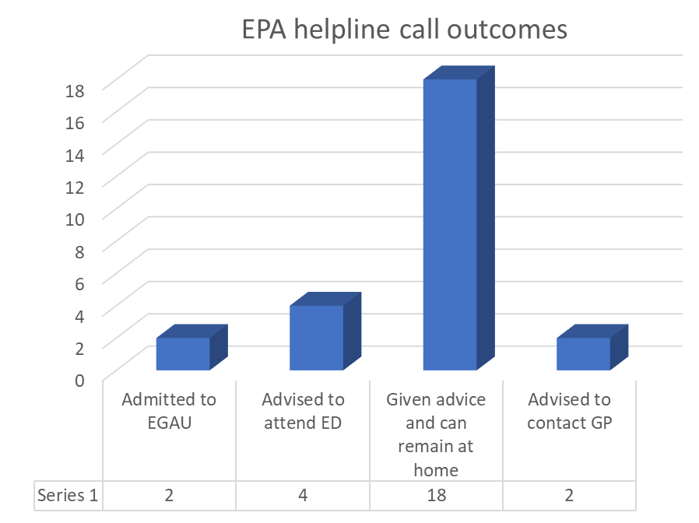
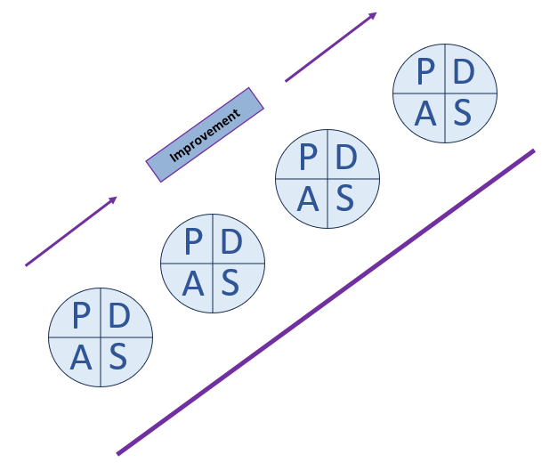


Gloucestershire Safety and Quality Improvement Academy 2025
To improve the availability of access to urgent telephone advice for all women under the care of Early Pregnancy Assessment
Becky Hutchinson & Laura Ferguson
Background
NICE guidance recommends that all patients under the care of Early Pregnancy Assessment (EPA) should have access to a 24 hour helpline.
QI team & Stakeholders
Becky Hutchinson – Matron
Laura Ferguson - ANP
Early pregnancy ANP team
9a ward staff
Gynaecology doctors
IT staff
Driver Diagram
To provide access to urgent advice to all women under care of EPA team
Staff engagement
patients
Administration
documentation
booking
operational
Communication
algorithm
Staff Training
SOP
Prior to the EPA helpline
All women under the care of Early Pregnancy Assessment (EPA) may have increased pain and bleeding and need to access to help and advice.
Prior to the helpline we only provided telephone advice and support for 8 hours a day.
For ⅔ of the day women could not gain useful advice, this could lead to poorer experiences for women by either staying at home and deteriorating or having unnecessary attendances to ED.
IT systems
leaflets
Since providing the EPA helpline
We are now able to offer the telephone advice line to EPA patients for 24 hours a day.
In 4 months, we have provided support to at least 26 additional patients (during the 16 hours that weren’t previously available). The majority of these women did not need emergency admission and were able to receive the advice they needed to safely stay at home with reassurance.
Without the helpline, potentially, these women could have all attended A&E unnecessarily or women who needed medical attention could have remained at home inappropriately and deteriorated further.
Process Measures
Number of helpline calls received
Number of calls not answered
Completion of algorithm
Type of advice given
PDSA 2
Phone/answer phone
Balancing Measures
ward staff sickness/ IT issues leading to inability to answer phone
EPA team checking answerphone at start of each shift
PDSA 1 Algorithm/proforma
Staff involvement
Staff on ward 9a have really engaged with the project and provided initial feedback at the start of the pilot. The feedback from staff since the helpline has been running out of hours has been positive and the staff have risen to the challenge. It has been smooth running.
Outcomes
The provision of the helpline has given increased care and reassurance to patients who are well enough to stay at home. This has likely reduced the number of EPA patients attending ED unnecessarily.
Next Steps
Gain patient feedback as appropriate
Re-audit data
#TheGSQIAWay

