Slide 1
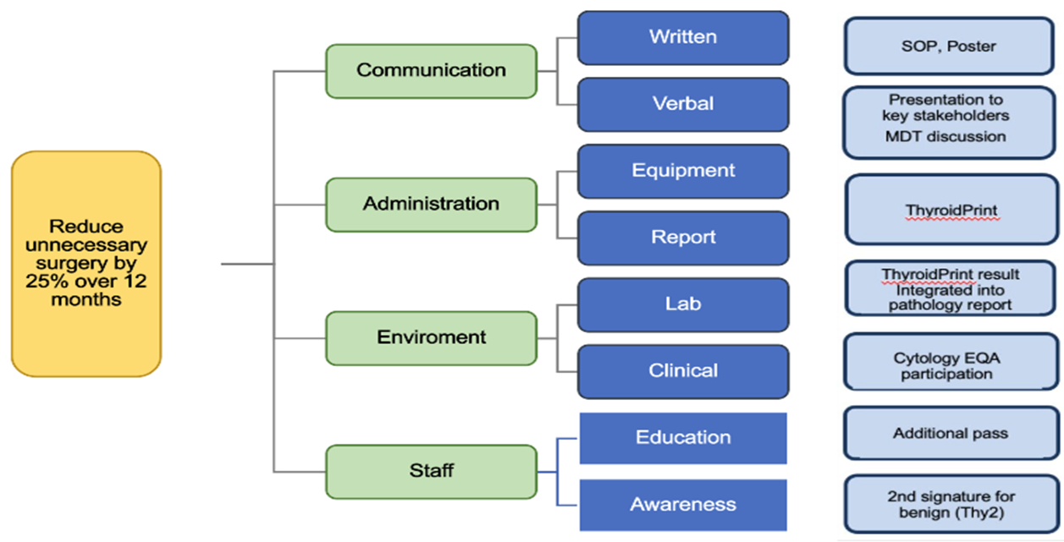
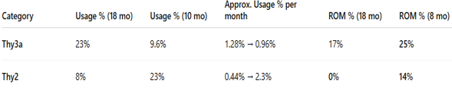
Gloucestershire Safety and Quality Improvement Academy 2025
Reducing Unnecessary Diagnostic Hemithyroidectomies by Improving Diagnostic Accuracy of Thyroid Cytology
Dr Mike Thomas, Consultant Histopathologist, Dr Camila Mondaca, Histopathology registrar
Thyroid cytology can yield indeterminate (Thy3a) results leading to unnecessary diagnostic hemithyroidectomy
We aim to reduce the number of unnecessary diagnostic hemithyroidectomies by 25% over 12 months through improvements to the diagnostic pathway, aiming to reduce the use of indeterminate cytology outcomes.
Understanding the problem
Just 17% of Thy3a outcomes are malignant.
Excess use of the Thy3a outcomes may result in unnecessary surgeries with associated morbidity and resource costs.
Fewer operations mean reduced use of theatres, anaesthetics, and single-use equipment, lowering the NHS carbon footprint and costs. This ensures surgical capacity is focused where it is most needed, while sparing patients avoidable risk.
Improvement methodology
We applied PDSA cycles to the cytology reporting pathway:
• We introduced a double reporting protocol for Thy2 (benign).
Audit findings were shared with the cytology reporting team, and the diagnostic criteria for Thy3a were reviewed to promote consistency.
• Regular audit cycles are planned to monitor local practice and to evaluate the impact of each intervention within the PDSA quality improvement cycle.
Results
Thy2 outcome usage increased significantly: 8% → 23%
61% of Thy2 were double reported
Thy3a usage dropped substantially: 23% → 9.6%
The ROM for Thy3a increased from 17% to 25% between audit cycles, reflecting more selective application of the category
False-positive rate for indeterminate/suspicious thyroid cytology fell from 65% to 25% translating to an estimated 40 fewer unnecessary hemithyroidectomies per 100 indeterminate cytology results — improving patient safety, conserving theatre capacity, and reducing environmental and financial costs
Next Steps
Thy3a report to specify whether the atypia observed is nuclear or architectural in nature.
Continue with regular audit cycles.
There is future scope for second needle pass and molecular testing for indeterminate samples to help stratifying risk to aid clinical decision making.

