Slide 1

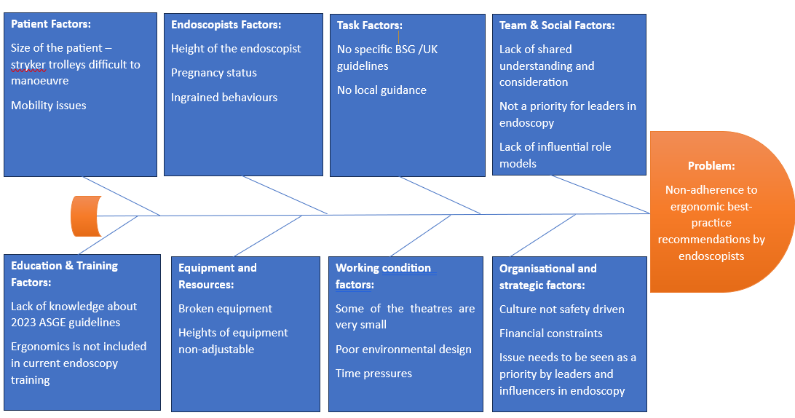
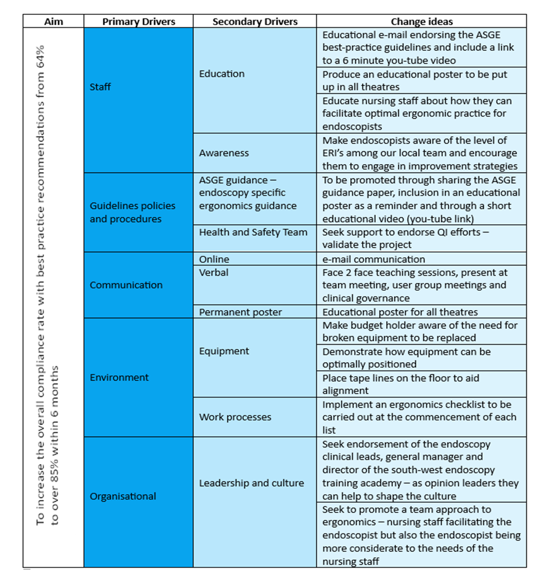
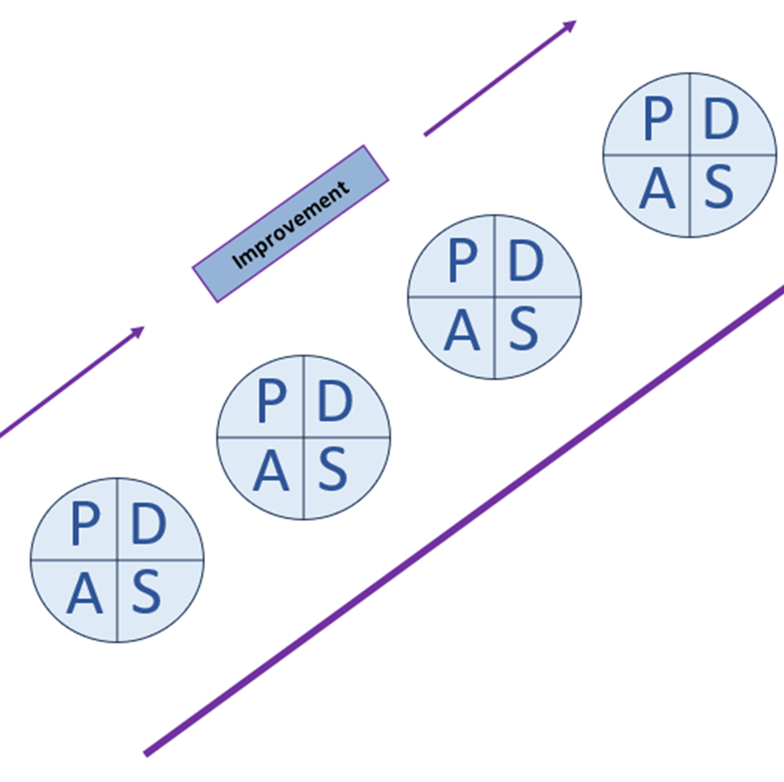
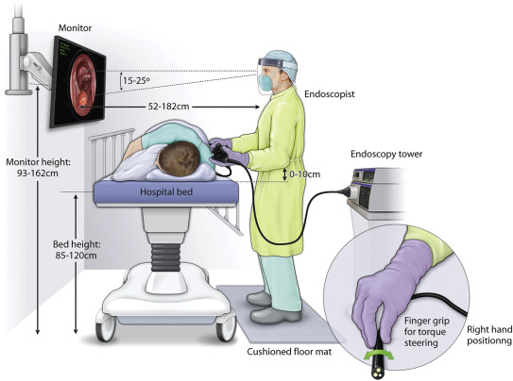
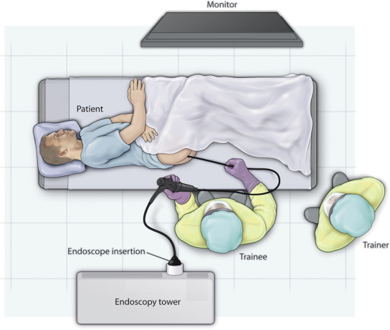
Gloucestershire Safety and Quality Improvement Academy 2025
Improving Ergonomic Practice in Endoscopy
Amber Prisk - Consultant Practitioner / Lead Clinical Endoscopist
Julian Layhe – Clinical Endoscopist
Background
Performing endoscopy is a physically demanding and repetitive task, and endoscopists are prone to developing musculoskeletal endoscopy-related injuries (ERI’s) (Young et al, 2017). ERI’s can shorten endoscopists’ careers, reduce personnel available for healthcare delivery, and thereby negatively impact patient care. Research evidence shows that adherence to best-practice recommendations regarding ergonomics in endoscopy can help to significantly reduce the risk of ERI’s (Walsh et al 2021).
SMART Aim
To increase the overall compliance
rate with best practice
recommendations from 64%
to over 85% within 6 months
Understanding the problem – fishbone analysis
Driver Diagram
The problem
The ERI rate among endoscopists at GRHNHSFT was found to be 48%. Local practice was observed and measured against four core best-practice recommendation relating to monitor height, equipment alignment, trolley height and endoscopist posture. This revealed that only 1/3 of endoscopists were adhering fully to all four best practice recommendations. The overall compliance rate for all observed elements among all endoscopists was found to be 64% which is sub-optimal and poses a significant risk to the health and wellbeing of our endoscopists.
Improvement team Stakeholders
Amber Prisk Endoscopy Clinical Leads
Consultant Clinical Endoscopy Training Academy Director
Endoscopist General Manager
Endoscopy Nursing Team
Julian Layhe Health and Safety Team
Clinical Endoscopist Endoscopy practice development nurse
Matron
PDSA Cycles
Cycle 1 (month 1):
Educational intervention for Endoscopists
Mirco-teach session for supporting nursing staff
Educational poster placed in all theatres
Cycle 2 (month 2):
Ergonomics checklist added to endoscopy list de-brief form
Tape lines placed on theatre floors to aid alignment of
equipment
Measures
Outcome:
To reduce endoscopy –related injuries among endoscopists
To increase the endoscopist compliance rates to best-practice recommendations
Process:
Observation and evaluation of of monitor height, trolley height, equipment alignment and endoscopist posture
Audit of whether the ergonomic checklist
is being regularly completed
Balancing:
Whether endoscopy list start or finish times are impacted by implementation of the ergonomic checklist
Acceptability of the ergonomic checklist by endoscopists and the nursing team
Results and key findings
Compliance percentages for the four individual best-practice recommendations all improved from the baseline figures, most notably in relation to endoscopists selecting the correct monitor height and in maintaining an optimal ergonomic posture
Endoscopist overall compliance scores improved significantly with only 34% achieving a maximum score during the baseline observations in August and this improved to 82% by October
The overall compliance rate for all observed elements among all endoscopists increased from 64% at baseline, to 80 % after PDSA cycle 1, and subsequently to 81% after PDSA cycle 2
At two months after implementing our change interventions we have not yet met our SMART aim of achieving 85% overall compliance. The results to date however are very positive and suggest we are on track to achieve our aim after 6 months.
Barriers and challenges
Long-term sickness of QI team member
Finding time to implement multiples changes interventions
Ingrained practices among endoscopists
Nursing staff forgetting to complete audit forms
Nursing workload precluding more frequent observations
Unanticipated additional training required to promote objective and consistent observations by nursing staff
Lack of funding for replacement of broken equipment
Next steps
Further observations to be undertaken to assess whether the observed improvements are sustained and whether further interventions are required
Ensure that all new nursing staff receive the microteach session
Consider developing an ergonomics in endoscopy e-learning module for all new endoscopists who join the Trust
Assess whether endoscopy trainers include ergonomics during training lists
Complete a risk assessment and utilise the health and safety team to encourage budget holders to prioritise replacement of broken and unsuitable equipment
Spread awareness of our initiative via the south-west endoscopy training academy
References
Pawa S, et al. (ASGE Standards of Practice Chair Committee Chair, 2020-2023) American Society for Gastrointestinal Endoscopy guideline on the role of ergonomics for prevention of endoscopy-related injury: summary and
recommendations: Gastrointesting Endoscopy. 2023 Oct;98(4):482-491.
2) Walsh, CM et al. Core Curriculum formergonomics in endoscopy. Gastrointestinal Endoscopy. 2021. 93(6). 1222-1227
3) Young DE, Banfi T, Ciuti G, Arrzzo A, Dario p, Koulaouzidis A. Musculoskeletal injuries in gastrointestinal endoscopists: A systematic review. Expert Reviews in Gastrointastinal Endoscopy. 2017. 11(10) 939-947
#TheGSQIAWay

