Slide 1
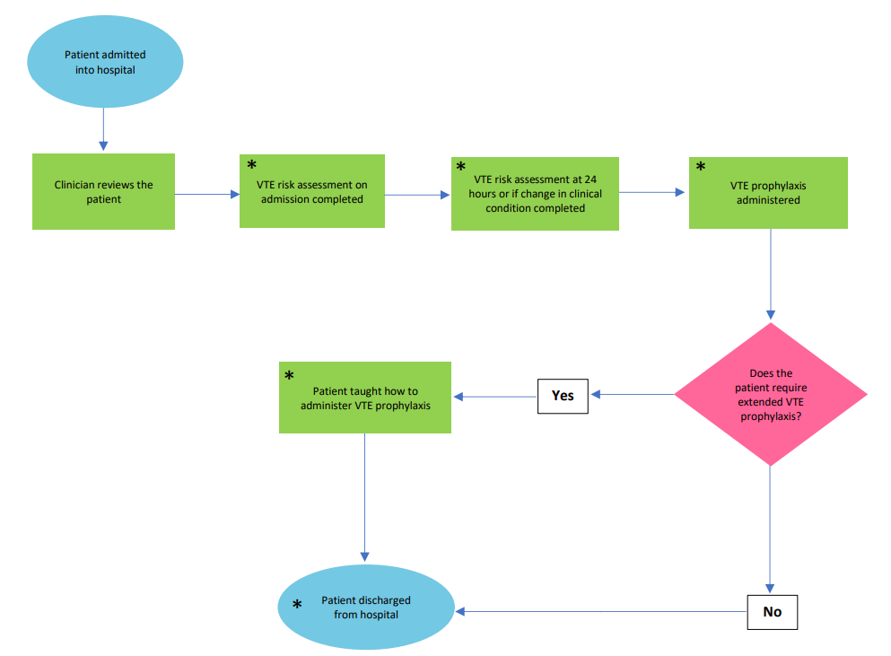
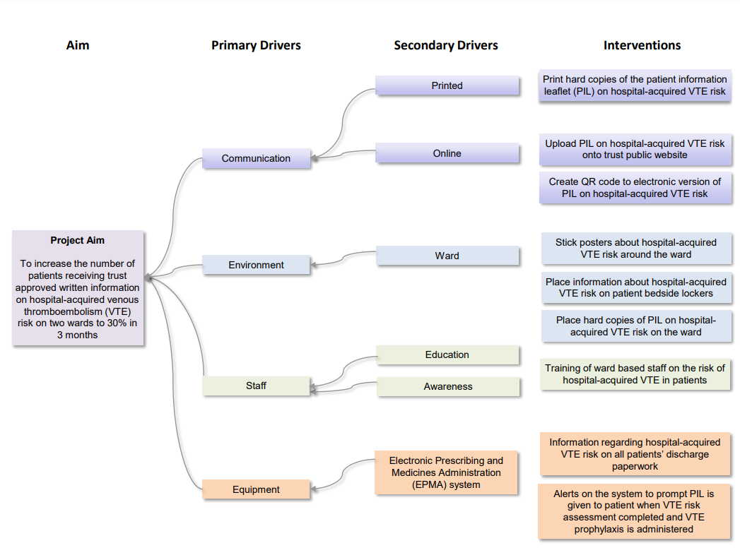
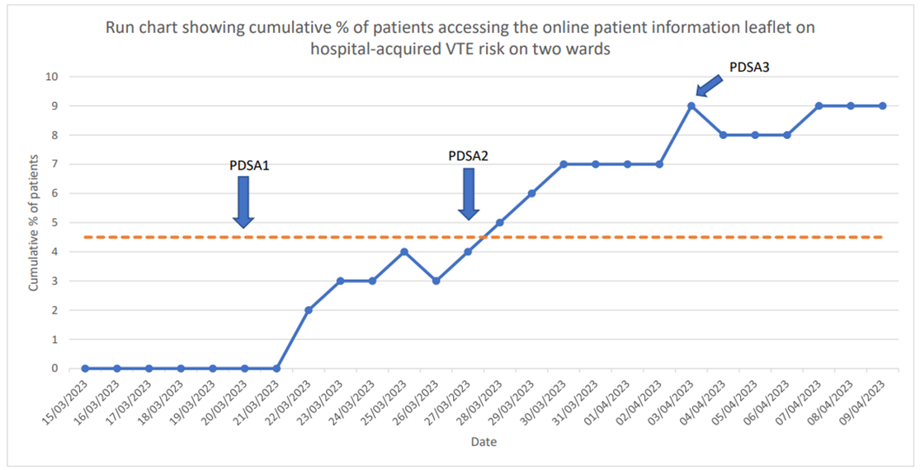
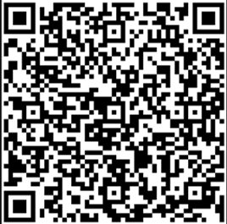
Gloucestershire Safety and Quality Improvement Academy 2025
Improving Written Patient Information On The Risk Of Hospital-acquired Venous Thromboembolism
Divya John, Pharmacy Department, Gloucestershire Hospitals NHS Foundation Trust
Introduction
Venous thromboembolism (VTE) is a major cause of avoidable death and a significant patient safety issue. Hospitalised patients are at a higher risk of developing VTE. NICE guideline (NG89) recommend that patients are given written information about the risks of VTE, signs and symptoms of VTE, how to reduce the risk, importance of VTE prophylaxis and seeking help if VTE is suspected.¹ NICE also recommend that patients are given information at discharge. Currently patients at this trust are not receiving written information about the risk of hospital-acquired VTE. This project will improve patient-centred care, safety and effectiveness.
The work was conducted on two wards within the trust involving medical and surgical patients. The team consisted of the trust-wide VTE Committee, Communications Team, Patient Information Team, pharmacists and nurses.
Aim
To increase the number of patients receiving trust approved written information on hospital-acquired venous thromboembolism risk on two wards to 30% in 3 months.
Problem Analysis
Outcome measure
Cumulative % of patients accessing the online patient information leaflet on hospital-acquired VTE risk on two wards
Process measure
Number of times the online patient information leaflet is accessed through QR code and weblink on two wards
Balancing measure
Number of admissions and discharges may vary throughout the year
* = opportunities to improve information provision or availability on hospital-acquired VTE risk
Driver Diagram
Methodology
A trust-approved patient information leaflet containing the NICE recommendations relating to hospital-acquired VTE risk was created and uploaded to the trust public website. A QR code and weblink to this online version was used to increase the number of patients receiving information.
The interventions were conducted over a 3-week period in April 2023 and included placing the QR code and weblink on the ward patient information areas, on patient bedside lockers and with discharge paperwork.
Results
Data was collected for the number of times the online patient information leaflet on hospital-acquired VTE risk was accessed. A run chart showing the cumulative % of patients accessing the online leaflet was produced. 18 patients out of a total of 208 accessed the online information leaflet by the end of the project. This showed a 9% increase from baseline of patients receiving trust approved written information on hospital-acquired VTE risk.
Conclusion
The biggest positive impact of this project is the availability of a trust approved patient information leaflet on hospital-acquired VTE risk on the trust’s public website. The changes using the QR code and weblink have shown an increase in the number of patients accessing information. The next step is to use the Electronic Prescribing and Medicines Administration system to repopulate information with the QR code and weblink on all patients’ discharge paperwork.
References
1. National Institute for Health Care and Excellence. 2019. Venous thromboembolism in over 16s: reducing the risk of hospital-acquired deep vein thrombosis or pulmonary embolism. [NG89]. https://www.nice.org.uk/guidance/ng89/ (Accessed 24 April 2023)
#TheGSQIAWay

