Slide 1
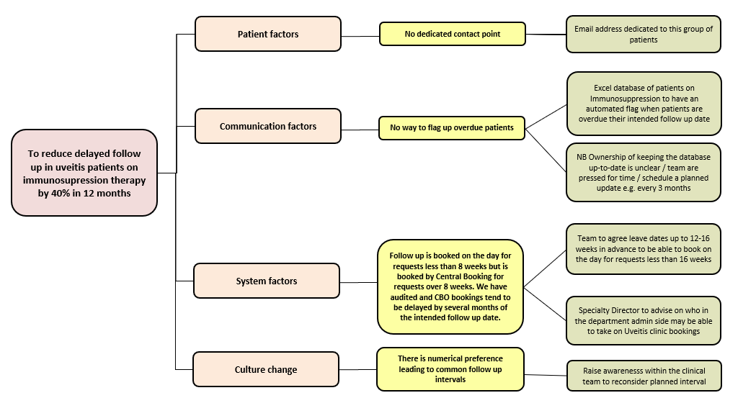
Gloucestershire Safety and Quality Improvement Academy 2025
Reducing Overdue Follow-up and Loss to Follow-up for Patients with Uveitis on Immunosuppression Therapy
Miranda Buckle & Claudia Dan
Ophthalmology Department
Safety Concern
Patients with uveitis are often treated with immune suppressive medication. This medication requires frequent monitoring for safety and efficacy.
Audit SG250606 (2024) identified significant delay to follow up for patients with uveitis on immune suppression, specifically that patients with intended follow up of 8 weeks or sooner were seen within 10 weeks, but patients with intended follow up of more than 8 weeks were delayed by several months.
Improvement Aim
To reduce delays to planned follow up clinic appointments for uveitis patients on immunosuppression medication by 40% in 12 months
Quality Improvement Team
Clinical Team
Miranda Buckle
Quresh Mohamed
Shanthi Raghava
Claudia Dan
Ruth O’Neill
Sponsor
Emily Fletcher (Clinical Lead)
Admin Team
Secretary
Stakeholders
Patients
Failsafe team
Laura Roberts (Ophth Gen Manager)
Other Hospital Specialities e.g. Rheumatology
PLAN | Change to be tested: New email address
 | How to test the change: Monitoring traffic through the email inbox
DO | Observations: We printed out the email address on paper slips so patients had a record of the address.
STUDY | The email is a third line safety net after i) contacting the Triage line ii) contacting Dr’s secretaries
ACT | We will continue to offer the email paper slip to patients on Immunosuppression to ensure there is a direct route of contact for this group
1
PDSA
PLAN | Change to be tested: Excel database of patients on Immunosuppression
 | How to test the change: Monitoring the number of patients overdue in the spreadsheet
DO | Observations: Fewer patients are flagged as overdue now they are easier to identify and act upon
STUDY | The specialist nurses update the spreadsheet although there are time pressures
ACT | An outstanding action is to try to find time to update the spreadsheet weekly
2
PLAN | Change to be tested: Booking on the day for up to 16 weeks in advance
 | How to test the change: Repeat a 4-month snapshot audit of patients 12 months after the change is implemented to see if fewer patients are delayed
DO | Observations: We agreed in the Uveitis team to supply our annual leave dates 16 weeks in advance (where feasible) so that we can begin to book appointments up to 16 weeks in advance
STUDY | Change not yet implemented – we need to find a member of staff who can book Uveitis clinics
ACT | Data not yet gathered – we need to wait several months after the change is implemented to be able to measure its effect on follow-up delays
3
Key Results
Greater understanding of the factors contributing to our delayed follow up for patients on immune suppression in the Uveitis clinic.
Only one patient overdue follow up in the spreadsheet.
Direct line of communication for patients to use.
Next Steps
We have asked the Specialty Director for advice on personnel who may be able to take on the booking responsibility for Uveitis
Implementation of booking 16 weeks in advance on the day will be an exciting change; we are expecting a significant positive impact on delayed follow up appointments and therefore hope to promote patient safety and outcomes.
#TheGSQIAWay

