Slide 1
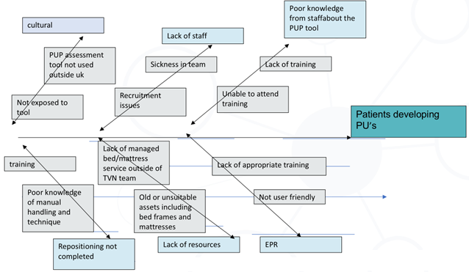
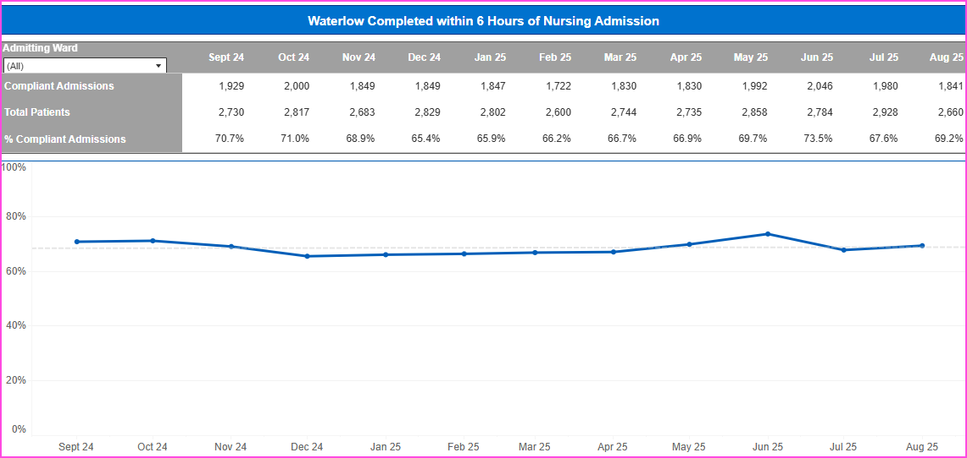
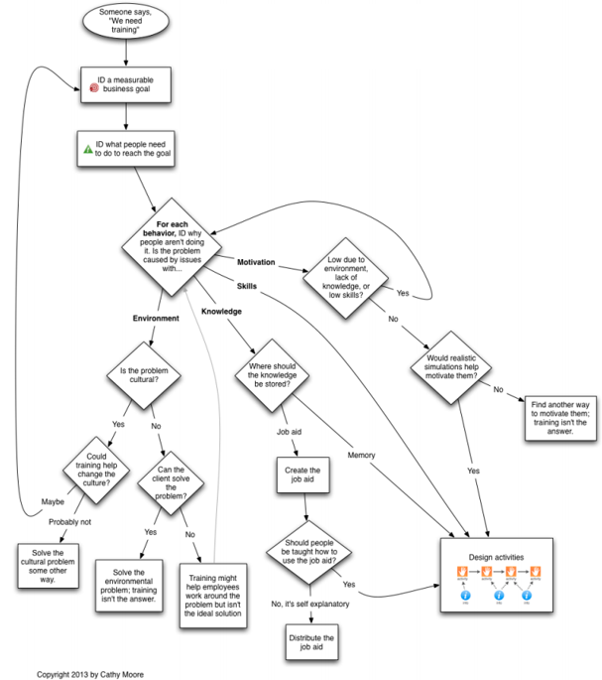
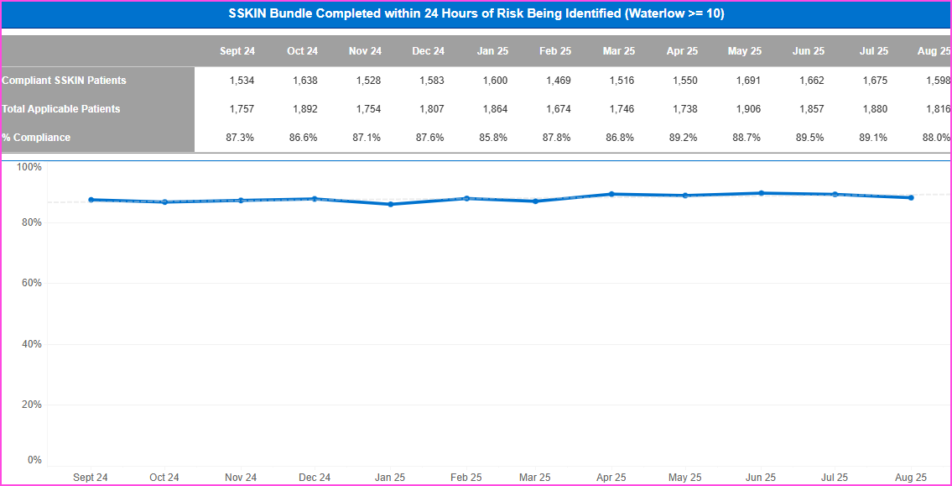
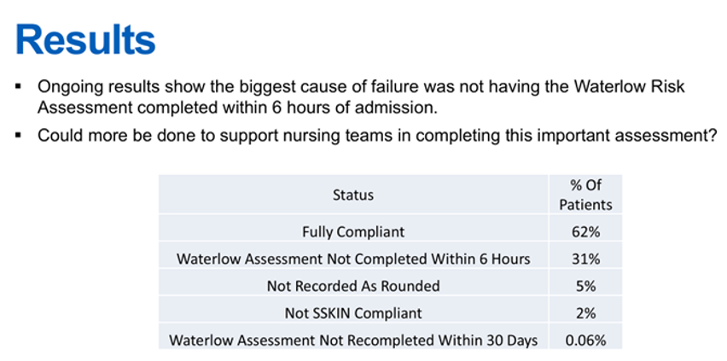
Gloucestershire Safety and Quality Improvement Academy 2025
Quality Improvement in Pressure Ulcer Prevention
The Tissue Viability Team
The Safety Concern
Pressure Ulcers (PU) are a significant worldwide health care problem as described by the European Pressure Ulcer Advisory Panel (EPUAP), National Pressure Injury Advisory Panel (NPIAP) and Pan Pacific Pressure Injury Alliance (PPPIA) 2025.
Achieving 85% of acute and community hospital inpatients aged 18+ having a pressure ulcer risk assessment that meets NICE guidance with evidence of actions against all identified risks.
The Aim
The Aim
Specific Decrease in hospital acquired PU’s through increased use of the PU risk assessment tool and SSKIN bundle
Measurable Through BI data
Achievable Interventions will be monitored through PDSA and adjusted if required
Time specific 6 months
Fishbone diagram
% compliance of PURAT/SSKIN Post
Is Training the Answer
Outcomes and Limitations
Simulated play was introduced into the PU prevention management training, and although the feedback was positive it did not initially improve the compliance.
Further PDSA is required to understand this. A reduction of PU however was achieved overall and increased compliance in SSKIN assessment was achieved .
% compliance of PU risk assessment (PURAT) Pre
The Future
Continuous monitoring ▪ Further PDSA ▪ Different QI approach?
#TheGSQIAWay

