Slide 1
The toolkit for managing intractable dyspnoea
Cath Morrison
Specialty doctor palliative care GRH

Slide 2
Why is this relevant to you?
20% of referrals to specialist palliative care over the last year were triggered by a request for advice on intractable dyspnoea so a common problem on the 8th floor
This session will provide you with some initial approaches to intractable dyspnoea that could be part of your daily toolkit going forward

Slide 3
Who are are we talking about?
Patients thought to be in the last year of life (see SPICT) with:
COPD
Fibrotic lung disease
Occasionally patients with bronchiectasis
AND tachypnoea/hypoxia in spite of medical optimisation following infective or non infective exacerbation
This is NOT about the management of
patients actively dying (hrs/dys) with dyspnoea

Slide 4
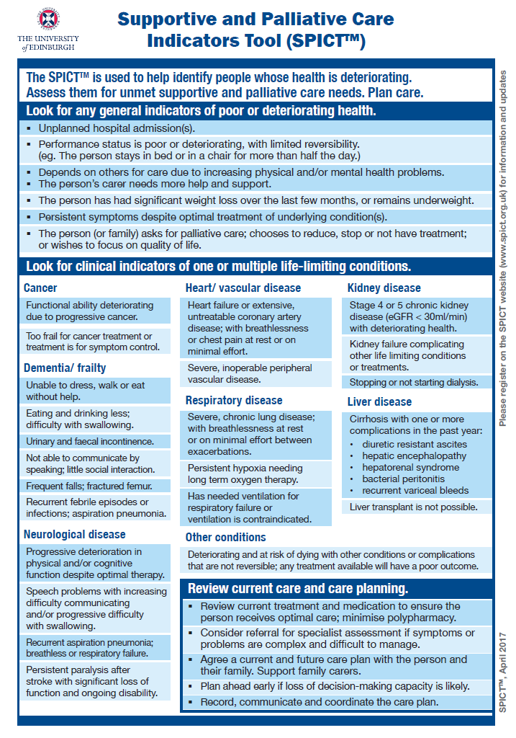

Slide 5
What you need to assess?
Confirm that the dyspnoea is at rest/on minimal exertion?
How would they rate the dyspnoea severity out of 10?
Is their dyspnoea associated with daily panic or ongoing anxiety?
Are they ‘just anxious’ about their breathing rather than objectively working hard?
What’s their eGFR?

Slide 6
Treat anxiety if present first
Non drug
Talk them through the rectangular breathing technique – they need to practice this when calm. Not all patients can follow this!
Consider referring them to Let’s Talk services
Drug
Start an SSRI such as sertraline 50mg od if not contraindicated as per NICE guidelines
Make sublingual lorazepam 0.5mg bd-qds PRN available whilst the SSRI takes effect – regular bzds increase mortality in LTOT patients (Ekstrom)

Slide 7
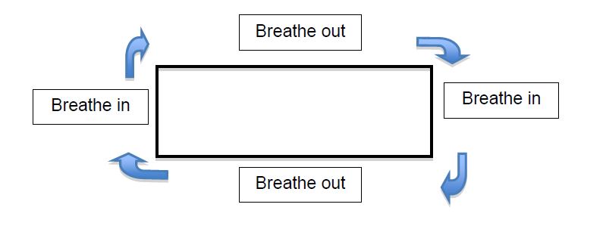
Rectangular breathing exercise

Slide 8
Non drug options to treat dyspnoea
Provide a fan (from respiratory nurse office) with explanation how this works – consider Cambridge patient leaflets
Involve the therapists if possible for aids and pacing strategies

Slide 9
Drug options for treating dyspnoea
eGFR >30
Start with MST 5mg bd and titrate up by 5mg bd per week to a maximum of 15mg bd (2/3 of patients only will respond). Discontinue if no benefit
If intolerant of morphine can try oxynorm e.g. 1.25mg IR qds. Low threshold to refer to SPCT
eGFR <30
Try 1mg IR oramorph bd – dose unlikely to exceed 5mg bd
Low threshold to refer to SPCT
Remember to prescribe a laxative e.g. senna 15mg nocte
Johnson, Currow BMJ Supportive & Palliative Care 2020; 10: 287-296

Slide 10
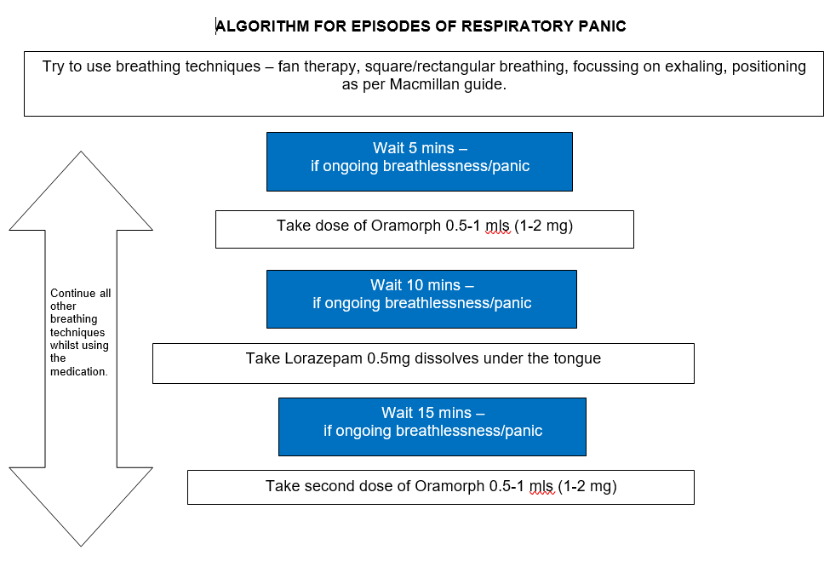
Use a panic plan to summarise with relative

Slide 11
On discharge- thinking ahead
Clarify optimisation approaches for primary care, guidance around further titration of opioids for example.
Where possible, please review ReSPECT plan to clarify treatment options for any further episodes of decline
Would non-invasive ventilation/high flow oxygen/intensive respiratory support be offered?
Would admission to the resp virtual ward be offered?
Would assessment by community services e.g. rapid response for consideration of IV antibiotics be felt appropriate?
Does the patient have a rescue pack in the home?
Is hospital an unacceptable option for the patient? If not, this may be a place of safety in the event of decline.

Slide 12
On discharge – referrals
Consider referral to district nursing services if being discharged with subcut JICM
Ensure linked with HOAS services if going home with oxygen.
Consider referral to community SPC if ongoing intractable symptoms. There is an expectation that patients referred will have not responded to first line treatments/interventions
Consider referral to one of the hospice led Fatigue and Breathlessness groups

Slide 13
Would a resource folder be helpful on 8A?
Rectangular breathing diagrams
Cambridge patient leaflets (https://www.cuh.nhs.uk/breathlessness-intervention-service-bis)
G Care breathlessness management (https://g-care.glos.nhs.uk/clinical-topic/breathlessness-1/prescribing#chapter_11349)
Master panic plans
Let’s Talk referrals
Referral forms for FAB groups

Slide 14
When do you rotate?
SPC would like this to be a rolling session so that we capture new staff joining the 8th floor as part of their induction
Please indicate on the attendance form how often your grade rotates through this post and what time of year this happens

Slide 15
Thank you

