Slide 1
Gloucestershire Safety & Quality Improvement Academy
Quality Improvement Initiative Title Presenter Name (s)

Slide 2
Improvement Aim
What, how good and by when? Make sure it’s SMART

Slide 3
Improvement team & Stakeholders
Include key team members, and sponsor.
List any additional key stakeholders

Slide 4
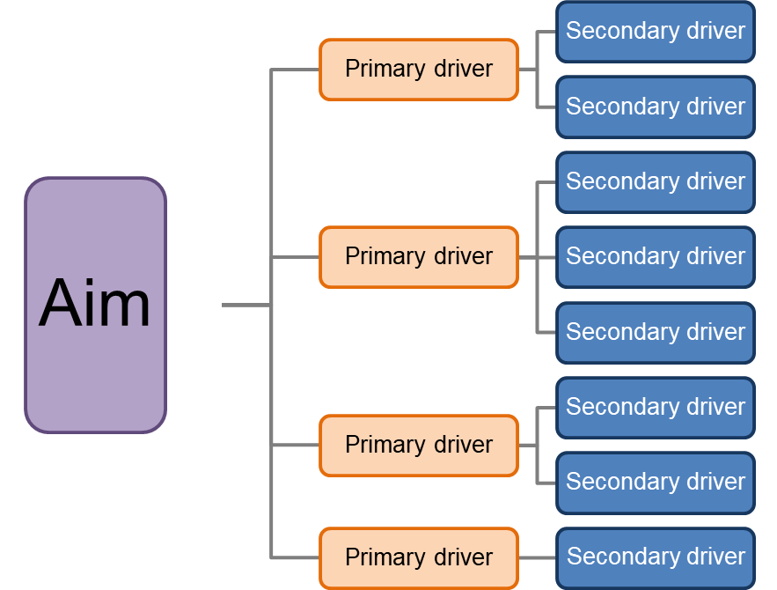
Driver Diagram
Change idea
Change idea
Change idea
Change idea
Change idea
Change idea
Change idea
Change idea

Slide 5
Measures
Outcome
Process
Balancing

Slide 6
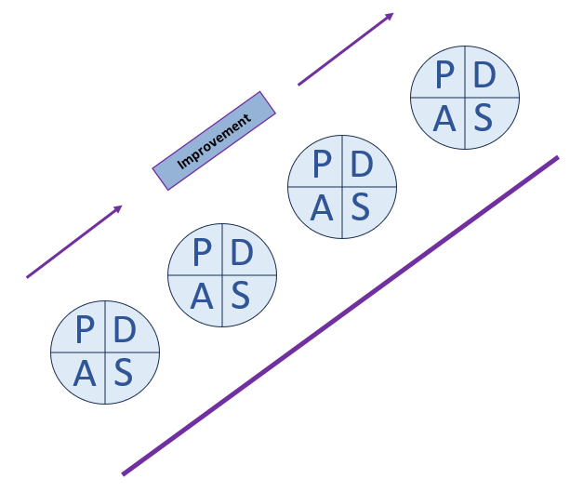
PDSA cycles
Which changes have you tested, and what are you going to next test using PDSA?

Slide 7
Data
Share results from your PDSA

Slide 8
Barriers or Challenges
What have you encountered, and how have you overcome this?
What do you need help with?

Slide 9
Next Steps
Further testing
Implementation
Scale up
Spread

