Slide 1
Gloucestershire Safety & Quality Improvement Academy
Quality Improvement Initiative Title Presenter Name (s)

Slide 2
Improvement Aim
What, how good and by when? Make sure it’s SMART

Slide 3
Improvement team & Stakeholders
Include key team members, and sponsor.
List any additional key stakeholders

Slide 4
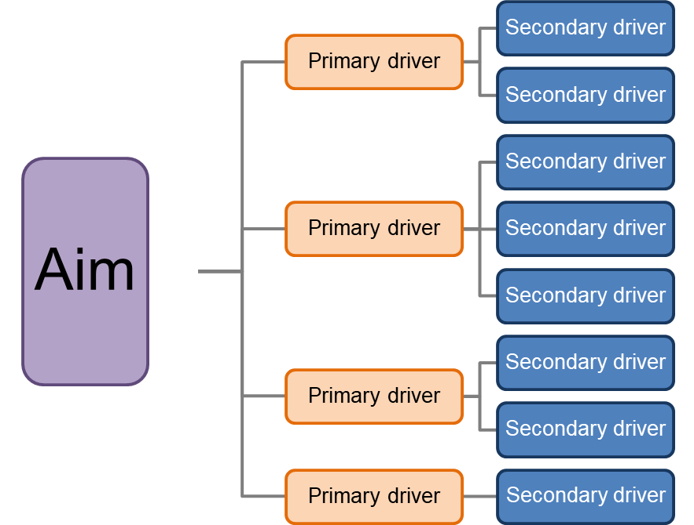
Driver Diagram
Change idea
Change idea
Change idea
Change idea
Change idea
Change idea
Change idea
Change idea
The above is an example of how to lay out your Driver Diagram – please delete and insert your own text boxes as appropriate

Slide 5
Measures
Outcome
Process
Balancing

Slide 6
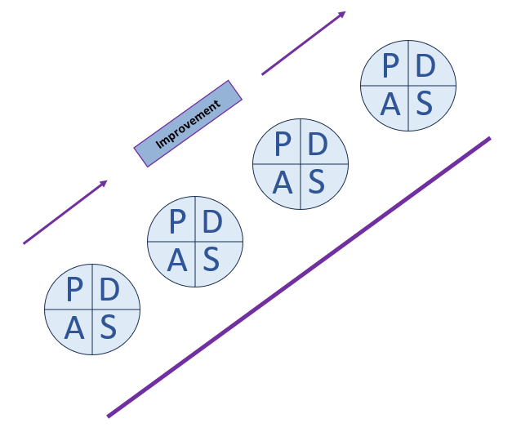
PDSA cycles
Which changes have you tested, and what are you going to next test using PDSA?

Slide 7
Data
Share results from your PDSA

Slide 8
Barriers or Challenges
What have you encountered, and how have you overcome this?
What do you need help with?

Slide 9
Next Steps
Further testing
Implementation
Scale up
Spread

