Slide 1

Gloucestershire Safety & Quality Improvement Academy
Data and Data Collection
Click forwards on the mouse or keyboard to move through the slides
Notes:
Welcome to this session on data and data collection, part of the GSQIA Measurement Module

Slide 2
Session Contents
Why collect data
Consistent data collection - Operational definition
Types of data – qualitative and quantitative
What is the story of the improvement?
Notes:
This session will cover why we collect data and the importance of a clear operational definition to ensure consistency.
We will also cover qualitative and quantitative data and their uses for demonstrating impact of the problem and how these impacts affect our patients, service users and colleagues.

Slide 3
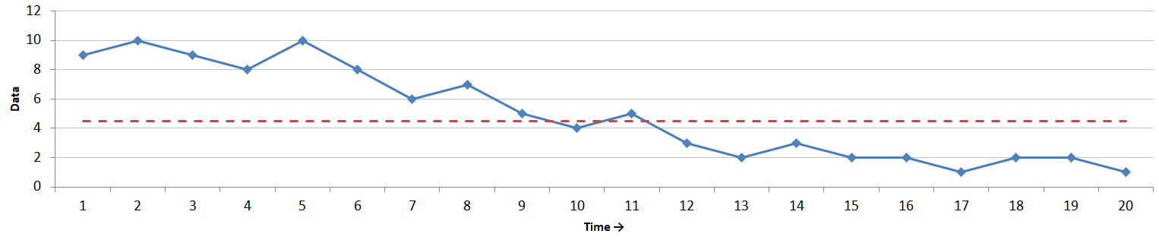
Why collect data?
Baseline data – demonstrates the problem and helps to formulate change ideas to test to achieve your aim
Continuous data collection during the QI shows whether changes (PDSAs) are helping you achieve your aim
Collecting data beyond the change period shows whether changes have been sustained long-term
Baseline data
PDSAs
Sustained improvement
Notes:
Data collection is vital for all improvement work to be able to demonstrate that an improvement has occurred.
Baseline data is used to show that a problem exists and an aim statement should be based on this data. Baseline data can also be further analysed to understand why the problem occurs which helps to formulate change ideas. A separate session on the further analysis of data is available as part of the measurement module.
Baseline data can be derived from many sources to show that compliance, performance or experience is not as it could or should be. It is helpful to be able to demonstrate that the problem is consistently occurring, so that changes are not being made on the basis of one data point or one persons experience.
Data should then be collected throughout the change period in order to evidence whether PDSA tests have had a positive impact, or if something isn’t working then it needs to be removed from the system.
Finally, data should be collected beyond the change period to ensure that changes have been sustained long-term.

Slide 4
Data Collection
How is data going to be collected?
Electronic – Trak, EPR, Database
Manual – consider a data collection proforma or spreadsheet for direct data entry
Frequency
Regular data collection needed for a run chart
Can be a relatively small sample size – just enough to reflect the current situation
Review the process
Stop collecting any information you are not using
Continually add to your run/SPC chart so that your data is driving your improvement
Notes:
There are various areas to consider when thinking about data collection.
How data is collected will have an impact on workload. If an electronic system or database provides data which is good enough for the purposes of the improvement project then it is worthwhile using this output rather than undertaking manual data collection.
If manual data collection is required, ensure that the people undertaking this role are collecting data consistently. A data collection proforma, or a spreadsheet for direct data entry is helpful to ensure that all required details have been collected ready for analysis.
Small rounds of consistently collected data are required for the QI process. This allows a run chart or SPC chart to provide a visual representation of the changes to data that are being found due to PDSA that are being tested. Keep in mind that each round of data collection doesn’t have to be large. As long as the project team agree that the amount of data collected reflects the current situation, then that is sufficient. This quantity will differ for each QI project.
It is helpful to include review points in your project timeline to ensure there isn’t any wasted time or effort on collecting and analysing data which isn’t being used to drive the improvement.
And finally ensure data is being regularly added to the run chat or SPC chart that is being used for each of the outcome, process or balancing measures so that it is the data that is driving the changes, rather than anyone's assumption or bias.

Slide 5
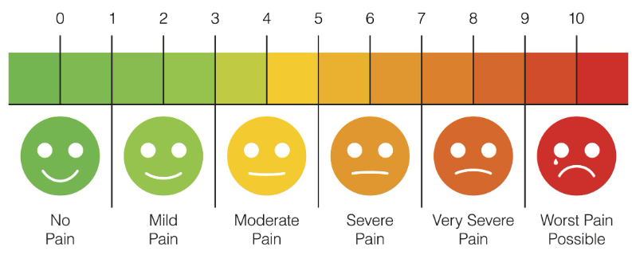
Operational definition
However data is being collected and/or extracted, consider how this will be done consistently
Operational definition - a clear, concise and detailed definition of a measure.
Notes:
An operational definition ensures that data collection is being collected consistently by project teams. Consistent data collection allows the team to have confidence in the evidence of the data, whether that be confidence in the level of performance that is being achieved, or confidence in the decisions that are being made – for example, whether a PDSA cycle is adopted, adapted or abandoned.
The operational definition depends entirely on the data that is being collected, but it provides a clear, concise and detailed definition of what data is being collected and how it is being gathered.
For example, a subjective measurement of pain on admission to ED, could be collected as: Pain is assessed on admission, using a pain scale from 0 – 10, where 0 is no pain and 10 is the worst pain imaginable. Followed by a reassessment after 15minutes.

Slide 6
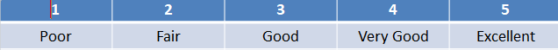
Types of Data
Quantitative
Numerical
Precise measurement – time, duration, cost, total number, frequency
Captures – who, what, where, when
Qualitative
Words – interviews, observation, experiences
Text analysis, thematic development
Captures – why, how, emotional impact
Likert scale - allows qualitative to be turned to quantitative
Notes:
Needs 11 Lab-ing
There are two types of data which provide project teams with useful information relating to their chosen topic.
Quantitative data is the hard objective evidence which provides numerical data around things like the frequency of something occurring, the duration of time something takes or the total cost. Quantitative data objectively measures the who, what, where and when of a project.
Conversely, Qualitative data provides a project team with subjective information of peoples thoughts, feelings and experiences. It captures information around why and how something occurs, and also any emotional impact of a process or implementation of change.
Although quantitative data provides responses as words rather than numbers, it is also worth noting that a Likert scale will allow these responses to be turned into a numerical response, to allow this information to be plotted on a run or control chart

Slide 7

Does your data tell you the full story?
Co-design
Patient/staff stories
Surveys
Interviews
Focus groups
Questionnaires
Emotional process mapping
Shadowing
Notes:
Needs 11 Lab-ing
Both types of data are important in a QI project as we need to understand the whole story of what is occurring.
A patient or staff story can help to build the momentum required for change and by involving all stakeholders within a system in the change process it ensures that changes are the right thing, ensures that all voices are heard and ultimately strengthens the change process.
There are various methodologies that help us to understand thoughts, feeling and experiences. Although information that is gained from surveys and questionnaires may be easier to collect it is sometimes helpful to be able to dig further into a response to gain a true insight, so consider an interview or focus group to be able to delve deeper. Additionally shadowing a patient through their journey can provide insight into how systems and processes work from the patients perspective.

Slide 8
Your facilitator / Gold coach and GSQIA are here to support – please get in touch ghn-tr.gsqia@nhs.net
Additional resources that are available around data and measurement:
Step by step creation of a run chart in Excel
A one page guide to the rules
SPC session and templates
Measures session: Outcome / Process / Balancing

