Slide 1
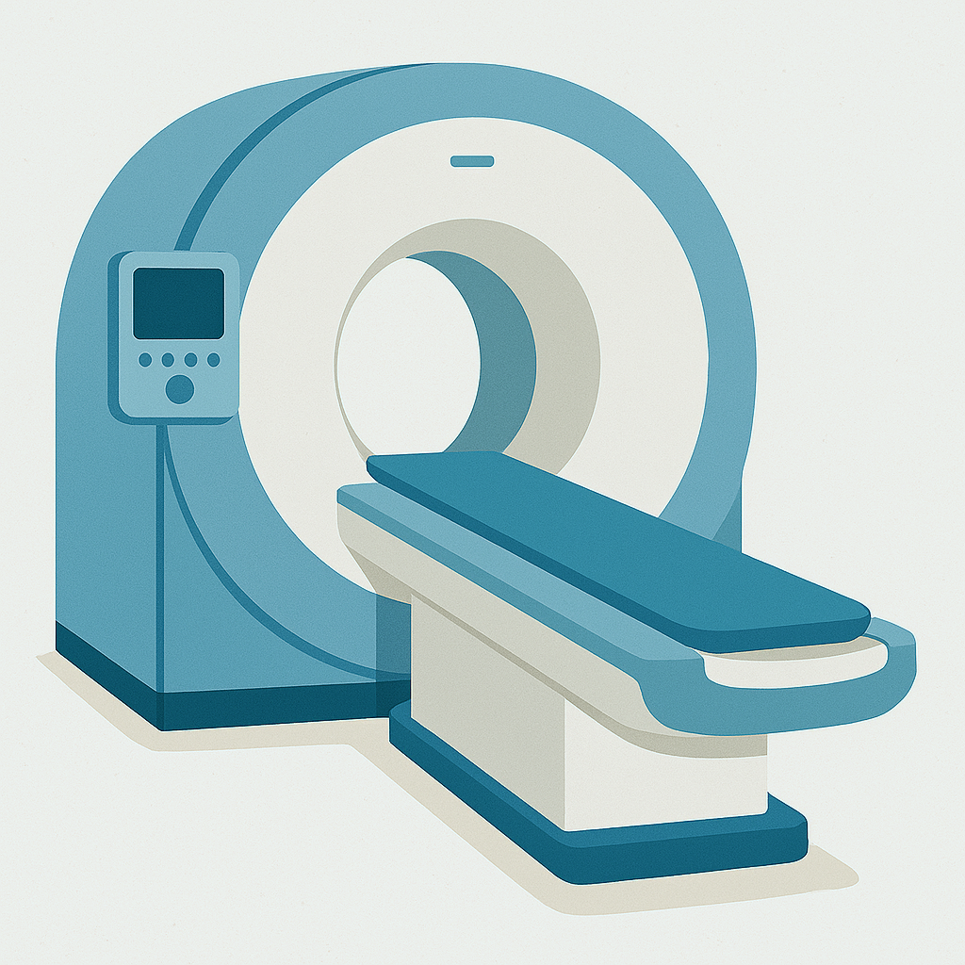

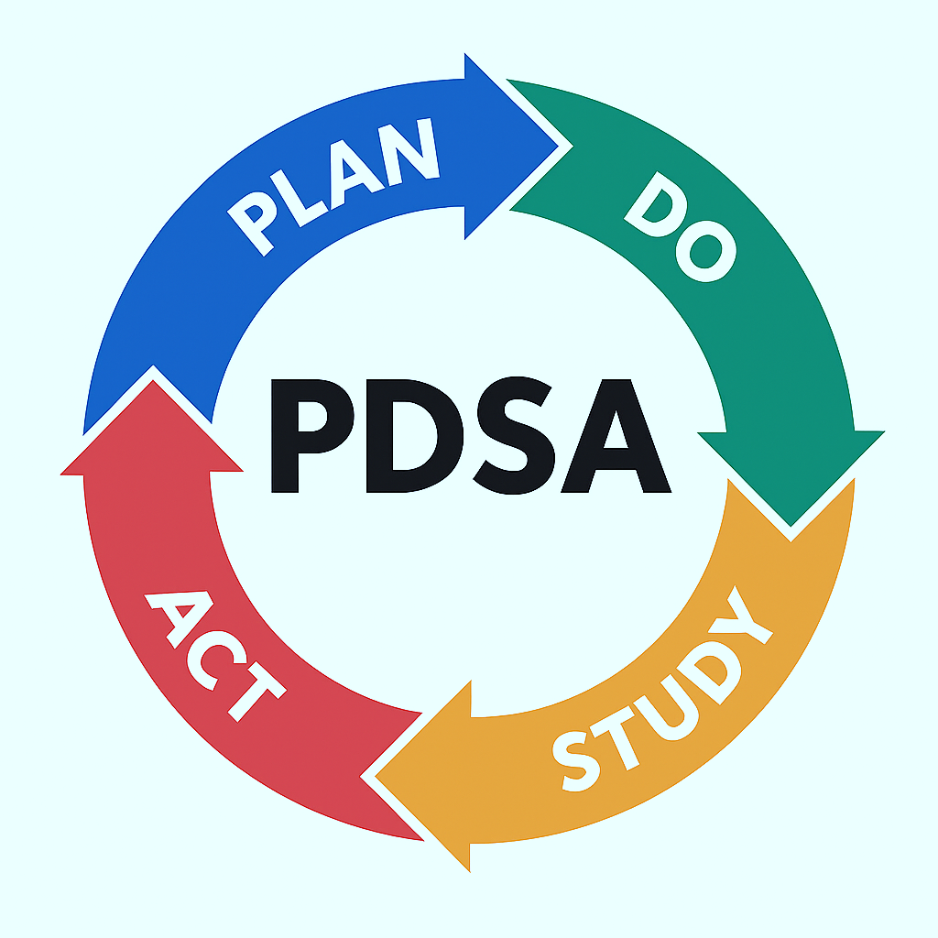



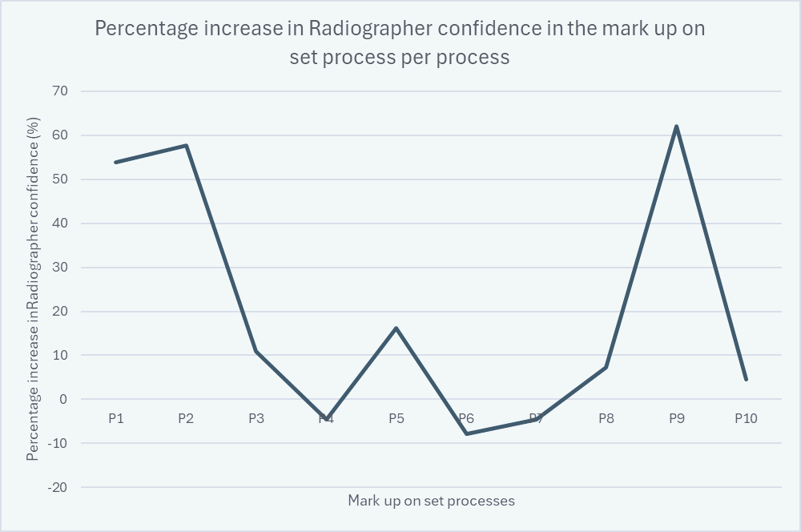


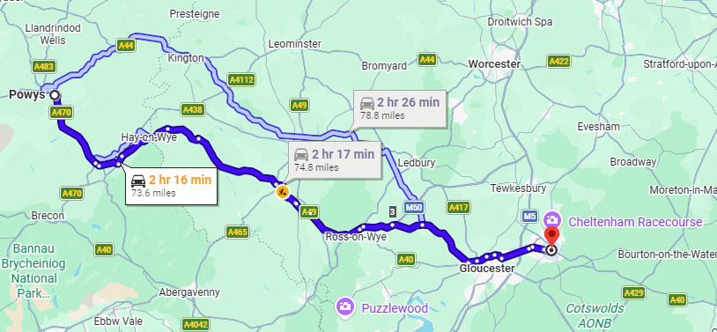

Gloucestershire Safety and Quality Improvement Academy 2026
Increasing Radiographer Confidence in the Mark Up On Set Process
Ellie Pitt – Specialist Practitioner Radiographer, Radiotherapy
Megan Webb – Specialist Practitioner Radiographer, Radiotherapy
Safety Concern
NICE 2023- offer urgent radiotherapy for emergencies:
How is this done when there is downtime on the department’s CT scanner?
Aim
Increase Radiographer confidence in the mark up on set process by 40% in 6 months by introducing an updated process, in line with clinical practice.
Staff training and competency
Practical simulation- based learning
Staff confidence and engagement
Increased familiarity with CBCT workflow
Access to reliable imaging for patients
Alternative planning pathway during CT downtime
Understanding of CBCT planning workflow
Understanding of imaging limitations
Confidence in decision making
Enable RT closer to home
Reduced dependence on CGH CT scanner
Cycle 1 – Create confidence questionnaire to assess current confidence in Mark Up On Set process, review results and prioritise areas for development with new training package and method of training delivery.
Cycle 2 - Creation of new mark up on set process, SOP and training package. Delivered to Radiographers using phantoms and re-measured confidence using second questionnaire.
Driver Diagram Summary
Increased confidence of procedure, based on feedback from the questionnaire following training
Review feedback from process
Review confidence of staff to establish if further training needed.
Review whether there is an increase in mark up on set numbers due to an increase in confidence
Review the impact on Linac capacity
Overall % increase in confidence = 15%
Other Benefits
Reduced need to travel to CGH
Enable radiotherapy closer to home
Minimise discomfort for patients with advanced cancers
In line with National Cancer Plan - 2026
Acknowledgements: Dr Katie Wallace, Elaine Smith, Ramona De Souza,
Mark Foggarty, Alison Cole
Next Steps- Additional training, implement into clinical practice and review staff confidence and patient numbers over 12 months.
#TheGSQIAWay

